Slide 1
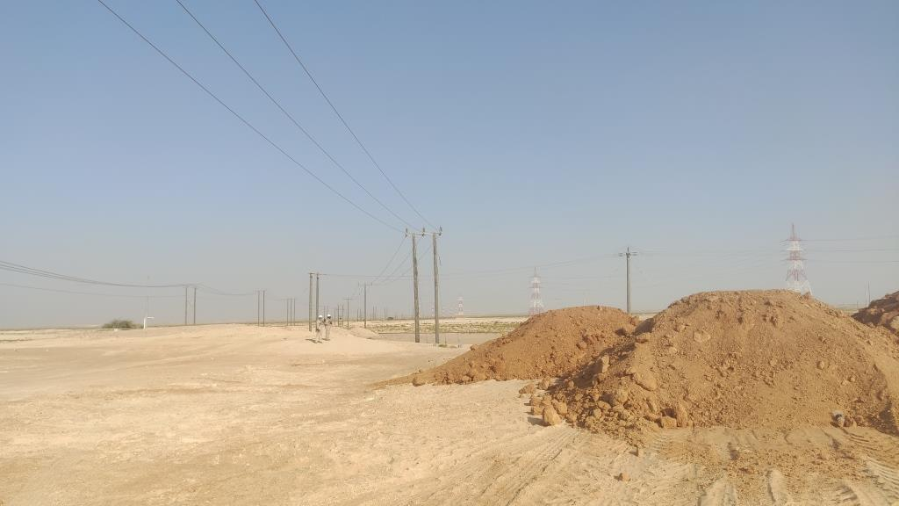
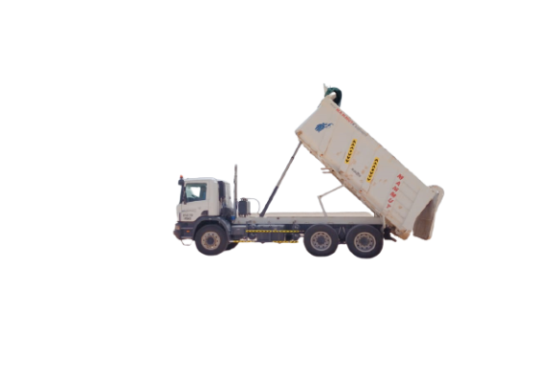
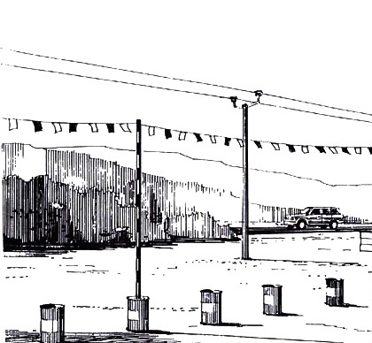
PDO Second Alert
Date:23.05.2021 Incident title:- HIPO#39
What happened?
On 23.05.2021 at 1449 Hrs., tipper (Regn # 9172 WK) was unloading soil transported from borrow pit (#06) for Switch Rack Demolition works at BGS, when it came in contact with the OHL resulting in tripping of few wells and compressor (K3614) of Birba Station.
Your learning from this incident..
Always ensure availability of Banksman with vehicles while loading/unloading and reversing activity.
Always maintain safe horizontal and vertical working distance and provide safety barriers for work in the vicinity of OHL.
No work in the vicinity of OHLs shall be carried out without having an OHL clearance.
OHL
Soil dumping area
Always maintain safe clearance from Over Head Lines
Notes:
Ensure all dates and titles are input
A short description should be provided without mentioning names of contractors or individuals. You should include, what happened, to who (by job title) and what injuries this resulted in. Nothing more!
Four to five bullet points highlighting the main findings from the investigation. Remember the target audience is the front line staff so this should be written in simple terms in a way that everyone can understand.
The strap line should be the main point you want to get across
The images should be self explanatory, what went wrong (if you create a reconstruction please ensure you do not put people at risk) and below how it should be done.

Slide 2
Management self audit
Date: 23.05.2021 Incident title: HiPo # 39
As a learning from this incident and ensure continual improvement all contract
managers must review their HSE HEMP against the questions asked below
Confirm the following:
Do you ensure Permit Applicant and Permit Holder visit the site together and the tasks are discussed and agreed for safe execution?
Do you ensure assessment of the area before allowing tipper operations for safe unloading of materials?
Do you ensure participation of drivers / operators in TBTs and that the hazards and controls related to vehicle / equipment movements are discussed?
Do you ensure availability of Banksman for guiding the vehicle / equipment movement safely?
Do you ensure safe distance is maintained whilst executing activities in the vicinity of OHLs?
* If the answer is NO to any of the above questions please ensure you take action to correct this finding.
Notes:
Ensure all dates and titles are input
Make a list of closed questions (only ‘yes’ or ‘no’ as an answer) to ask others if they have the same issues based on the management or HSE-MS failings or shortfalls identified in the investigation.
Imagine you have to audit other companies to see if they could have the same issues.
These questions should start with: Do you ensure…………………?

