Slide 1
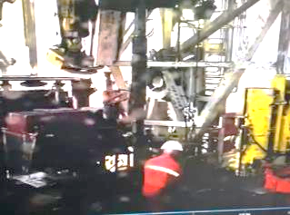
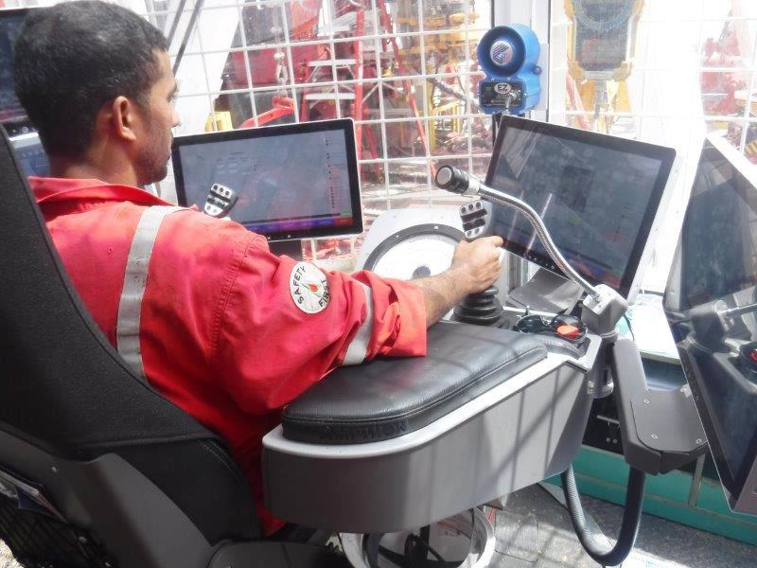
PDO Second Alert
Date: 29.07.2021 Incident title: HIPO#42- Drop
What happened?
On 29th July 2021 at 17:10 hours, after TCP perforation and reverse circulation, the crew work to disconnect assembly of two crossover, safety valve and lifting-sub. Assistant driller open the elevator unintentionally while floor man used chain tong to unscrew the assembly at EUE connection causing the assembly to fall down on rig floor towards v-door direction. No injury and no equipment damage resulted from this incident.
Your learning from this incident..
Driller/AD should always focus on indicator panel to ensure equipment is in correct condition
Ensure JSA is updated to include all job steps and hazards
Ensure elevator is in correct operating position before caring out any task
Always ensure to have a proper planning for the task and is understood by all involved.
While rotating any equipment with chain tong crew should be vigilant of overhead hazards.
Ensure to maintins red zone at all times
Intervene and ask to raise MoC when deviating from procedure
Notes:
Ensure all dates and titles are input
A short description should be provided without mentioning names of contractors or individuals. You should include, what happened, to who (by job title) and what injuries this resulted in. Nothing more!
Four to five bullet points highlighting the main findings from the investigation. Remember the target audience is the front line staff so this should be written in simple terms in a way that everyone can understand.
The strap line should be the main point you want to get across
The images should be self explanatory, what went wrong (if you create a reconstruction please ensure you do not put people at risk) and below how it should be done.

Slide 2
Management self audit
Date: 29.07.2021 Incident title: HIPO#42- Drop
As a learning from this incident and ensure continual improvement all contract
managers must review their HSE Risk Register against the questions asked below
Confirm the following:
Do you ensure that adequate supervision for the ongoing jobs/activities all the time?
Do you ensure the crew are utilizing procedures/JSA?
Do you ensure your team conducts TBTs effectively?
Do you ensure your team intervene and stops third party operations if normal steps are not followed?
Notes:
Make a list of closed questions (only ‘yes’ or ‘no’ as an answer) to ask other contractors if they have the same issues based on the management or HSE-MS failings or shortfalls identified in the investigation. Pretend you have to audit other companies to see if they could have the same issues.

