Slide 1
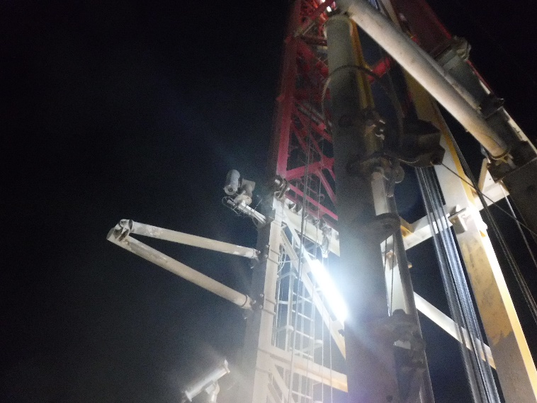
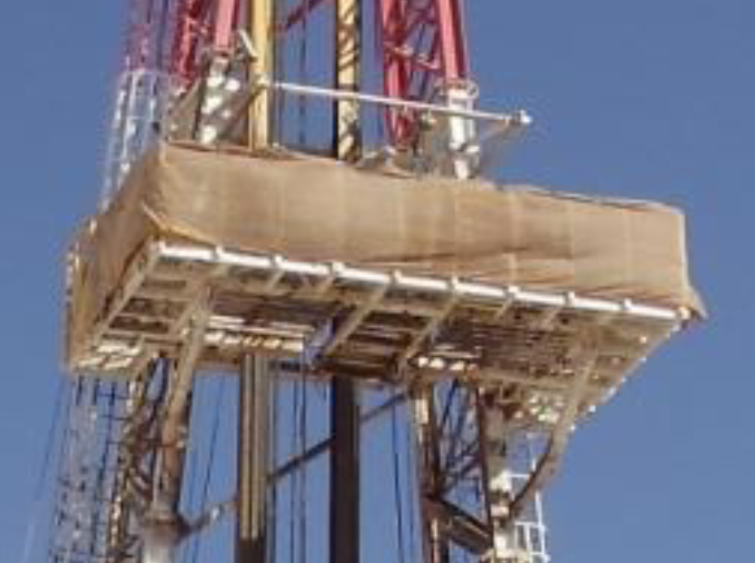
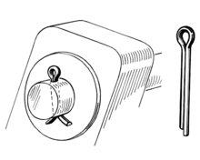
PDO Second Alert
Date:10/06/2022 Incident title: Drops Near Miss Pattern: HiPo#42 Potential severity: C4P
Target Audience: Tool Pushers, Drillers, Derrick-man (drilling & Workover)
What happened?
On 10th June 2022, at 19:04 hours, while drilling 17.5’’ Top Section, one pin fall from monkey board fall arrestor frame assembly, landing on the ground near pipe cat area. (Approximate height: 36 m & Weight 1 Kg).
At 20:00 hours after crew change & handover, Derrick-man observed the pin on the ground and informed Night Pusher, operation was immediately stopped. After reviewing the CCTV observed the pin drop and at the time of incident red zone was well managed.
Why it happened/Finding :
Last two rig moves were with mast up.
Design and location of pin dies not allow adequate inspection mast up.
Split pin had come out of position
Heavy vibration during drilling 17.5” top section.
Red zone was managed at the time of the incident
Your learning from this incident..
Ensure all Drop object hazards are identified by Tool pushers, and control measures applied
Ensure drops inspection done prior to spud by derrick-man and verified by Tool Pusher
Ensure red zone is managed at all times by supervisors
Ensure all split pin installed properly in mast and checked during drop inspection for wear and damage by derrick-man and verified by Tool Pusher
Structure swing
Dropped pin
Always carry out mast periodic inspection while drilling with high vibration
Notes:
Ensure all dates and titles are input
A short description should be provided without mentioning names of contractors or individuals. You should include, what happened, to who (by job title) and what injuries this resulted in. Nothing more!
Four to five bullet points highlighting the main findings from the investigation. Remember the target audience is the front line staff so this should be written in simple terms in a way that everyone can understand.
The strap line should be the main point you want to get across
The images should be self explanatory, what went wrong (if you create a reconstruction please ensure you do not put people at risk) and below how it should be done.

Slide 2
Management self audit
Date:10.06.2022 Incident title: HiPo#42 Pattern: DROPS Potential severity: C4P
As a learning from this incident and ensure continual improvement all contract managers must review their HSE risk management against the questions asked below
Confirm the following:
Do you ensure to capture all the hazards related to design change?
Do you ensure your PSP include drop survey frequency during vibration and jarring ?
Do you ensure drop inspection is adequately performed?
Do you ensure Split pins are fit for use (length and size / diameter) and in good condition?
Do you ensure that split pins are one time use at location?
Do you ensure new design is not adding additional hazards?
* If the answer is NO to any of the above questions please ensure you take action to correct this finding
Notes:
Ensure all dates and titles are input
Make a list of closed questions (only ‘yes’ or ‘no’ as an answer) to ask others if they have the same issues based on the management or HSE-MS failings or shortfalls identified in the investigation.
Imagine you have to audit other companies to see if they could have the same issues.
These questions should start with: Do you ensure…………………?

