Slide 1
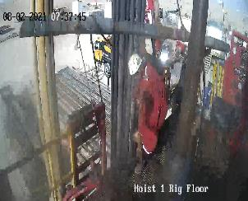
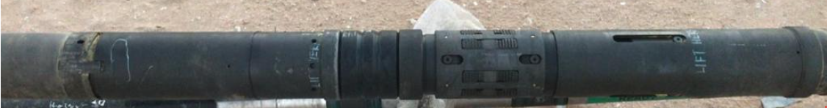
PDO Second Alert
Date: 02.08.2021 Incident title: HiPo#43A Drop
What happened?
On 2nd of Aug, a Thermal QUANTUM Packer assembly was picked up by a crane with two web slings and moved to the rig floor. The 3 ½” hoist elevator was latched on to the handling sub of the assembly and continued to pick it up, while the crane continued to lower the assembly to the hoist floor. When the assembly was fully vertical and about 30cm from the hoist floor, the QUANTUM Packer assembly de-coupled from the service tool. The driller continued to pick up the service tool 1.2m till it was out of the QUANTUM Packer assembly , and the assembly dropped on the hoist floor causing First Aid for two IP’s. Operation was suspended and the situation was assessed.
Your learning from this incident..
Ensure the running tool is properly prepared before shipping to wellsite.
Ensure appropriate lifting method is used to lift and run quantum packer.
Ensure red zone is effectively managed
Ensure adherence to procedure.
✓
Ensure the running tool is properly connected to quantum packer prior to pick up to floor
Notes:
Ensure all dates and titles are input
A short description should be provided without mentioning names of contractors or individuals. You should include, what happened, to who (by job title) and what injuries this resulted in. Nothing more!
Four to five bullet points highlighting the main findings from the investigation. Remember the target audience is the front-line staff so this should be written in simple terms in a way that everyone can understand.
The strap line should be the main point you want to get across
The images should be self explanatory, what went wrong (if you create a reconstruction please ensure you do not put people at risk) and below how it should be done.

Slide 2
Management self audit
Date: 02.08.2021 Incident title: HiPo#43A Drop
As a learning from this incident and ensure continual improvement all contract
managers must review their HSE HEMP against the questions asked below
Confirm the following:
Do you ensure effective TBT conducted with the team and all hazard are mitigated & dynamic hazard highlighted as well?
Do you ensure all third-party tool connections are inspected & properly tightened?
Do you ensure the proper lift plan used for third party tools
Do you have empowerment to stop the job
Do you have the right procedure to follow
* If the answer is NO to any of the above questions, please ensure you take action to correct this finding.
Notes:
Ensure all dates and titles are input
Make a list of closed questions (only ‘yes’ or ‘no’ as an answer) to ask others if they have the same issues based on the management or HSE-MS failings or shortfalls identified in the investigation.
Imagine you have to audit other companies to see if they could have the same issues.
These questions should start with: Do you ensure…………………?

