Slide 1
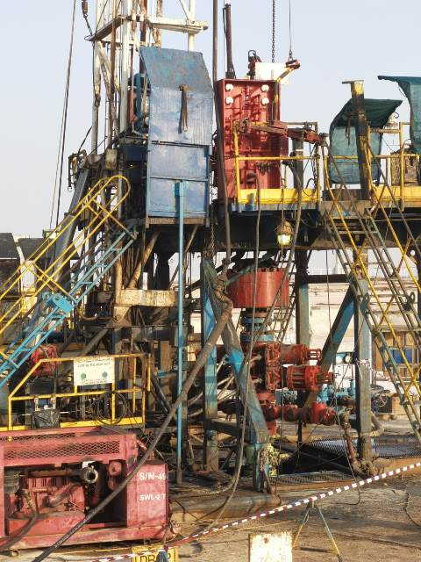
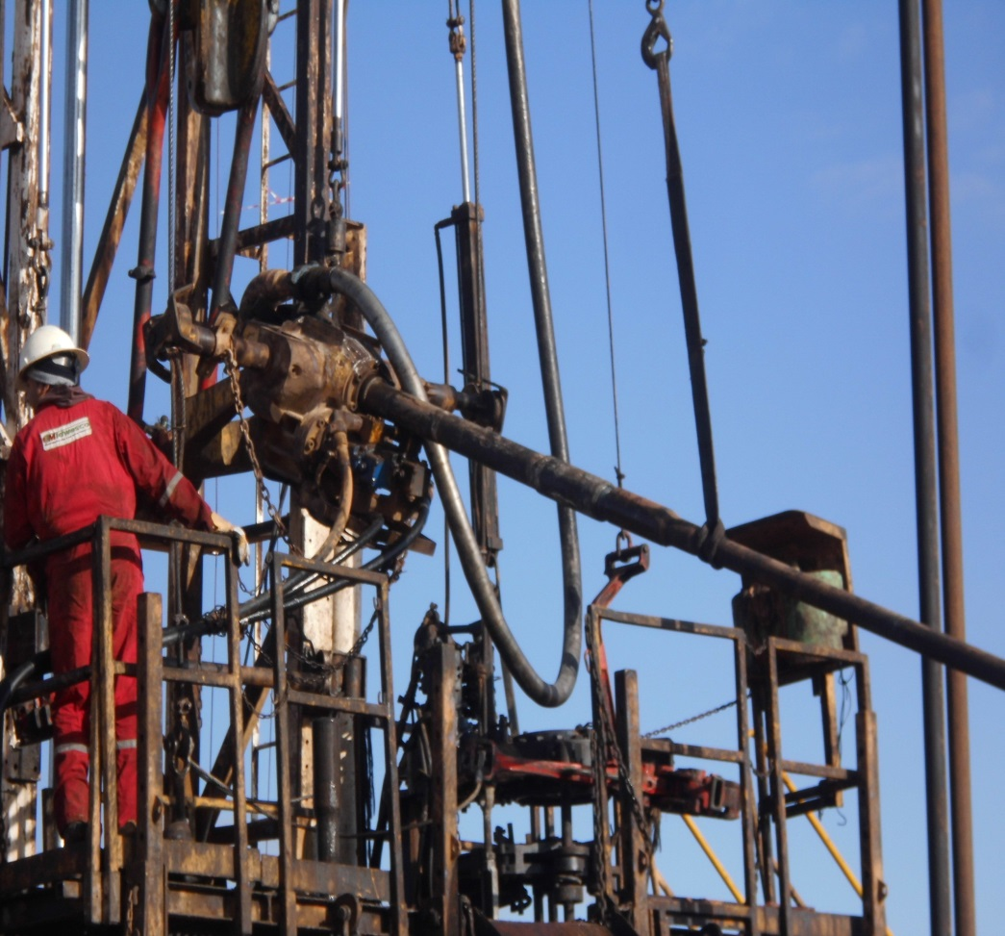
PDO Second Alert
Date:11.08.2021 Incident title: HIPO #44 Dropped Joint
What happened?
RIH a gas lift completion on 2.3/8” NU tubing was in progress until a hold up observed on top of 4.5” liner, tried with working on the string but no success to pass obstruction. It was decided to connect a standpipe hose and try passing an obstruction by washing down. Operation is carried out by using of 2 3/8” completion Tubing + X/O + FOSV + Circulation head, the makeup done in the V-door due to the high stick up of the string once held up. After stopping of wash down the Tubing was B/O in order to be laid down and it immediately started tilting upside down due to the weight above the Elevator was bigger than the weight of the Tubing below the Elevator. The hanging assembly flipped 180 degrees and the Tubing slid down thru the Elevator dropping near the driller room and on the ground.
Your learning from this incident..
Always ensure relevant SOP is followed, otherwise manage process thru MOC with proper risk assessment done
Always ensure AD not to be left acting alone on the brake in any non routine operations must be supervised by RM and carried out by the Driller
Always ensure to utilize Power swivel regardless of string rotation is required or not (otherwise initiate an MOC)
Always ensure positive Handover happen on the Site location .
Utilize Power swivel for washing down operation
Notes:
Ensure all dates and titles are input
A short description should be provided without mentioning names of contractors or individuals. You should include, what happened, to who (by job title) and what injuries this resulted in. Nothing more!
Four to five bullet points highlighting the main findings from the investigation. Remember the target audience is the front line staff so this should be written in simple terms in a way that everyone can understand.
The strap line should be the main point you want to get across
The images should be self explanatory, what went wrong (if you create a reconstruction please ensure you do not put people at risk) and below how it should be done.

Slide 2
Management self audit
Date:11.08.2021 Incident title: HIPO #44 Dropped Joint
As a learning from this incident and ensure continual improvement all contract
managers must review their HSE HEMP against the questions asked below
Confirm the following:
Do you ensure MOC process is followed by front line supervisors?
Do you ensure all your risks are managed appropriately by your supervisory staff?
Do you ensure organization are having protocols for addressing personnel issues & Emergency ?
Do you ensure Your Learning from incident process is effective?
Do you ensure front line supervisors are monitored appropriately by line managers?
Do you ensure a Positive handover happens in the Site location?
* If the answer is NO to any of the above questions please ensure you take action to correct this finding.
Notes:
Ensure all dates and titles are input
Make a list of closed questions (only ‘yes’ or ‘no’ as an answer) to ask others if they have the same issues based on the management or HSE-MS failings or shortfalls identified in the investigation.
Imagine you have to audit other companies to see if they could have the same issues.
These questions should start with: Do you ensure…………………?

