Slide 1
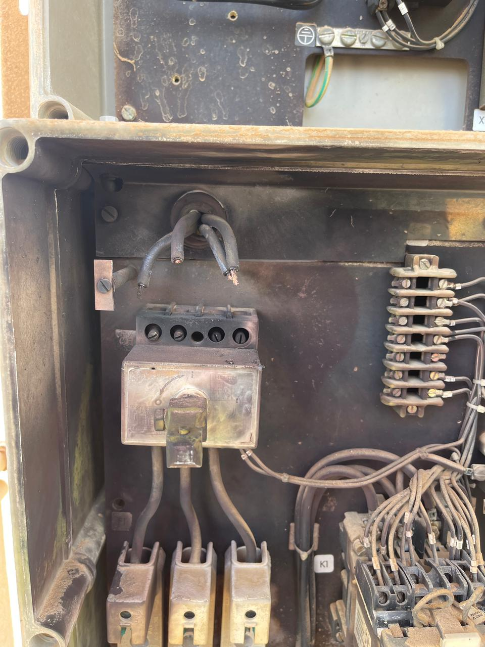
PDO Second Alert
Date: 10.08.2021 Incident title: HiPo#45 -Electric Flash
What happened?
On 10.08.2021, at around 11:05am, while attempting to loosen the base plate inside 415 V feeder for demolition of redundant equipment at Runib Station, a flash occurred from the live, incoming area on top of the feeder, and as its consequence, the Electrician suffered burns on his right hand.
Your learning from this incident..
Do not work on / open live installations without proper authority.
Use insulated gloves for working on or near live equipment.
Do not be complacent; discuss the concerns with the Supervisor for a safe solution when faced with challenges.
Never assume; ask, when in doubt.
Exposed live wires came in contact with each other due to movement caused
Electricity kills; be sure and do not assume.
Notes:
Ensure all dates and titles are input
A short description should be provided without mentioning names of contractors or individuals. You should include, what happened, to who (by job title) and what injuries this resulted in. Nothing more!
Four to five bullet points highlighting the main findings from the investigation. Remember the target audience is the front line staff so this should be written in simple terms in a way that everyone can understand.
The strap line should be the main point you want to get across
The images should be self explanatory, what went wrong (if you create a reconstruction please ensure you do not put people at risk) and below how it should be done.

Slide 2
Management self audit
Date: 10.08.2021 Incident title: HiPo#45 -Electric Flash
As a learning from this incident and ensure continual improvement all contract
managers must review their HSE HEMP against the questions asked below
Confirm the following:
Do you ensure isolation of equipment before any work in it?
Do you ensure crew is briefed of the electrical safety precautions?
Do you ensure crew understands the hazards specific to the task and controls needed?
Do you ensure crew is aware of their authority to stop work when they feel unsafe?
Do you ensure right PPE for the task is used and correctly?
* If the answer is NO to any of the above questions please ensure you take action to correct this finding.
Notes:
Ensure all dates and titles are input
Make a list of closed questions (only ‘yes’ or ‘no’ as an answer) to ask others if they have the same issues based on the management or HSE-MS failings or shortfalls identified in the investigation.
Imagine you have to audit other companies to see if they could have the same issues.
These questions should start with: Do you ensure…………………?

