Slide 1
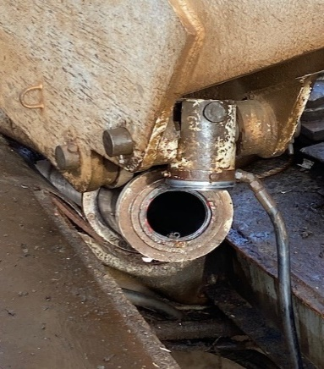
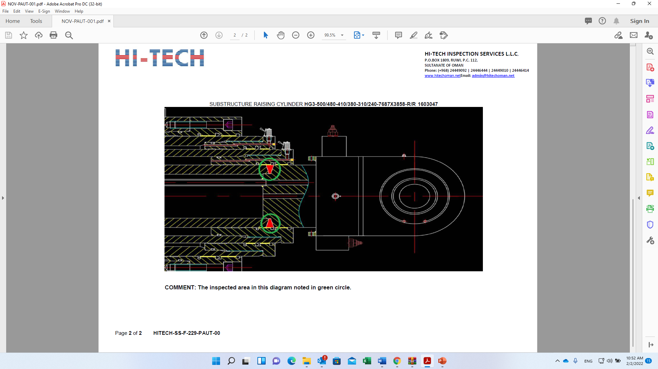
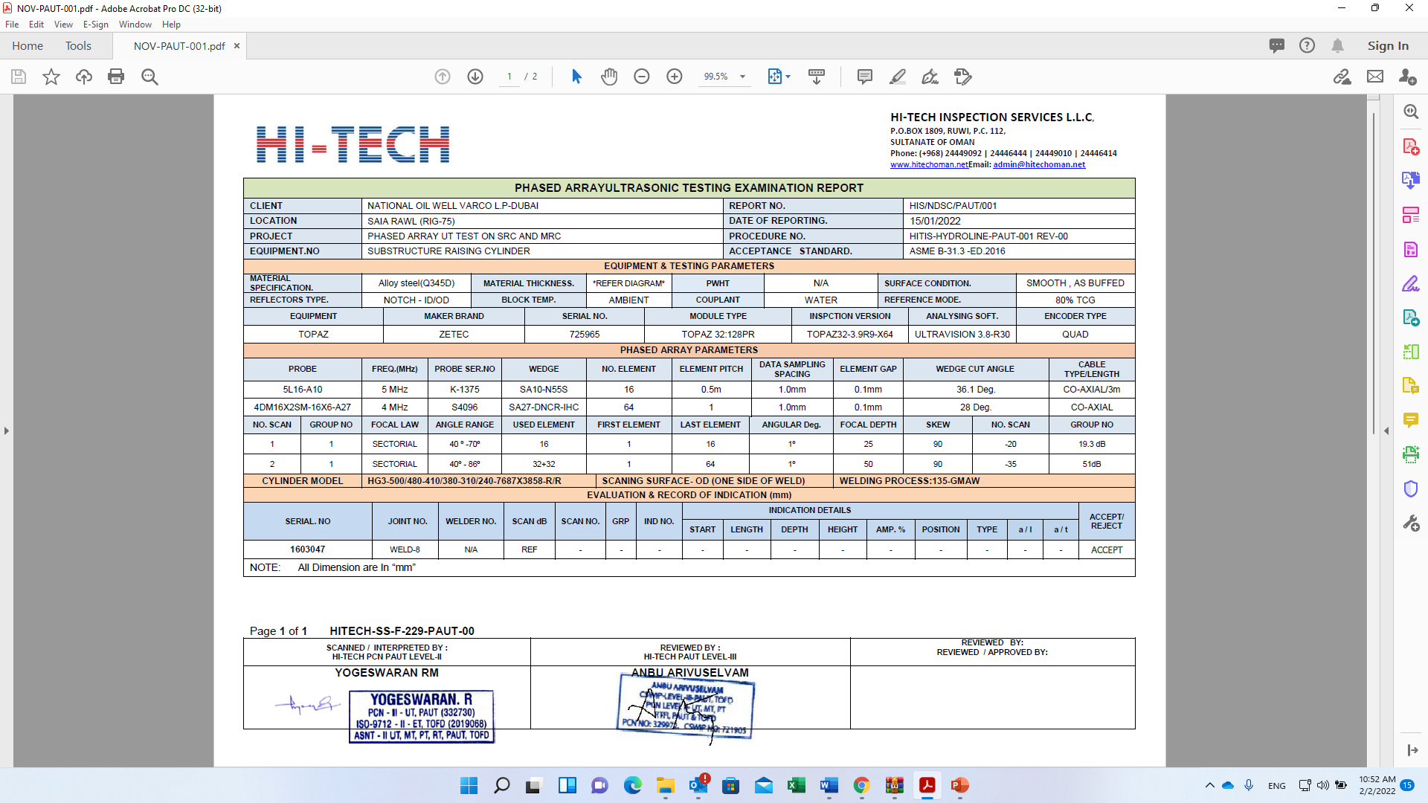
PDO Second Alert
Date: 21.08.2021 Incident Type: HiPo#46
What happened?
On August 21st 2021, after lowering the substructure, crew connected mast raising cylinders to the mast and attempt to lower the mast, at 17:30hrs, and during mast lowering (approximately at 80 degree), suddenly mast descended uncontrolled due to failure of both mast raising cylinders. No injuries were incurred.
Findings
Based on metallurgical laboratory test results, the failure of Driller side mast raising 4 stage telescopic hydraulic cylinder assembly attributed to the fracture of circumferential weld seam between rod eye and stage 4 cylinder, which lead to the loss of cylinder integrity:
Further, Weldment fracture of the rod eye and 4th Stage due to the presence / entrapment of slag (confirmed with the help of EDS elemental analysis) forming a discontinuity / potential stress raiser at the weld root side due to poor workmanship. This slag-entrapment or stress raiser at weld root area triggered fatigue cracking.
These damages of the welded parts in the cylinder assembly caused compression loading on the gland end of off-driller side cylinder fist stage cylinder which subsequently bulged and fractured.
learning from this incident..
Always ensure to stay away from line of fire.
Always ensure raising cylinders are synchronized while movement up or down.
Always ensure the integrity of raising cylinder hydraulic circuit (health checks, preventive and predictive maintenance work order).
Sheared Driller side Mast Raising cylinder
Phased array UT Test
Ensure Phased array UT test of raising cylinder is part of OEM COC and annual/major overhauling to detect subsurface cracks.
Notes:
Ensure all dates and titles are input
A short description should be provided without mentioning names of contractors or individuals. You should include, what happened, to who (by job title) and what injuries this resulted in. Nothing more!
Four to five bullet points highlighting the main findings from the investigation. Remember the target audience is the front line staff so this should be written in simple terms in a way that everyone can understand.
The strap line should be the main point you want to get across
The images should be self explanatory, what went wrong (if you create a reconstruction please ensure you do not put people at risk) and below how it should be done.

Slide 2
Management self audit
Date: 21.08.2021 Incident Type: HiPo#46 Drop
As a learning from this incident and ensure continual improvement all contract
managers must review their HSE HEMP against the questions asked below
Confirm the following:
Do you ensure minimum/total elimination of people on rig floor while lowering/raising the mast
Do you ensure raising cylinder manufacturing data book is part of your quality control of your certification procedure
Do you ensure Phased array UT test inspection part of maintenance requirements for annual and major overhauling raising/lowering cylinders.
Do you ensure raising/lowering cylinders movement are synchronized via monitoring system while moving up or down?
Do you ensure the integrity of raising cylinder hydraulic circuit (health checks, preventive and predictive maintenance work order).
* If the answer is NO to any of the above questions, please ensure you take action to correct this finding.
Notes:
Ensure all dates and titles are input
Make a list of closed questions (only ‘yes’ or ‘no’ as an answer) to ask others if they have the same issues based on the management or HSE-MS failings or shortfalls identified in the investigation.
Imagine you have to audit other companies to see if they could have the same issues.
These questions should start with: Do you ensure…………………?

