Slide 1
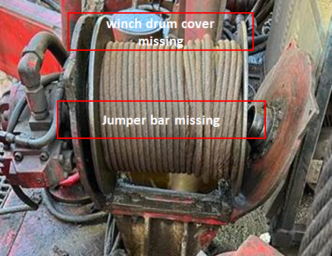
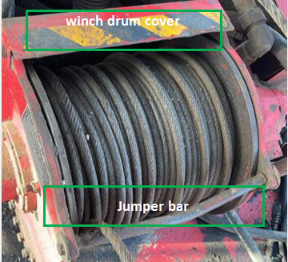
Midwesco WPH12_HiPo#47, PIM#1159233
Date:17/09/2023 Incident title: HIPO Pattern: DROP . Potential severity: 4P Activity: winching operation
Target Audience: ALL
What happened?
The operation was to lower down the ESP Sheave from the Mast by use of Service winch operated by the Driller (ODS 3Ton Hydraulic Winch). While lowering down the sheave the service Winch failed resulting in uncontrolled descent of the the sheave on to the rig floor (sheave weight approx. 100kg with Cable suspended). Zone management was adhered to, no injuries to individuals occurred.
Why it happened/Finding :
• Service winch condition was not checked thoroughly by the mechanic at the start of the hitch
• Jumper bar & winch drum cover were not installed after the last winch line replacement
• Derickman safely attached winch line to the ESP Sheave, area confirmed clear before RD start
• The communication during execution of the task was good
• Driller checked the winch line is free yet failed to identify potential failure in Winch integrity
• Zone management was adhered to during RD of the ESP sheave (Crew were out of the LoF)
Your learning from this incident :
- Mechanic to always ensure the work orders are available & followed for checking and maintenance of equipment
- RM/NTP Always ensure the Supervisors play their role efficiently in verification of the quality of checks of the SCE
- Maintenance lead to always ensure quality maintenance program in place & implemented (part of PMS and details work orders)
- RM /Driller/AD Always ensure the zone management is adhered to
Always ensure All equipment PMS work orders for task in hand is available & followed
Notes:
Ensure all dates and titles are input
A short description should be provided without mentioning names of contractors or individuals. You should include, what happened, to who (by job title) and what injuries this resulted in. Nothing more!
Four to five bullet points highlighting the main findings from the investigation. Remember the target audience is the front line staff so this should be written in simple terms in a way that everyone can understand.
The strap line should be the main point you want to get across
The images should be self explanatory, what went wrong (if you create a reconstruction please ensure you do not put people at risk) and below how it should be done.

Slide 2
Midwesco WPH12_HiPo#47, PIM#1159233
Date:17/09/2023 Incident title: HIPO Pattern: DROP . Potential severity: 4P Activity: winching operation
As a learning from this incident and ensure continual improvement all contract managers must review their HSE risk management against the questions asked below
Confirm the following:
Do you ensure all winches guards are installed after inspections ?
Do you ensure out of supervisors are aware of equipment design & OEM parts?
Do you ensure all critical equipment SOP for maintenance are available ?
Do you ensure Hoist mechanic are having sufficient competency for the implementation of PMS
Do you ensure newly assigned mechanics are given appropriate introduction to assigned unit?
Do you ensure all staff are adhering to zone management Procedures
* If the answer is NO to any of the above questions please ensure you take action to correct this finding
Notes:
Ensure all dates and titles are input
Make a list of closed questions (only ‘yes’ or ‘no’ as an answer) to ask others if they have the same issues based on the management or HSE-MS failings or shortfalls identified in the investigation.
Imagine you have to audit other companies to see if they could have the same issues.
These questions should start with: Do you ensure…………………?

