Slide 1
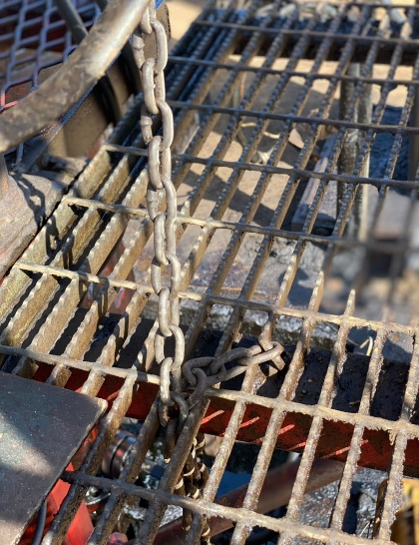
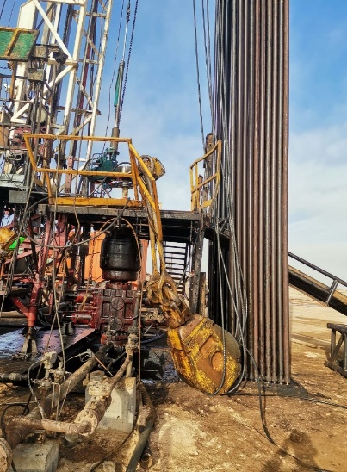
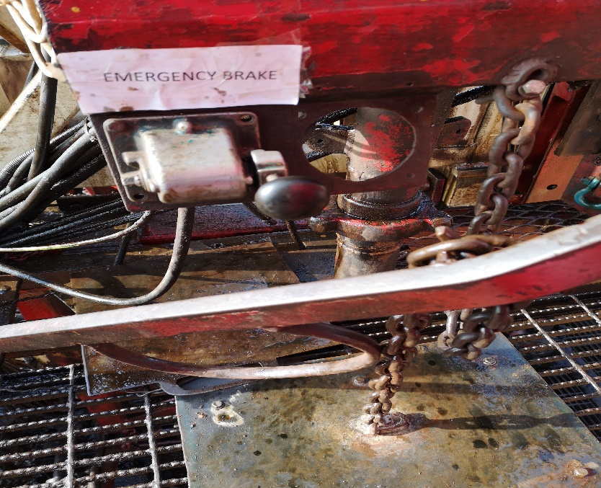
PDO Second Alert
Date: 24th Aug’2021 @ 07:30 am HiPo#48
Incident title : Uncontrolled descending of Travelling Block
What happened?
Rig floor crew ware preparing for changing tubing tong jaw. The driller left the driller console after securing the travelling block hanging @3m above floor using draw works brake handle chained down without noticing the chain was stuck in the grating platform. The traveling block started descending down to the rig floor and continued to drag towards the V-door side and fell on the ground. All crew members safely came down using ODS (Off Driller side) ladder
Your learning from this incident..
Ensure the travelling block is correctly secured and brakes are engaged before leaving the Driller console.
Check and ensure the chain locking mechanism is free from obstructions.
Always ensure floor activities are performed under supervision.
Ensure the SOP and HEMP is reviewed and updated to confirm it meets OEM/ Stds.
Photo explaining what was done wrong
Ensure Emergency brake is engaged, and brake handle is correctly secured when Driller is away
Notes:
Ensure all dates and titles are input
A short description should be provided without mentioning names of contractors or individuals. You should include, what happened, to who (by job title) and what injuries this resulted in. Nothing more!
Four to five bullet points highlighting the main findings from the investigation. Remember the target audience is the front line staff so this should be written in simple terms in a way that everyone can understand.
The strap line should be the main point you want to get across
The images should be self explanatory, what went wrong (if you create a reconstruction please ensure you do not put people at risk) and below how it should be done.

Slide 2
Management self audit
Date: Incident title
As a learning from this incident and ensure continual improvement all contract
managers must review their HSE HEMP against the questions asked below
Confirm the following:
Do you ensure the learning from incidents related to engineering control are implemented?
Do you ensure the procedures conforms to OEM/Standards and appropriate to working requirements?
Did you verify the personnel with safety critical roles fully aware of safe work arrangements?
Do you ensure the Draw woks brake is applied and verified whenever travelling block is stopped for any other task / leaving the drilling console ?
Do you ensure the chain securing mechanism is free from any obstruction?
* If the answer is NO to any of the above questions please ensure you take action to correct this finding.
Notes:
Ensure all dates and titles are input
Make a list of closed questions (only ‘yes’ or ‘no’ as an answer) to ask others if they have the same issues based on the management or HSE-MS failings or shortfalls identified in the investigation.
Imagine you have to audit other companies to see if they could have the same issues.
These questions should start with: Do you ensure…………………?

