Slide 1
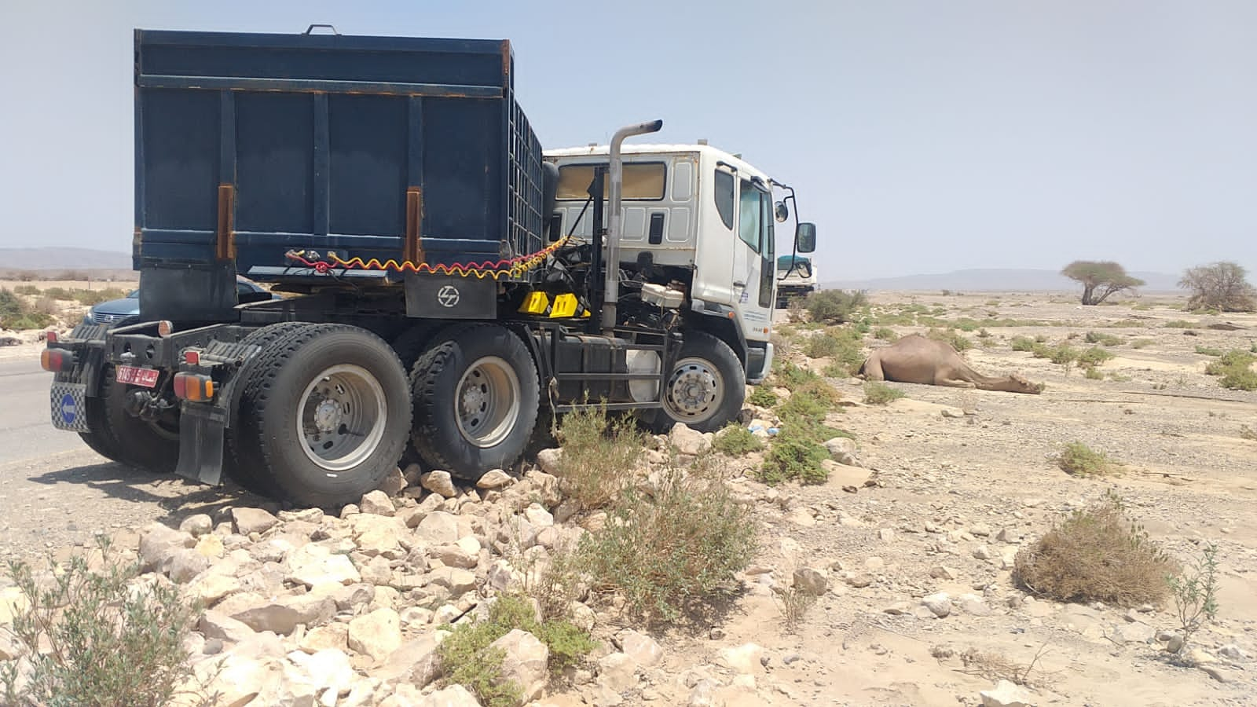
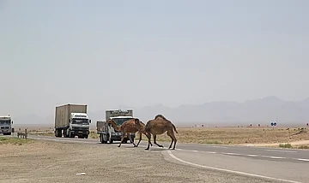
PDO Second Alert
Date: 23.8.2021 Incident title : HiPo#49-MVI
What happened?
Trailer was moving on the black top and was transporting materials for the project.
A camel suddenly ran across the highway. The driver tried to control the vehicle , however the prime mover hit the camel and it died few minutes later. No injuries to driver and minor damages to the prime mover
Your learning from this incident..
Always ensure to apply defensive driving techniques
Always slow down totally / stop whenever you notice camel crossing the road
Always drives very cautious when approaching the wadi
Driver hit camel while driving
While driving, always stay focus on the route hazards
Driver shall slow down the vehicle and give way to the camels before proceeding

Slide 2
Management Self Audit
Date: 23.8.2021 Incident title : HiPo#49-MVI
As a learning from this incident and ensure continual improvement all contract
managers must review their HSE HEMP against the questions asked below
Confirm the following:
Do you ensure to routinely remind defensive driving techniques in Driver’s Forums, TBT, etc?
Do you ensure drivers are cautious to note camel crossings on route ?
Do you ensure drivers notices all road safety signs and adopt appropriate driving controls?
* If the answer is NO to any of the above questions please ensure you take action to correct this finding.
2
Notes:
Ensure all dates and titles are input
Make a list of closed questions (only ‘yes’ or ‘no’ as an answer) to ask others if they have the same issues based on the management or HSE-MS failings or shortfalls identified in the investigation.
Imagine you have to audit other companies to see if they could have the same issues.
These questions should start with: Do you ensure…………………?

