Slide 1
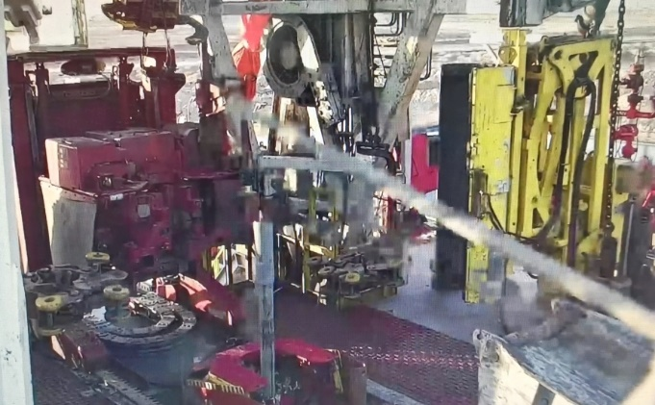
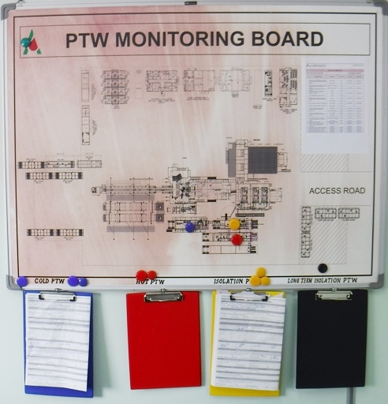
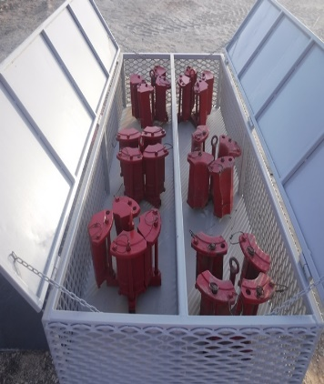
PDO Second Alert
Date: 04.09.2021 Incident title: HIPO#50_Rig 127_Nearmiss (DROP)
What happened?
At 18:01 hours, during RIH 4” Drill pipe by lifting stands from the v-door, Elevator was latched on the drill pipe stand. While lifting drill pipe stand, it slipped through elevator and fell down on pipe cat trough from height of approximately 10 meters. The stand hit tool joint of the pipe and trough on its way down and finally rested between pipe cat trough and V-door guardrail.
Immediately stopped the operation, secured the area and prepared recovery plan. No injuries and damages observed. Red zone was well managed.
Your learning from this incident..
Always ensure to store elevator segment in dedicated area under lock.
Always ensure to use PTW when you have to change BX elevator segment
Always ensure Red Zone and No-go Zone is always managed
Do not change BX elevator segment size without raising PTW
Notes:
Ensure all dates and titles are input
A short description should be provided without mentioning names of contractors or individuals. You should include, what happened, to who (by job title) and what injuries this resulted in. Nothing more!
Four to five bullet points highlighting the main findings from the investigation. Remember the target audience is the front line staff so this should be written in simple terms in a way that everyone can understand.
The strap line should be the main point you want to get across
The images should be self explanatory, what went wrong (if you create a reconstruction please ensure you do not put people at risk) and below how it should be done.

Slide 2
Management self audit
Date: 04th September, 2021 Incident title: HIPO#50_Rig 127_Nearmiss (DROP)
As a learning from this incident and ensure continual improvement all contract
managers must review their HSE Risk Register against the questions asked below
Confirm the following:
Do you ensure that drillers are aware of correct size of segment as per operational requirement?
Do you ensure elevator segment are stored at controlled place?
Do you ensure BX elevator procedure is updated and communicated with involved crew?
Do you ensure drillers consult with unit managers when they are in doubt?
Notes:
Make a list of closed questions (only ‘yes’ or ‘no’ as an answer) to ask other contractors if they have the same issues based on the management or HSE-MS failings or shortfalls identified in the investigation. Pretend you have to audit other companies to see if they could have the same issues.

