Slide 1
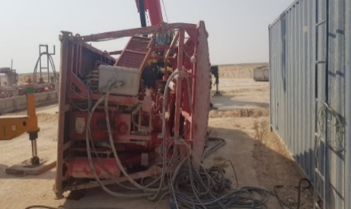
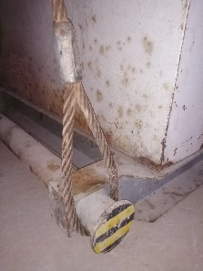
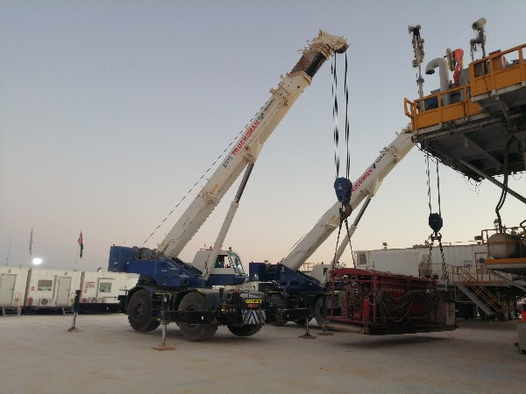
PDO Second Alert
Date: 26.09.2021 Incident title: HiPo#55 -Drops
What happened
During rig Move/up activities, one of the tasks was to spot the (BOP HPU: Hydraulic Power Unit) next to the subbase. This requires loading it from its position near runoff area and placing it on Oil field truck, then offload the same on the target spot near subbase.
When the loading started and at around a height of 1m above the ground, the load became unbalanced causing one of the sling to slip from the skid trunnion (lifting points ).The HPU unit then flipped 90 degrees to the side due the sudden unbalance at such height on both cranes . No one was injured.
Koomy position after incident
Your learning from this incident:
Ensure Critical lifts must be supervised and led by competent lifting supervisor.
Ensure the lifting equipment's ( sling, shackle, cranes etc.) are fit for the task
Ensure that any critical lifts has an approved lift plan which should be reviewed before the lift.
Verify that the rigging method and sling selection is done in accordance with the lifting plan.
Ensure the red zone is fully controlled before starting any lift.
Correct slinging
Do not perform any lifting operation without the presence of lifting supervisor and approved lift plan
Correct lifting method using two cranes
Notes:
Ensure all dates and titles are input
A short description should be provided without mentioning names of contractors or individuals. You should include, what happened, to who (by job title) and what injuries this resulted in. Nothing more!
Four to five bullet points highlighting the main findings from the investigation. Remember the target audience is the front line staff so this should be written in simple terms in a way that everyone can understand.
The strap line should be the main point you want to get across
The images should be self explanatory, what went wrong (if you create a reconstruction please ensure you do not put people at risk) and below how it should be done.

Slide 2
Management self audit
Date: 26.09.2021 Incident title: HiPo#55 -Drops
As a learning from this incident and ensure continual improvement all contract
managers must review their HSE HEMP against the questions asked below
Confirm the following:
Do you ensure the MOC system is implemented upon change in people, operation or equipment?
Do you ensure Specific and detailed lifting plans are available and approved?
Do you ensure that all lifting operations are properly and effectively supervised and monitored?
Do you ensure proper premobilization system for 3rd party is working and effectively implemented?
Do you ensure to verify 3rd party workers competency and equipment integrity/availability through premobilization and pre-site entrance inspection systems?
* If the answer is NO to any of the above questions, please ensure you take action to correct this finding.
Notes:
Ensure all dates and titles are input
Make a list of closed questions (only ‘yes’ or ‘no’ as an answer) to ask others if they have the same issues based on the management or HSE-MS failings or shortfalls identified in the investigation.
Imagine you have to audit other companies to see if they could have the same issues.
These questions should start with: Do you ensure…………………?

