Slide 1
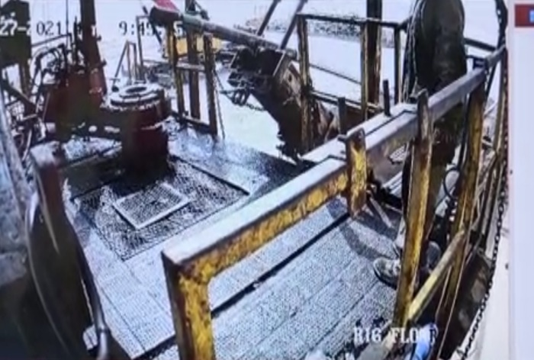
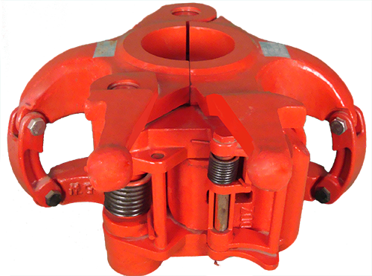
PDO Second Alert
Date:27/09/2021 Incident title: HIPO#56 Pattern: Drops Potential severity: C3P
Target Audience: Drilling & Operation
What happened?
On 27th Sep 2021 @ 09:45 hrs. While RIH 4-1/2 Wire Wrapped Screen casing, crew make-up 5-1/2” casing elevator into the bails and they make up XO ( 4-1/2 LTC to 5-1/2 LTC ) in the WWS to be used as lifting sub. After latching the elevator driller lifted the joint from the v-door and while lifting it up, elevator lock unlatched & joint fell on to the V-door, One floor man was on the side of the floor holding rope to slow down the joint movement. No injury & no asset damage.
Why it happened/Finding :
Improper equipment been use “wrong size elevator”.
Driller Failed to follow the procedure. ”shortcut”.
Floor man did not ensure elevator fully latched.
Floor man was in line of fire.
Your learning from this incident..
Always ensure proper elevator size considering the size of tools.
Ensure to follow and adhere to the operation procedure
Always ensure elevator fully latched and secured prior lifting.
Ensure to stay away from line of fire.
Ensure adequate supervision while handling different size of tools.
correct size of elevator to be used & Lock is closed properly
Notes:
Ensure all dates and titles are input
A short description should be provided without mentioning names of contractors or individuals. You should include, what happened, to who (by job title) and what injuries this resulted in. Nothing more!
Four to five bullet points highlighting the main findings from the investigation. Remember the target audience is the front line staff so this should be written in simple terms in a way that everyone can understand.
The strap line should be the main point you want to get across
The images should be self explanatory, what went wrong (if you create a reconstruction please ensure you do not put people at risk) and below how it should be done.

Slide 2
Management self audit
Date:27/09/2021 Incident title: HIPO#56 Pattern: Drops Potential severity: C3P
As a learning from this incident and ensure continual improvement all contract managers must review their HSE risk management against the questions asked below
Confirm the following:
- Do you ensure the SOP adequately addresses the correct size of elevator?
- Do you ensure that the driller is fully aware and implement the SOP instructions?
- Do you ensure that no one are in line of fire?
- Do you ensure that the all required sizes of elevators are available in the site?
* If the answer is NO to any of the above questions please ensure you take action to correct this finding
Notes:
Ensure all dates and titles are input
Make a list of closed questions (only ‘yes’ or ‘no’ as an answer) to ask others if they have the same issues based on the management or HSE-MS failings or shortfalls identified in the investigation.
Imagine you have to audit other companies to see if they could have the same issues.
These questions should start with: Do you ensure…………………?

