Slide 1
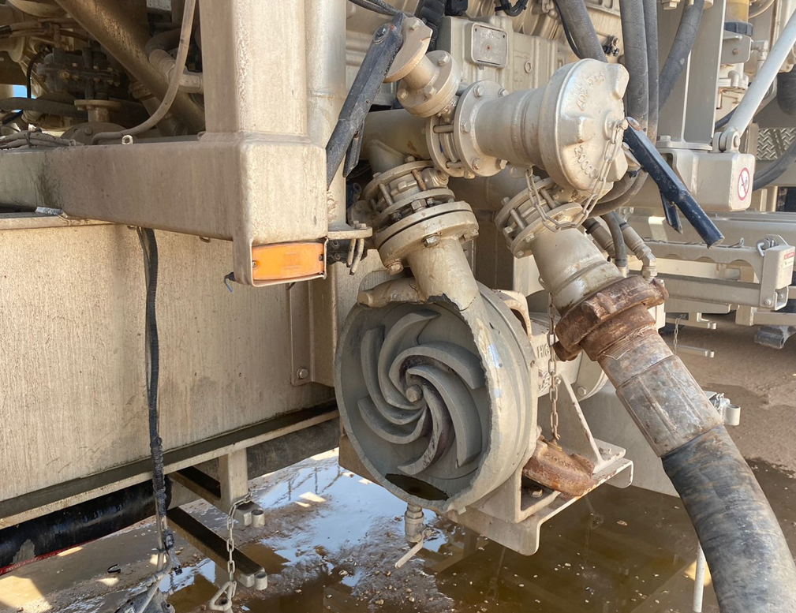
PDO Second Alert
Date:30/09/2021 Incident title: HiPo#56A Pattern: Released Energy Potential severity: B4P
Target Audience: Drilling, Logistics, Operation & Construction
What happened?
On 30-Sep-2021, Cementing job was ongoing at RHNS 17, after completing displacement of cement and during pressure testing the casing 7“, cement supervisor and DSV heard abnormal noise, they found out centrifugal pump on the unit has been burst causing part of pump's housing been ejected approximately 6 meters away. No injuries.
Why it happened/Finding :
Part of Centrifugal pump sheared and ejected under pressure
Cement Supervisor did not switch off the pump, he did not make walkthrough to the equipment before case testing.
Suction Discharge butterfly valves were closed caused the pump to be overheated
Risk of human error for misuse of centrifugal pump was not captured in the risk register
Learning from this incident..
Potential failure of centrifugal pump can occur due when no fluid flow through the pump and discharge (outlet) and/or suction (inlet) are shut.
Always consider to Include potential failure of Centrifugal pumps to HEMP
Always ensure pump is running with flow and never run it with either discharge or suction valve shut.
Communicate the learning to all employees
Recommendation to modify the C-pump to shut off automatically, in case of operating the pump in dry mode (both inlet and outlet valves are closed).
Notes:
Ensure all dates and titles are input
A short description should be provided without mentioning names of contractors or individuals. You should include, what happened, to who (by job title) and what injuries this resulted in. Nothing more!
Four to five bullet points highlighting the main findings from the investigation. Remember the target audience is the front line staff so this should be written in simple terms in a way that everyone can understand.
The strap line should be the main point you want to get across
The images should be self explanatory, what went wrong (if you create a reconstruction please ensure you do not put people at risk) and below how it should be done.

Slide 2
Management self audit
Date:30/09/2021 Incident title: HiPo#56A Pattern: Released Energy Potential severity: B4P
As a learning from this incident and ensure continual improvement all contract managers must review their HSE risk management against the questions asked below
Confirm the following:
- Do you ensure Centrifugal pump ready to use before operate it?
- Do you ensure the risk of potential pump failure / burst is included in your HEMP?
- Do you ensure controls in place to prevent human error to leave centrifugal pump running without flow with closed inlet/outlet valves?
* If the answer is NO to any of the above questions please ensure you take action to correct this finding
Notes:
Ensure all dates and titles are input
Make a list of closed questions (only ‘yes’ or ‘no’ as an answer) to ask others if they have the same issues based on the management or HSE-MS failings or shortfalls identified in the investigation.
Imagine you have to audit other companies to see if they could have the same issues.
These questions should start with: Do you ensure…………………?

