Slide 1
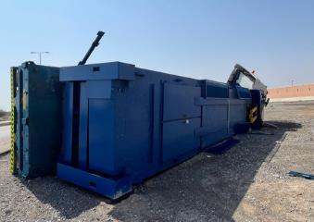
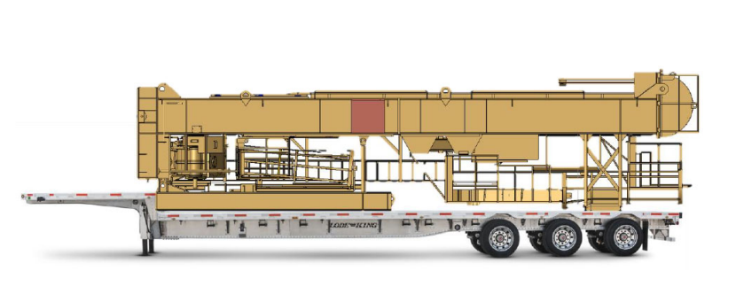
PDO Second Alert
Date: 11/10/2021 Incident title: HiPo# 57 Pattern: MVI Potential severity: C4P
Photo explaining what was done wrong
What happened?
A driver was transporting ROTAFLEX from Muscat to Nimr. At Manah roundabout, when the driver felt the rear end of the trailer was leaning towards the right, it appeared that the front axle right outer side of the trailer sustained cuts and punctured, the driver slowed down in an attempt to get off the road when he lost control and toppled towards the right side, resulting in damaging the vehicle and load. No injury.
Why it happened/Finding :
Driver Lost the control of the vehicle whilst trying to get off the road due to biased load following the puncture.
Your learning from this
Ensure you use competent driver to carry out the work
Ensure you follow defensive driving technique whilst facing road hazards
Ensure you select appropriate vehicle for the job
Ensure you secure the load properly as per SP 2001
Ensure you carry out risk assessment prior to commencement of work
Ensure you have enough rest prior to journey
Photo explaining how it should be done right
Target Audience: Drilling, Logistics, Operation & Construction
Notes:
Ensure all dates and titles are input
A short description should be provided without mentioning names of contractors or individuals. You should include, what happened, to who (by job title) and what injuries this resulted in. Nothing more!
Four to five bullet points highlighting the main findings from the investigation. Remember the target audience is the front line staff so this should be written in simple terms in a way that everyone can understand.
The strap line should be the main point you want to get across
The images should be self explanatory, what went wrong (if you create a reconstruction please ensure you do not put people at risk) and below how it should be done.

Slide 2
Management self audit
Date: 11/10/2021 Incident title: HiPo#57 Pattern: MVI Potential severity: C4P
As a learning from this incident and ensure continual improvement all contract managers must review their HSE risk management against the questions asked below
Confirm the following:
Do you ensure your subcontractor are using competent driver?
Do you ensure you audit your subcontractor frequently?
Do you ensure your risk assessment is robust to cover risks in your operations?
Do you ensure you carry out observations during loading/unloading?
Do you ensure you secure your load properly?
Do you ensure all the documents related to vehicle and drivers are verified and compliant?
* If the answer is NO to any of the above questions please ensure you take action to correct this finding
Notes:
Ensure all dates and titles are input
Make a list of closed questions (only ‘yes’ or ‘no’ as an answer) to ask others if they have the same issues based on the management or HSE-MS failings or shortfalls identified in the investigation.
Imagine you have to audit other companies to see if they could have the same issues.
These questions should start with: Do you ensure…………………?

