Slide 1
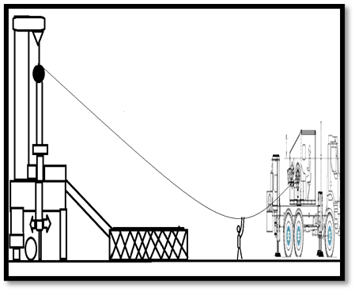
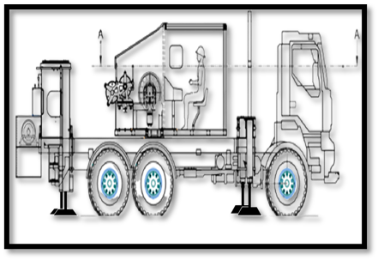
PDO Second Alert
Date:06/03/2024 Incident title: HiPo#03 (Asst. Operator lifted by slickline Wire under tension) Pattern: Released Energy Potential severity: P4C Activity: Retrieved Plug
Target Audience: Drilling, Well Intervention, Operation & Well Services
What happened?
On 24th Jan 2024, while the Slickline Crew attempted to retrieve the shallow 3.630” R plug body from R nipple with Unit after performing
15 jars up without success, the Slickline Operator instructed the Assistant Operator to perform manual hand jarring. After the second
attempt to jar, the plug released and was blown down and the Assistant Operator lifted by the force and fell to the ground. Fortunately, no
one was injured, and no equipment was damaged
Why it happened/Finding:
The asst. operator was lifted 1.7m above the ground and fell, due to the plug blow down.
The slickline unit could not retrieve the plug through the normal jarring process.
The wrong BHA was used for the Service Execution
The Operator did not follow the jarring Procedure as stipulated in the SOP
The crew believe that hand jarring is part of the operation
The operator did not communicate with the base management to seek expert advice on what to do before instructing the assistant operator to go for hand jarring
Hand Jarring was not part of SOP and Management of change was not initiated by the operator.
The assistant operator was wearing full PPE
There were no injuries or equipment damage
Your learning from this incident:
Always ensure that there is a process in place to select the correct tools and/or equipment for service execution (operation)
Always ensure proper job briefing and handover are carried out between CSE and 2 shifts
Always ensure that crew are trained and competent for their selected activity and they are competent with implementing dynamic risk assessment when task conditions change
Always ensure that crew are implementing Musta’ed effectively at the worksite
Always ensure effective communication between the site crew and base management are established
Always ensure employees stay away from the line of fire & STOP hand jarring.
Always ensure to follow the right procedure for each specific Task.
Always ensure to stop and discuss if any dynamic risk arises and manage the change properly.
Make sure the right tools are available for use to avoid Hand jarring
Notes:
Ensure all dates and titles are input
A short description should be provided without mentioning names of contractors or individuals. You should include, what happened, to who (by job title) and what injuries this resulted in. Nothing more!
Four to five bullet points highlighting the main findings from the investigation. Remember the target audience is the front line staff so this should be written in simple terms in a way that everyone can understand.
The strap line should be the main point you want to get across
The images should be self explanatory, what went wrong (if you create a reconstruction please ensure you do not put people at risk) and below how it should be done.

Slide 2
Management self audit
Date: 24 Jan 2024 Incident title: HiPo Near Miss (Asst. lifted-up by slickline wire under tension) Pattern: Released Energy Potential severity: P4C
As a learning from this incident and ensure continual improvement all contract managers must review their HSE risk management against the questions asked below
Confirm the following:
Is it safe to do Hand Jarring (Manual Handling) ? No.
Can it be done in another way without exposure to line of fire ? Yes.
Do you ensure your employees are aware of Line of Fire hazards in their operation?
Do you ensure your Operators are competent in operating equipment?
Do you ensure existing standard operating procedures address all aspects of the operations, including identifying the correct tools?
Do your risk management tools used to identify and cover all the risks involved in the tasks?
* If the answer is NO to any of the above questions please ensure you take action to correct this finding
Disclaimer
This document is provided for information only. It may not be relied upon for any purpose. Neither PDO nor any party providing information for this document accepts any liability for its accuracy, completeness, omissions, advice, or any consequences arising from its use, even if reasonable care was not exercised. No representation or warranty, express or implied, is made that following this document will achieve any specific results or meet any legal or regulatory requirements. This document does not constitute technical advice; consult a qualified professional if such advice is needed
Notes:
Ensure all dates and titles are input
Make a list of closed questions (only ‘yes’ or ‘no’ as an answer) to ask others if they have the same issues based on the management or HSE-MS failings or shortfalls identified in the investigation.
Imagine you have to audit other companies to see if they could have the same issues.
These questions should start with: Do you ensure…………………?

