Slide 1
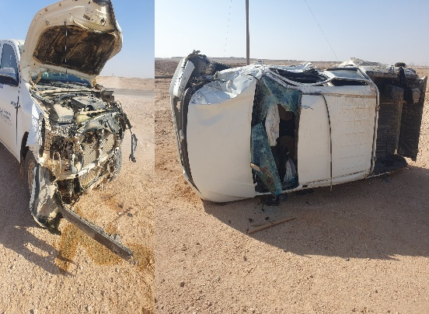
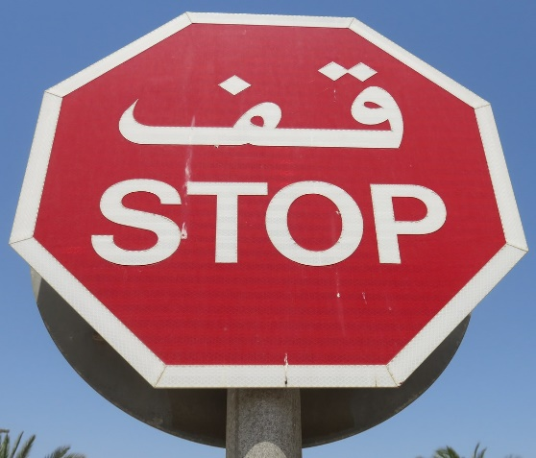
PDO Second Alert
Date:19/02/2024 Incident title: HIPO#6,FAC Pattern: Road Safety Potential severity: C4P Activity: Driving
Target Audience: Drilling, Logistics, Operation & Construction
Photo explaining what was done wrong
What happened?
At 06:09 am on 19 February the H28 Rig Manager was driving Toyota pickup on a graded Road from the camp towards the Hoist. To complete the journey, He needed to cross the Black Top Shaleem Road, at a 4-way junction. while crossing the blacktop road he collided with 3rd Party Mitsubishi pickup which was travelling along the blacktop road, towards the junction. it impact caused the third-party vehicle to roll over. There were no serious injuries to the people in either vehicle. But both vehicles were severely damaged.
Why it happened/Finding :
Driver didnt STOP in T junction .
Driver’s attention was diverted 50m before the blacktop road
Used private road.
The driver recognized the important of STOP sign.
The STOP sign was in good condition and visible to driver.
Your learning from this incident..
Always plan your journey in advance and use authorized road only.
Avoid driving during the dusk and dawn times as visibility is poor.
Always obey road signs and stop before crossing the main road from the secondary road.
Check the road is clear before crossing the road.
Always use the authorized road.
Photo explaining how it should be done right
Always Stop at the Stop sign. Check the road before crossing the Junction.
Notes:
Ensure all dates and titles are input
A short description should be provided without mentioning names of contractors or individuals. You should include, what happened, to who (by job title) and what injuries this resulted in. Nothing more!
Four to five bullet points highlighting the main findings from the investigation. Remember the target audience is the front line staff so this should be written in simple terms in a way that everyone can understand.
The strap line should be the main point you want to get across
The images should be self explanatory, what went wrong (if you create a reconstruction please ensure you do not put people at risk) and below how it should be done.

Slide 2
Effective Learning
Date:19/02/2024 Incident title: HIPO#6,FAC Pattern: Road Safety Potential severity: C4P Activity: Driving
To make sure learning is translated to the site day to day activities , please answer the below questions :-
How learning can be implemented at site ?
Assure obey road signs and bring the vehicle to the full stop before crossing the main road from the secondary road.
Assure double check blind spots both left and right side of the vehicle before crossing the Junction, Taking turns or Changing lanes.
Assure the driver have excellent hazard awareness and road/traffic perception.
Assure avoid driving during the dusk and dawn times as visibility is poor.
How can you sustain the action ?
Conducting driving campaign/awareness for all drivers.
Focus on the green Band driver on their behaviors including the STOP sign , reduce speed …ect.
Re-Training defense driving course to enhance driver abilities react to potential hazards.
Disclaimer
This document is provided for information only. It may not be relied upon for any purpose. Neither PDO nor any party providing information for this document accepts any liability for its accuracy, completeness, omissions, advice, or any consequences arising from its use, even if reasonable care was not exercised. No representation or warranty, express or implied, is made that following this document will achieve any specific results or meet any legal or regulatory requirements. This document does not constitute technical advice; consult a qualified professional if such advice is needed
Notes:
Guideline for Effective Learning & Sustainability
•Can be replicated across similar contractor / activities
•Shall be SMART- Specific ,Measurable , Achievable ,Realistic & Timebound
•Can be implemented in a months' time

Slide 3
PDO Second Alert
Date: 19/02/2024 Incident title: Road traffic incident Pattern: MVI Potential severity: C5P
الفئة المستهدفة:
صورة توضح الخطأ الذي حدث
ماذا حدث؟
في الساعة 06:09 من صباح يوم 19 فبراير ، كان مدير منصة H28 يقود سيارة تويوتا بيك آب على طريق متدرج من المخيم باتجاه الرافعة. لإكمال الرحلة ، احتاج إلى عبور طريق بلاك توب شليم ، عند تقاطع 4 اتجاهات. أثناء عبوره طريق Blacktop ، اصطدم ببيك آب ميتسوبيشي 3rd Party الذي كان يسافر على طول طريق Blacktop ، باتجاه التقاطع. تسبب تأثيره في انقلاب مركبة الطرف الثالث. لم تكن هناك إصابات خطيرة للأشخاص في أي من السيارتين. لكن كلتا السيارتين
نتائج التحقيق:
. لم يتوقف السائق في تقاطع T.
كان هناك مستوى منخفض من الضوء في الساعة 06.25 صباحا
كان شروق الشمس في خط البصر المباشر للسائق ، مما جعل من الصعب تحديد المركبات مباشرة في رؤيته الأمامية
تم تحويل انتباه السائق قبل 50 مترا من الطريق الأسود
طريق خاص مستعمل
القيادة الليلية.
الدروس المستفادة من الحادثة:
خطط دائما لرحلتك مسبقا واستخدم الطريق المصرح به فقط.
تجنب القيادة خلال أوقات الغسق والفجر لأن الرؤية ضعيفة.
التزم دائما بإشارات الطريق وتوقف قبل عبور الطريق الرئيسي من الطريق الثانوي.
تحقق من أن الطريق واضح قبل عبور الطريق.
استخدم دائما الطريق المصرح به.
قم دائما بتوفير لوحة لافتات على الطريق الأسود.
صورة توضح كيفية القيام بذلك بشكل صحيح
تأكد من التوقف الكامل والتحقق من الطريق قبل عبور طريق التقاطع
Notes:
Ensure all dates and titles are input
A short description should be provided without mentioning names of contractors or individuals. You should include, what happened, to who (by job title) and what injuries this resulted in. Nothing more!
Four to five bullet points highlighting the main findings from the investigation. Remember the target audience is the front line staff so this should be written in simple terms in a way that everyone can understand.
The strap line should be the main point you want to get across
The images should be self explanatory, what went wrong (if you create a reconstruction please ensure you do not put people at risk) and below how it should be done.

