Slide 1
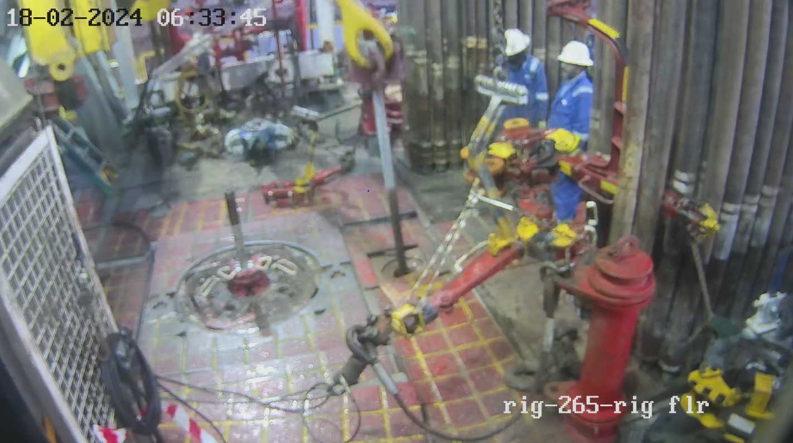
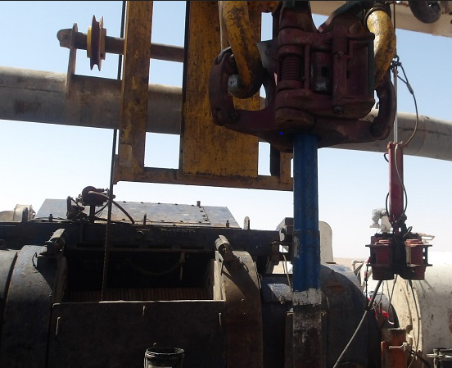
PDO Second Alert
Date:18/02/2024 Incident title: HiPo# , Near Miss Pattern: Drops Potential severity: C4P Activity: Pick up 2 7/8” PAC Pipe
Target Audience: Drilling
What happened?
While Picking up the 3rd joint of 2-7/8” HT PAC pipes from the mouse hole using the 2-7/8” center latch drill pipe elevator and at about 20cm above the mouse hole, the Drill pipe joint slipped through the elevator bore and fall back inside the mousehole.
No injury to personnel
No equipment damage
Work was stopped and safety stand down performed.
Why it happened/Finding :
Center latch elevator was sent to rig site as per callout, without the right handling tools for 2-7/8” HT PAC pipe.
Driller raised concern of missing lifting sub while Rigging up to Night Tool Pusher, however they missed to escalate the matter to the next level
SOP was not available for handling 2 7/8 PAC pipes.
The elevator was checked physically on joint and was holding, however the dimensional check of 2 7/8” tool joint OD was not done
Your learning from this incident..
Always inspect and perform dimensional check prior to start the job including 3rd party equipment
Always involve the Rig Manager and DSV for callout review and whenever there is unclarity
Always ensure to have SOP for handling 2 7/8 PAC pipe.
Always ensure to conduct an effective 7 steps of Musta’ed
Elevator latched directly on DP
Using lifting sub
Always perform dimensional checks, and use proper tools for handling 2 7/8” PAC Pipe
Notes:
Ensure all dates and titles are input
A short description should be provided without mentioning names of contractors or individuals. You should include, what happened, to who (by job title) and what injuries this resulted in. Nothing more!
Four to five bullet points highlighting the main findings from the investigation. Remember the target audience is the front line staff so this should be written in simple terms in a way that everyone can understand.
The strap line should be the main point you want to get across
The images should be self explanatory, what went wrong (if you create a reconstruction please ensure you do not put people at risk) and below how it should be done.

Slide 2
Management self audit
Date: 18/02/2024 Incident title: 2 7/8" PAC pipe fell inside mousehole Pattern: DROPs Potential severity: C4P
As a learning from this incident and ensure continual improvement all contract managers must review their HSE risk management against the questions asked below
Confirm the following:
Do you ensure that your call out is aligned with the vendor’s 2 7/8 PAC pipes package ?
Do you have specific SOP for handling 2 7/8” PAC pipe ?
Do you ensure that dimensional checks are performed prior to pick up 2 7/8” PAC pipes ?
Do you involve Rig Manager and DSV to review the callout and whenever there is unclarity?
Do you ensure proper implementation of Musta’ed process ?
Disclaimer
This document is provided for information only. It may not be relied upon for any purpose. Neither PDO nor any party providing information for this document accepts any liability for its accuracy, completeness, omissions, advice, or any consequences arising from its use, even if reasonable care was not exercised. No representation or warranty, express or implied, is made that following this document will achieve any specific results or meet any legal or regulatory requirements. This document does not constitute technical advice; consult a qualified professional if such advice is needed
Notes:
Ensure all dates and titles are input
Make a list of closed questions (only ‘yes’ or ‘no’ as an answer) to ask others if they have the same issues based on the management or HSE-MS failings or shortfalls identified in the investigation.
Imagine you have to audit other companies to see if they could have the same issues.
These questions should start with: Do you ensure…………………?

Slide 3
PDO Second Alert
Date:18/02/2024 Incident title: HiPo# , Near Miss Pattern: Drops Potential severity: Activity: Pick up 2 7/8” PAC Pipe
الفئة المستهدفة:
ماذا حدث؟
شرح مفصَل عن الحادث
أثناء رفع ثالث أنوب حفر حجم 2-7/8” HT Pac 20 سم من الماوس هول بستعمال حاملة الأنابيب انزلق الانبوب من حاملة الأنابيب وسقط في الماوس هول
لاتوجد إصابات لأي عامل في منصة الحفر ولم تضضرر المعدة جراء هذه الحادثة
تم إيقاف العمل
تمت مناقشة الخطأ مع فريق العمل
نتائج التحقيق:
. حاملة الأنابيب كانت مرسله إلى موقع الحفاره من دون الأدوات الصحيحة لرفع أنابيب حجم 2-7/8”
خطوات وإجراءات العمل كانت حاضره ولكن لم تنص على إستخدام حاملة الأنابيب تلك لحمل ذات الأنابيب
.لم يتم قياس أنابيب 2-7/8” بشكل المطلوب
نبه الحفار مسوؤل الفترة المسائية بإن lifting sub مفقوده أثناء الرفع ومع ذلك تم إستكمال العمل للمرحلة التي تليها
الدروس المستفادة من الحادثة:
. دائما" افحص أدوات العمل قبل البدء وإفحص أيضا" معدات شركات الطرف الثالث
دائما" شارك مدير الحفر في عمل قبل بدء العمل في حالة عدم وضوح خطوات وطرق العمل.
دائما تاكد من وجود خطوات وإجراءات العمل لرفع أنابيب حجم 2-7/8
دائما" إبدء عملك بإستعمال خطوات مستعد السبعه وتأكد من تطبيقها
استخدام مباشر لحامل الانبوب
استخدام الطريقة الصحيحة
دائما افحص أدوات العمل قبل البدء واستخدم الأدوات المناسبة للتعامل مع أنابيب 2 7/8”
Notes:
Ensure all dates and titles are input
A short description should be provided without mentioning names of contractors or individuals. You should include, what happened, to who (by job title) and what injuries this resulted in. Nothing more!
Four to five bullet points highlighting the main findings from the investigation. Remember the target audience is the front line staff so this should be written in simple terms in a way that everyone can understand.
The strap line should be the main point you want to get across
The images should be self explanatory, what went wrong (if you create a reconstruction please ensure you do not put people at risk) and below how it should be done.

