Slide 1
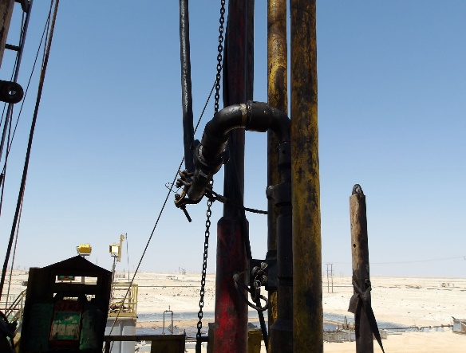
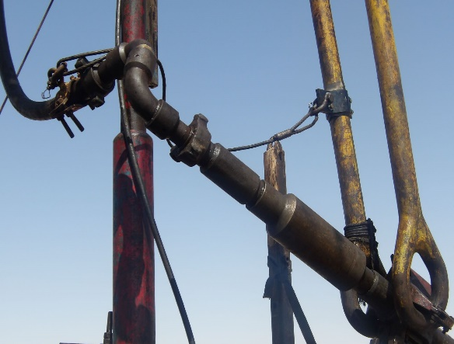
PDO Second Alert
Date:24/02/2024 Incident title: HIPO#9 Pattern: DROP. Potential severity: C4P Activity: washing down
Target Audience: Drilling & Operation
What happened?
At approximately 0100hrs on 24th February 2024, Hoist was preparing for washing down after experiencing a tight spot at 844m. Circulation assembly made up of FOSV, circulation head, 2” swivel, and a 2” wash-down hose was assembled at V –the door and attached to the tubing string. The assembly was then picked up with the elevator and attempted to make up the connection with the power tong. Upon rotating, the FOSV backed off from the string at an approximate height of 10m and the entire assembly, suspended on the Kelly hose swung out of the Rig floor. On its reentry to the hoist floor, it struck on the handrails and floor man from behind.
Floorman sustained abrasions over the back from the base of the neck, first aid was administered by Rima clinic Doctor and sent to Nizwa Hospital after being referred by Haima Hospital.
Why it happened/Finding :
Plan: Although TBT, Musta’ed, JSA and TRIC were prepared and used, risks associated with activity was not adequately evaluated and discussed.
Check Equipment: All certifications valid however the secondary retention was not installed.
Prepare Area :. Zone management is always maintained but during the connection, power tong operator had to stay on the hoist floor.
Control Energy:. While making up the connection with power tong, possibility of backing off the circulation assembly was not considered.
Communication : Communication between the work parties were not adequate to identify the potential risks.
Final check : Failed to walk the line and final check to verify that all potential DROPS are secured properly.
Start Work: Crew did not pay attention to the circulation assembly while operating the power tong.
Your learning from this incident..
Always ensure to implement Musta’ed 7 steps effectively.
Always ensure potential DROPS are identified and Secondary retention is installed.
Always stay out of the line of fire.
Always intervene for unsafe actions.
Always watch the suspended circulation assembly while making up connections.
Always ensure secondary retention is installed on the circulation assembly
Notes:
Ensure all dates and titles are input
A short description should be provided without mentioning names of contractors or individuals. You should include, what happened, to who (by job title) and what injuries this resulted in. Nothing more!
Four to five bullet points highlighting the main findings from the investigation. Remember the target audience is the front line staff so this should be written in simple terms in a way that everyone can understand.
The strap line should be the main point you want to get across
The images should be self explanatory, what went wrong (if you create a reconstruction please ensure you do not put people at risk) and below how it should be done.

Slide 2
Management self audit
Date: 24/02/2024 Incident title: HIPO# 9 Pattern: DROP Potential severity: C4P
As a learning from this incident and ensure continual improvement all contract managers must review their HSE risk management against the questions asked below
Confirm the following:
Do you ensure the proper torquing of circulation assembly on the work string?
Do you ensure secondary retention on circulation assembly?
Do you ensure power to operators are standing out of line of fire.
* If the answer is NO to any of the above questions please ensure you take action to correct this finding
Disclaimer
This document is provided for information only. It may not be relied upon for any purpose. Neither PDO nor any party providing information for this document accepts any liability for its accuracy, completeness, omissions, advice, or any consequences arising from its use, even if reasonable care was not exercised. No representation or warranty, express or implied, is made that following this document will achieve any specific results or meet any legal or regulatory requirements. This document does not constitute technical advice; consult a qualified professional if such advice is needed
Notes:
Ensure all dates and titles are input
Make a list of closed questions (only ‘yes’ or ‘no’ as an answer) to ask others if they have the same issues based on the management or HSE-MS failings or shortfalls identified in the investigation.
Imagine you have to audit other companies to see if they could have the same issues.
These questions should start with: Do you ensure…………………?

Slide 3
PDO Second Alert
Date:24/02/2024 Incident title: HIPO#9 Pattern: DROP. Potential severity: C4P Activity: washing down
الفئة المستهدفة: منصات عمليات الحفر ومنصات صيانة الآبار
ماذا حدث؟
في حوالي الساعة 0100 يوم 24 فبراير 2024، كانت الرافعة رقم 34 تستعد لعملية غسيل لانبوب الحفر الداخلي. تم تجميع الاجهزة المكونة من FOSV، ورأس التدوير، و2” مفصل دوار، وخرطوم غسيل 2” وربطهم بسلسلة الأنابيب. تم بعد ذلك التقاط شبكة الاجهزة ومحاولة توصيلها مع انبوب الحفر.
واثناء الدوران، انفصلت FOSV عن الانبوب على ارتفاع تقريبي يبلغ 10 أمتار وتأرجحت الشبكة بأكملها، المعلقة على الخرطوم،
وعند عودتها إلى أرضية الرافعة، اصطدمت بالدرابزين وببعامل تبطين الابار (المصاب) من الخلف.
أصيب العامل بسحجات في الظهر من قاعدة الرقبة، وتم تقديم الإسعافات الأولية من قبل طبيب عيادة ريما وإرساله الى مستشفى نزوى بعد إحالته من قبل مستشفى هيما لإكمال الفحوصات اللازمة للتأكد من سلامته.
نتائج التحقيق:
الخطة: على الرغم من عمل الاجتماع اللازم قبل البدء بالعمل، ومناقشة مستعد، وJSA، وTRIC، إلا أنه لم يتم تقييم ومناقشة المخاطر المرتبطة بالنشاط بشكل كافٍ.
فحص المعدات: جميع شهادات المعدات صالحة ولكن لم يتم التأكد من وجود سلك الحماية الثانوي.
إعداد المنطقة :. يتم الحفاظ على إدارة المنطقة دائمًا، ولكن أثناء العمل ، كان على العامل البقاء على أرضية الرافعة.
طاقة التحكم:. أثناء إجراء عملية الغسيل الداخلي، لم يتم أخذ إمكانية انفصال الانبوب عن مجموعة التدوير في الاعتبار.
التواصل: لم يكن التواصل بين فرق العمل كافياً لتحديد المخاطر المحتملة.
الفحص النهائي: فشل في السير على الخطة والفحص النهائي للتحقق من تأمين جميع احتمالات السقوط المحتملة للمعدات بشكل صحيح.
البدء بالعمل: لم ينتبه الطاقم إلى مجموعة التدوير المعلقة أثناء تشغيل الباور تونج.
الدروس المستفادة من الحادثة:
تأكد دائمًا من تنفيذ الخطوات السبعة عن طريق مستعد بشكل فعال.
تأكد دائمًا من تحديد حالات السقوط المحتملة وتثبيت سلك الحماية الثانوي.
ابق دائمًا بعيدًا عن خط النار.
التدخل دائمًا في الإجراءات غير الآمنة.
راقب دائمًا الاجهزة والتوصيلات المعلقة أثناء إجراء عمليات الفك والتركيب .
تأكد دائما من تثبيت سلك الحماية الثانوي في جميع الاجهزة القابلة للسقوط
Notes:
Ensure all dates and titles are input
A short description should be provided without mentioning names of contractors or individuals. You should include, what happened, to who (by job title) and what injuries this resulted in. Nothing more!
Four to five bullet points highlighting the main findings from the investigation. Remember the target audience is the front line staff so this should be written in simple terms in a way that everyone can understand.
The strap line should be the main point you want to get across
The images should be self explanatory, what went wrong (if you create a reconstruction please ensure you do not put people at risk) and below how it should be done.

