Slide 1
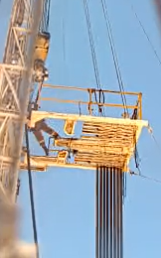
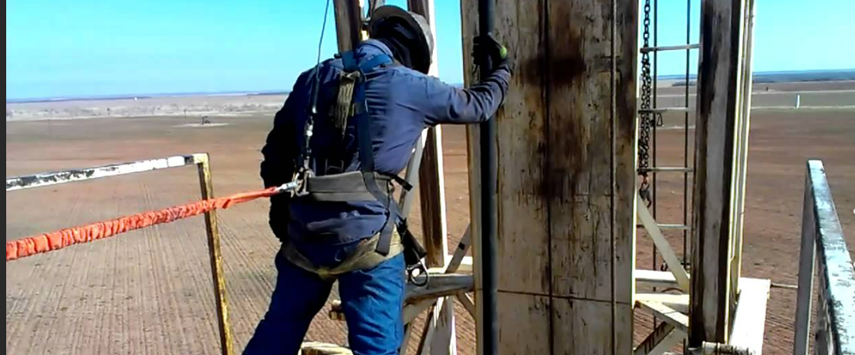
PDO Second Alert
Date: 05/ 05 / 2024 Incident title: HIPO#14 Pattern: Fall from Height Potential severity:C4P Activity: Run-In-Hole (RIH)
Target Audience: Derrickman, Drillers, NTP & Rig Manager
What happened?
On 5 May at 11:45 AM, while working on Hoist-28, a trained Floorman was covering for the Derrickman, who had stepped away for a short rest. After completing the acid soak and preparing to Run-In-Hole (RIH) to displace the acid, the Floorman attempted to latch a stand into the elevator without securing his safety lanyard. While leaning forward, he lost his balance and stumbled toward the mast. He managed to grab onto the mast, and his safety harness prevented a fall. After recovering, he returned to the Monkey Board and properly secured himself to the safety lanyard. No injury occurred.
Why it happened? Finding:
The work plan was not confirmed with the Floorman to ensure he understood his responsibilities, particularly the requirement to use fall protection while RIH. Although he had completed Work-at-Height training, it was overlooked that he had not performed Derrickman duties for over a month.
The lanyard was available and in good condition, but the Floorman failed to inspect or attach it as required.
The Driller discussed preparations with the Assistant Driller, but did not verify that the Floorman on the Monkey Board had his fall protection lanyard attached.
An experienced Floorman was substituting for the Derrickman, but there was poor communication between the Driller and the Derrickman to confirm the lanyard was secured. During the Toolbox Talk, there was only a general discussion about working at height, the team was advised to wear safety shoes and use fall arrestors, but no specific verification occurred.
the Driller lacked adequate supervision during operations on the Monkey Board.
No designated person was assigned during the Toolbox Talk to monitor or assist the Driller in confirming that the Floorman was wearing his lanyard, nor was it confirmed that the Floorman fully understood his duties on the Monkey Board.
The Floorman failed to connect his safety lanyard, and no crew member intervened to stop the unsafe act.
Your learning from this incident:
Always ensure all Musta’ed steps are implemented.
Always ensure every team member understands their safety duties and responsibilities.
Always focus on one task at a time, especially when working at height.
Always ensure effective supervision is in place during high-risk operations.
Always ensure clear, direct communication between the Driller and Derrickman (or substitute).
Always ensure the Toolbox Talk is effective, not just a formality. Confirm understanding and assign accountability.
Always wear full fall protection (safety harness, lanyard, and fall arrester) when working at height, no exceptions.
Always stop an unsafe act or condition, intervene immediately if you see someone at risk.
Photo explaining what was done wrong
DM to always ensure lanyard and fall arrestor are attached to the safety harness before starting the activity
Notes:
Ensure all dates and titles are input
A short description should be provided without mentioning names of contractors or individuals. You should include, what happened, to who (by job title) and what injuries this resulted in. Nothing more!
Four to five bullet points highlighting the main findings from the investigation. Remember the target audience is the front line staff so this should be written in simple terms in a way that everyone can understand.
The strap line should be the main point you want to get across
The images should be self explanatory, what went wrong (if you create a reconstruction please ensure you do not put people at risk) and below how it should be done.

Slide 2
Effective Learning
Date: 05/05/2024 Incident title: working at height Pattern: HIPO Potential severity: C5P
To make sure learning is translated to the site day to day activities , please answer the below questions :-
How learning can be implemented at site ?
Assure SOP are reviewed in TBT and good understanding of task by crew.
Assure derrick man or acting Derrickman using the safety lanyard for monkey board while working on it
Assure adequate communication between driller and derrick man while working on the derrick.
Assure to always monitor the CCTV, ensure everything is safe before starting working in Monkey Board
How can you sustain the action ?
Carryout awareness campaign among units on working at height including attaching the lanyard to the harness
Paging system enhancement communication between Derrickman and Driller.
Revised Standard Operating Procedure to cover the working at height requirement.
Disclaimer
This document is provided for information only. It may not be relied upon for any purpose. Neither PDO nor any party providing information for this document accepts any liability for its accuracy, completeness, omissions, advice, or any consequences arising from its use, even if reasonable care was not exercised. No representation or warranty, express or implied, is made that following this document will achieve any specific results or meet any legal or regulatory requirements. This document does not constitute technical advice; consult a qualified professional if such advice is needed
Notes:
Guideline for Effective Learning & Sustainability
•Can be replicated across similar contractor / activities
•Shall be SMART- Specific ,Measurable , Achievable ,Realistic & Timebound
•Can be implemented in a months' time

Slide 3
PDO Second Alert
Date: 05/ 05 / 2024 Incident title: HIPO#14 Pattern: Fall from Height Potential severity:C4P Activity: RIH Run-In-Hole (RIH)
الفئة المستهدفة: ديريك مان، حفار، نايت بوشر، مدير الحفر
Photo explaining what was done wrong
ماذا حدث؟
في 5 مايو الساعة 11:45 صباحا ، الرافعة 28 ، بعد الانتهاء من نقع الحمض وأثناء الاستعداد ل RIH لإزاحة الحمض ، كان رجل الطابق المدرب يغطي Derrickman الذي ذهب لقضاء فترة راحة قصيرة. فشل Floorman في تأمين حبل الأمان الخاص به بينما كان يغلق الحامل على المصعد. تسبب الانحناء إلى الأمام دون ضبط حبل الأمان في فقدان Floorman للتوازن والتعثر نحو الصاري. كان قادرا على التمسك بالصاري. ومنعه حزام الأمان من السقوط. بعد التعافي ، عاد إلى Monkey Board وقام بتأمين نفسه بشكل صحيح على حبل الأمان. لم يصب بأذى.
لماذا حدث هذا؟ ايجاد:
لم يتم تأكيد الخطة للتأكد من أن رجل الأرضية يفهم مسؤولياته ، لا سيما في استخدام مانع السقوط أثناء RIH. على الرغم من أنه حضر العمل في تدريب المرتفعات ، إلا أنه تم التغاضي عن أنه لم يعمل كرجل ديريكمان لمدة شهر. فحص المعدات: كان الحبل متاحا في حالة جيدة ، لكن رجل الأرضية فشل في فحصه وفحصه كما هو مطلوب. منطقة
ناقش الحفار الاستعدادات مع مساعد الحفار ، لكنه فشل في التأكد من أنFloorman على لوحة قد تم إرفاق حبل الحماية من السقوط.
رجل الطابق من ذوي الخبرة يحل محل رجل ديريك ولكن كان هناك اتصال ضعيف بين الحفار وداريك مان لإعطاء إشارة مناسبة لتأكيد أنه متصل بالحبل. خلال حديث Toolbox ، كان هناك نقاش عام حول المخاطر المرتبطة بالعمل في المرتفعات ، ونصح فقط باستخدام أحذية السلامة ومانع السقوط. الحفار يفتقر إلى الإشراف أثناء التشغيل في Monkey Board ..
شخص غير معين بشكل كاف لكل عنصر تحكم في الخطر أثناء مناقشة نقاش صندوق الأدوات لمساعدة الحفار على التحقق من رجل الأرضية الذي يرتدي الحبل والفشل في تأكيد فهم رجل الأرضية لواجبه في Monkey Board.
فشل Floorman في توصيل حبل الأمان الخاص به ولم يتدخل أي شخص آخر في الطاقم لإيقافه
تعلمك من هذه الحادثة:
تأكد دائما من تنفيذ جميع خطوات مستعد. تأكد دائما من أن كل منصب يعرف واجباته ومسؤولياته المتعلقة بالسلامة.
تأكد دائما من التركيز على مهمة واحدة في كل مرة.
تأكد دائما من وجود إشراف فعال.
تأكد دائما من وجود اتصال فعال بين الحفار وديريكمان. دائما ،
تأكد من فعالية نقاش صندوق الأدوات قبل المهمة. تأكد دائما من ارتداء الحماية من السقوط (حزام أمان وحبل ومانع للسقوط) عند العمل على ارتفاع.
تأكد دائما من إيقاف أي فعل أو حالة غير آمنة.
DM للتأكد دائما من توصيل الحبل ومانع السقوط بحزام الأمان قبل بدء النشاط
Notes:
Ensure all dates and titles are input
A short description should be provided without mentioning names of contractors or individuals. You should include, what happened, to who (by job title) and what injuries this resulted in. Nothing more!
Four to five bullet points highlighting the main findings from the investigation. Remember the target audience is the front line staff so this should be written in simple terms in a way that everyone can understand.
The strap line should be the main point you want to get across
The images should be self explanatory, what went wrong (if you create a reconstruction please ensure you do not put people at risk) and below how it should be done.

