Slide 1
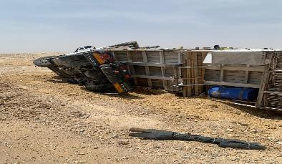

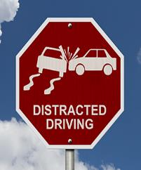
PDO Second Alert
Date: 27/06/2024 Incident title: HiPo#15 Pattern: MVI Potential severity: D4P Activity: Driving
Target Audience: Logistics, Operation & Construction
What happened?
On 27th June,2024 at 12:11 hrs a sub-contracted truck loaded with chemical bags on route to Fahud
supply yard was involved in rollover incident when the driver was not able to control the vehicle as he
descended an incline and veered on to a damaged section of the road embankment where it tipped over
onto its right side. The driver was taken to PDO clinic, where he was assessed with a minor abrasion on
right hand.
Why it happened/Finding :
Driving not focused on road and road conditions.
Ineffective communication of road related hazards.
Inadequate review of road hazards and communication.
Your learning from this incident..
Always stay cautious on the road.
Do not get distracted during driving.
Do not concurrently engage in activities while driving.
Always anticipate unexpected events and adhere to defensive driving techniques.
Adhere to defensive driving techniques and stay cautious on the road.
Notes:
Ensure all dates and titles are input
A short description should be provided without mentioning names of contractors or individuals. You should include, what happened, to who (by job title) and what injuries this resulted in. Nothing more!
Four to five bullet points highlighting the main findings from the investigation. Remember the target audience is the front line staff so this should be written in simple terms in a way that everyone can understand.
The strap line should be the main point you want to get across
The images should be self explanatory, what went wrong (if you create a reconstruction please ensure you do not put people at risk) and below how it should be done.

Slide 2
Management self audit
Date: 27/06/2024 Incident title: HiPo#15 Pattern: MVI Potential severity: D4P Activity: Driving
As a learning from this incident and ensure continual improvement all contract managers must review their HSE risk management against the questions asked below
Confirm the following:
Do you ensure that the drivers are reiterated on the defensive driving techniques?
Do you ensure that the driver cabins are free of objects/item which causes distraction?
Do you encourage your drivers communicate the road hazards?
Do you ensure that the road related hazards communicated from stakeholders are cascaded to your team?
Do you ensure that the subcontractors are audited prior to onboarding?
Do you ensure TBTs are conducted prior to work?
Do you reiterate the workforce on the importance of PDO emergency number?
* If the answer is NO to any of the above questions please ensure you take action to correct this finding
Disclaimer
This document is provided for information only. It may not be relied upon for any purpose. Neither PDO nor any party providing information for this document accepts any liability for its accuracy, completeness, omissions, advice, or any consequences arising from its use, even if reasonable care was not exercised. No representation or warranty, express or implied, is made that following this document will achieve any specific results or meet any legal or regulatory requirements. This document does not constitute technical advice; consult a qualified professional if such advice is needed
Notes:
Ensure all dates and titles are input
Make a list of closed questions (only ‘yes’ or ‘no’ as an answer) to ask others if they have the same issues based on the management or HSE-MS failings or shortfalls identified in the investigation.
Imagine you have to audit other companies to see if they could have the same issues.
These questions should start with: Do you ensure…………………?

