Slide 1
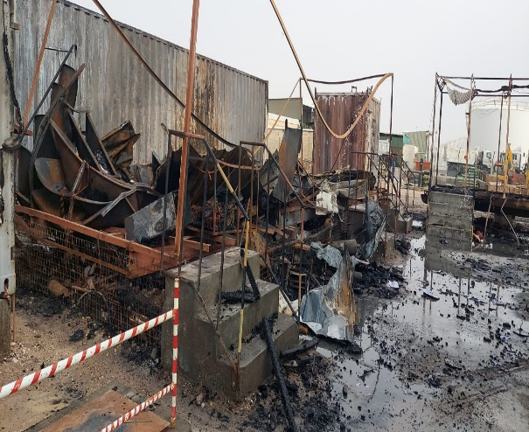

PDO Second Alert
Date:29/06/2024 Incident title:Hipo#16,Equipment/Asset Pattern:Fire/explosion Potential severity: C4P Activity: NA
Target Audience: Drilling, Logistics, Operation & Construction
What happened?
On June 29th at 04:15 am, Wireline Client Service Engineer (WL CSE) was heading to workshop when he observed smoke emanating from the workshop. He promptly called the PDO emergency team and reported the situation. Ten minutes later, the fire team arrived at the location and began fighting the fire. The fire team successfully extinguished the fire without any injuries.
Why it happened/Finding:
CCTV footage suggests that fire started from within vicinity of an isolation switch with loose connection or short circuit
Earth-leakage circuit breaker failed to trip on time to prevent fire
A smoke detector is in place to signal the presence of fire but alarm was localized
Upon noticing the smoke, the witness promptly contacted the base manager & PDO emergency team
PDO fire team arrived within 10 minutes and promptly prevented spread of fire to other portacabins
Previous electrical integrity inspection was carried out in May.2020
Your learning from this incident..
Ensure monthly ELCB/RCCB trip test and panel cleaning are done by Company electrician
Ensure 3rd party electrical integrity inspection is done every year
Ensure in-house electrical integrity inspection is done every 3 months
Ensure there is a reliable fire detection and alarm system to indicate fires
Ensure to disconnect the power when you leave the workshop and offices
Display reminder stickers in all offices (e.g., TURN OFF ALL LIGHTS, A/C, APPLIANCES)
Always perform regular electrical integrity inspection of facilities to correct identified faults.
Notes:
Ensure all dates and titles are input
A short description should be provided without mentioning names of contractors or individuals. You should include, what happened, to who (by job title) and what injuries this resulted in. Nothing more!
Four to five bullet points highlighting the main findings from the investigation. Remember the target audience is the front line staff so this should be written in simple terms in a way that everyone can understand.
The strap line should be the main point you want to get across
The images should be self explanatory, what went wrong (if you create a reconstruction please ensure you do not put people at risk) and below how it should be done.

Slide 2
Effective Learning
Date:29/06/2024 Incident title:Hipo#16,Equipment/Asset Pattern:Fire/explosion Potential severity: C4P Activity: NA
To make sure learning is translated to the site day to day activities , please answer the below questions :-
How learning can be implemented at site ?
Conduct awareness/learning sessions with employees
Sticker to remind employees to switch off lights and other electrical equipment before leaving office to be displayed on prominent locations in all offices
Monitor and verify annual 3rd party electrical integrity inspections and in-house inspections through the CEO MP and monthly report from Senior Workshop Supervisor
How can you sustain the action ?
By regular audit and inspections
By including this latest fire incident in LFI sessions
Include status review of electrical inspections in monthly HSE meetings
By consistent review of actions listed and taken in the CEO Monitoring Plan
Disclaimer
This document is provided for information only. It may not be relied upon for any purpose. Neither PDO nor any party providing information for this document accepts any liability for its accuracy, completeness, omissions, advice, or any consequences arising from its use, even if reasonable care was not exercised. No representation or warranty, express or implied, is made that following this document will achieve any specific results or meet any legal or regulatory requirements. This document does not constitute technical advice; consult a qualified professional if such advice is needed
Notes:
Guideline for Effective Learning & Sustainability
•Can be replicated across similar contractor / activities
•Shall be SMART- Specific ,Measurable , Achievable ,Realistic & Timebound
•Can be implemented in a months' time

