Slide 1
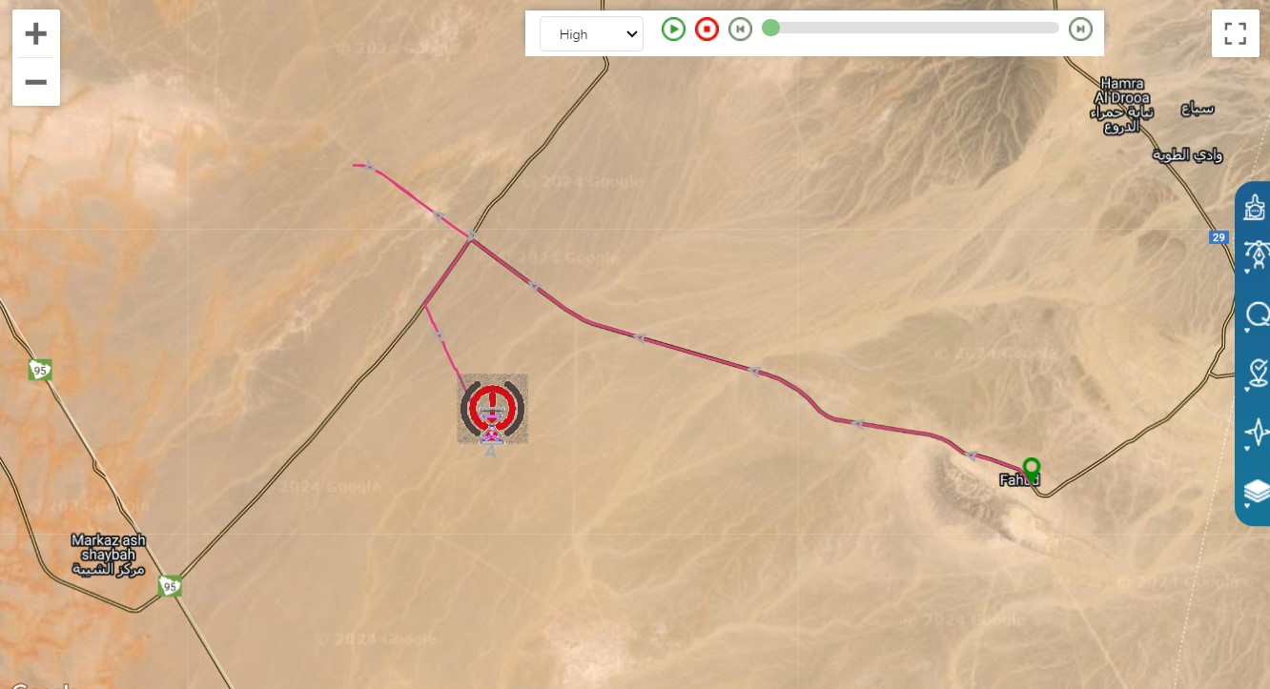
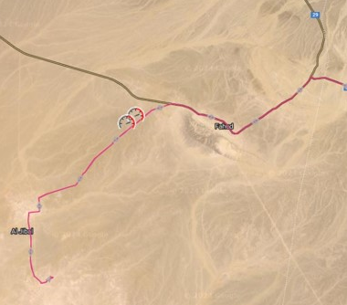
PDO Second Alert
Date:01/07/2024 Incident title: HiPo#17 Pattern: MVI Potential severity: C4P Activity: Cargo Transport
Target Audience: Drilling, Logistics, Operation & Construction
Photo explaining what was done wrong
What happened?
On 01/07/2024, a driver was heading from Fahud to Rig 145 located in Al Huwaisah. During which he
missed the Yibal turn and headed to Lekhwair route and then received the location from the rig
team when he crossed Al Masrooq R/A, while heading back he took another route which was also
wrong and got stuck at 07:30. The Coordinates where he got stuck was Lat 22.3639751, Long
55.8974741. The PDO emergency number was notified at 15:45 by the HSE Advisor in site and the
rig team were notified, and the search began. The driver was found by the rig search party at 17:10
and his vehicle was stuck.
The driver was fine as he was having enough food and water, and the truck had enough diesel to
keep the A/C on. The driver was taken to the rig site where the medic team checked all his vitals and
confirmed he is not dehydrated.
Why it happened/Finding :
Driver started the journey without making sure of the final destination.
JMCC trackers missed to check on the driver for 6 hours
The JM issuing the journey did not explain the final destination to the driver properly
Man lost procedure was initiated late
Your learning from this incident..
JMCC Tracker must always check on all drivers through IVMS and by direct communication
IVMS need to be unified to avoid delay in monitoring the vehicles
An interface between both JM issuing the journey and JMCC tracking team should have been in place to ensure monitoring of Journeys from Duqm base as well (now in place)”.
Photo explaining how it should be done right
Don’t proceed with your journey unless you are sure of the Destination
Notes:
Ensure all dates and titles are input
A short description should be provided without mentioning names of contractors or individuals. You should include, what happened, to who (by job title) and what injuries this resulted in. Nothing more!
Four to five bullet points highlighting the main findings from the investigation. Remember the target audience is the front line staff so this should be written in simple terms in a way that everyone can understand.
The strap line should be the main point you want to get across
The images should be self explanatory, what went wrong (if you create a reconstruction please ensure you do not put people at risk) and below how it should be done.

Slide 2
Effective Learning
Date: 01/07/2024 PIM Number: 1167867 Pattern: MVI Potential severity: C4P
To make sure learning is translated to the site day to day activities , please answer the below questions :-
How learning can be implemented at site ?
Through awareness for other drivers and full JMCC team on the man lost procedure
Continuous monitoring from the Management
How can you sustain the action ?
AMLS Management will be directly monitoring the Dashboard to make sure all checks on drivers are done on time
Continuous training and awareness
Disclaimer
This document is provided for information only. It may not be relied upon for any purpose. Neither PDO nor any party providing information for this document accepts any liability for its accuracy, completeness, omissions, advice, or any consequences arising from its use, even if reasonable care was not exercised. No representation or warranty, express or implied, is made that following this document will achieve any specific results or meet any legal or regulatory requirements. This document does not constitute technical advice; consult a qualified professional if such advice is needed
Notes:
Guideline for Effective Learning & Sustainability
•Can be replicated across similar contractor / activities
•Shall be SMART- Specific ,Measurable , Achievable ,Realistic & Timebound
•Can be implemented in a months' time

Slide 3
PDO Second Alert
Date: 01/07/2024 Incident title: HIPO#17 , Near Miss Pattern: MVI Potential severity: C4P
الفئة المستهدفة: الحفر والخدمات اللوجستية والتشغيل والبناء
صورة توضح الخطأ الذي حدث
ماذا حدث؟
بتاريخ 01/07/2024 كان سائق متوجها من فهود إلى منصة 145 الواقعة في الحويسة. أخطأ خلاله السائق من اخذ منعطف جبال وتوجه إلى طريق لخوير ثم حصل على الموقع من فريق الحفارة عندما عبر دوار مسروق ، أثناء عودته متابعا للموقع من جوجل ماب، سلك طريقا آخر كان خاطئا أيضا. في الساعة 07:30 وصل منطقة و غرز. الإحداثيات التي فيها كانت Lat 22.3639751 ، Long 55.8974741. تم إخطار رقم الطوارئ لشركة تنمية نفط عمان في الساعة 15:45 من قبل مستشار الصحة والسلامة والبيئة في الموقع وتم إخطار فريق الحفارة وبدأ البحث. تم العثور على السائق من قبل فريق الحفارة في الساعة 17:10 وكانت سيارته عالقة.
كان السائق بخير لأنه كان لديه ما يكفي من الطعام والماء ، وكان لدى الشاحنة ما يكفي من الديزل للحفاظ على مكيف الهواء. تم نقل السائق إلى موقع الحفارة حيث قام الفريق الطبي بفحص جميع عناصره الحيوية وأكد أنه لا يعاني من الجفاف.
نتائج التحقيق:
.بدأ السائق الرحلة دون التأكد من الوجهة النهائية.
فريق التتبع تاخروا للاطمئنان على السائق لمدة 6 ساعات
لم يشرح مدير الرحلة الذي أصدر الرحلة الوجهة النهائية للسائق بشكل صحيح
بدأ إجراء عملية فقدان الرجل في وقت متأخر.
الدروس المستفادة من الحادثة:
.يجب على فريق التتبع التحقق من جميع السائقين من خلال IVMS وعن طريق الاتصال المباشر (whatsapp أو المكالمات) في كل الاوقات
يجب توحيد نظام IVMS لتجنب التأخير في مراقبة المركبات
كان من المفترض أن تكون هناك واجهة بين كل من JM الذي يصدر الرحلة وفريق التتبع JMCC لضمان مراقبة الرحلات من قاعدة الدقم أيضًا (موجود الآن)".
صورة توضح كيفية القيام بذلك بشكل صحيح
لا تتابع رحلتك إلا إذا كنت متأكدا من الوجهة الاخيرة
Notes:
Ensure all dates and titles are input
A short description should be provided without mentioning names of contractors or individuals. You should include, what happened, to who (by job title) and what injuries this resulted in. Nothing more!
Four to five bullet points highlighting the main findings from the investigation. Remember the target audience is the front line staff so this should be written in simple terms in a way that everyone can understand.
The strap line should be the main point you want to get across
The images should be self explanatory, what went wrong (if you create a reconstruction please ensure you do not put people at risk) and below how it should be done.

