Slide 1
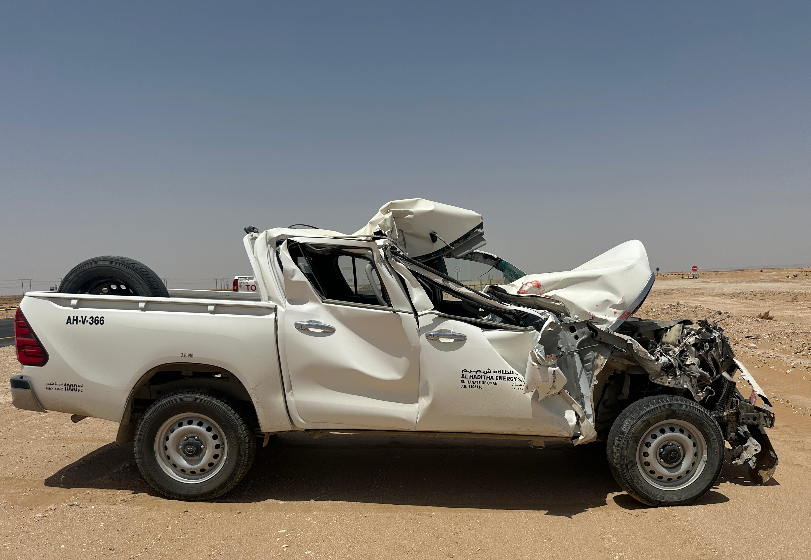
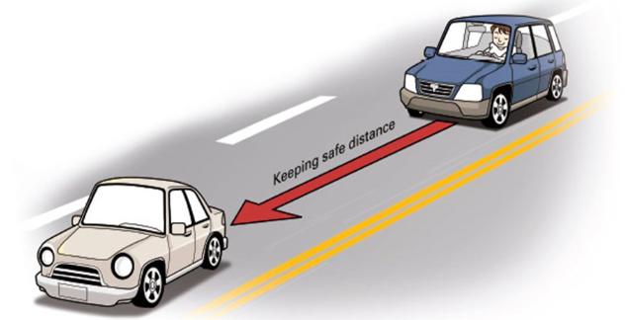
PDO Second Alert
Date: Time: | 23/05/2025 12:26 Hrs | Incident title: PIM# | HiPo# 17 1178124 | Risk Category: Injury / Asset Damaged: | MVI Vehicle damage | Actual Severity: Potential severity: | 1P, 2A D4PA | Activity: Location: | Driving Yibal
Target Audience: Logistics, Operation & Construction
What happened?
A pickup vehicle travelling from Adam to Yibal camp, collided with the left rear end of a third-party trailer, near the Khulud area at Fahud-Yibal road. The driver sustained minor scratches on forearms, and the pickup sustained extensive damage.
Why it happened/Finding:
Pickup driver was driving too close to the Trailer.
Lack of attention while driving.
Driver was possibly fatigued from poor sleep the previous night.
Reflective Questions
Are you ensuring to maintain a safe distance from up front vehicle?
Are you observing the behavior of third-party drivers to be safe while driving?
Are you ensuring the driver is not fatigued?
Are you complying with Defensive Driving Techniques?
Always Maintain safe distance and Apply defensive driving!
Notes:
Ensure all dates and titles are input
A short description should be provided without mentioning names of contractors or individuals. You should include, what happened, to who (by job title) and what injuries this resulted in. Nothing more!
Four to five bullet points highlighting the main findings from the investigation. Remember the target audience is the front line staff so this should be written in simple terms in a way that everyone can understand.
The strap line should be the main point you want to get across
The images should be self explanatory, what went wrong (if you create a reconstruction please ensure you do not put people at risk) and below how it should be done.

Slide 2
Management Reflective Questions
As a learning from this incident and ensure continual improvement all contract managers must review their HSE risk
management against the questions asked below
Confirm the following:
- Do you ensure the compliance of road safety requirements?
- Do you ensure the drivers are not fatigued?
- Do you ensure the drivers are up to date and complying with LSR – Driving?
- Do you ensure all the drivers are fit the work?
Notes:
Ensure all dates and titles are input
Make a list of closed questions (only ‘yes’ or ‘no’ as an answer) to ask others if they have the same issues based on the management or HSE-MS failings or shortfalls identified in the investigation.
Imagine you have to audit other companies to see if they could have the same issues.
These questions should start with: Do you ensure…………………?

