Slide 1
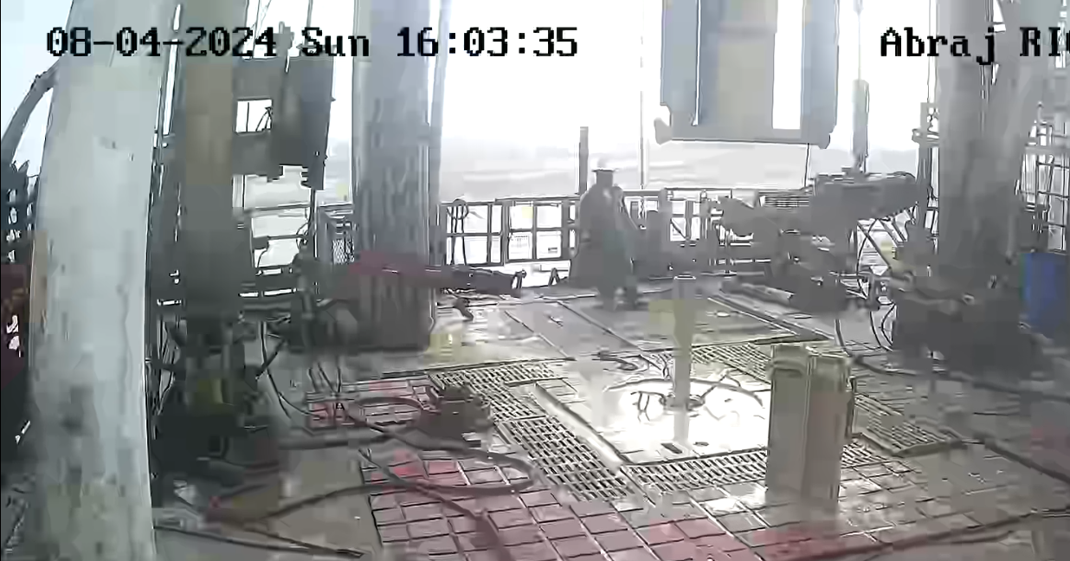
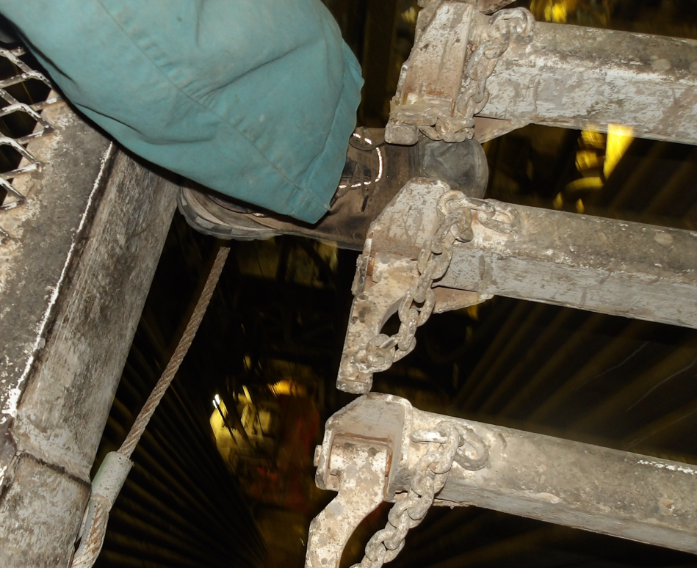
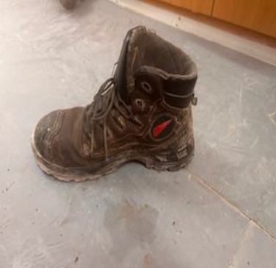
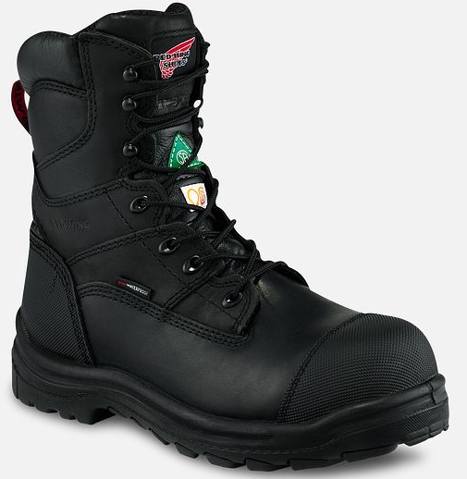
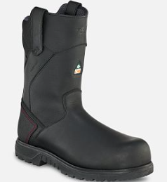
PDO Second Alert
Date: 04.08.2024 Incident title: Safety boot dropping from monkey board to rig floor Pattern: NRM Potential severity: C3P Activity: Pooh operation
Target Audience: Drilling, Logistics, Operation & Construction
What happened?
On 4th August 2024 At 16:03 during POOH operation on stand no. 39, The derrickman was opening the safety lock of racking finger by using his safety boot, while doing this he caught the heel of his safety boot on the edge of diving board, Resulting in the safety boot dropping from monkey board to rig floor set back area, during the event there was one floor man at rig floor area out of red zone. Fortunately, No personal injury or equipment damaged reported.
Boot weighs 0.5kg dropped 26m, incident reported by site team
Why it happened/Finding :
• All Control of work was in place, and TBT held prior to start the work with all involved person.
• Derrickman start the work wearing safety boot with laces loose, there was no intervention from crew member or supervisors.
• The paging system and CCTV was functioning at monkey board.
• Zone management was well maintained at rig floor
Your learning from this incident..
• Always ensure correct size and utilization of PPE.
• Always intervene to stop any unsafe practice.
• Ensure to inspect/check all PPE before working at height activities
• Ensure to discuss 7 steps of Mustae’d effectively prior to start the job.
The derrickman safety boots get caught the heel on the edge of diving board.
Ensure your safety boot are fit size, condition and tightened laces.
Always ensure to utilize PPE correctly, size, condition, tightened laces, design, fit for purpose

Slide 2
Management self-audit
Date: 04.08.2024 Incident title: Safety boot dropping from monkey board to rig floor Pattern: NRM Potential severity: C3P
As a learning from this incident and ensure continual improvement all contract managers must review their HSE risk management against the questions asked below
Confirm the following:
Do you ensure that all crew are aware of correct way to use PPE safety boots ?
Do you ensure supervisors check PPE before working at height activity ?
Do you ensure crew have the correct PPE suitable for task ?
Do you ensure that all involved personnel attend TBT meeting (Musta’ed) prior to start the task?
* If the answer is NO to any of the above questions please ensure you take action to correct this finding
Disclaimer
This document is provided for information only. It may not be relied upon for any purpose. Neither PDO nor any party providing information for this document accepts any liability for its accuracy, completeness, omissions, advice, or any consequences arising from its use, even if reasonable care was not exercised. No representation or warranty, express or implied, is made that following this document will achieve any specific results or meet any legal or regulatory requirements. This document does not constitute technical advice; consult a qualified professional if such advice is needed
Notes:
Ensure all dates and titles are input
Make a list of closed questions (only ‘yes’ or ‘no’ as an answer) to ask others if they have the same issues based on the management or HSE-MS failings or shortfalls identified in the investigation.
Imagine you have to audit other companies to see if they could have the same issues.
These questions should start with: Do you ensure…………………?

Slide 3
PDO Second Alert
Date: 04.08.2024 Incident title: Safety boot dropping from monkey board to rig floor Pattern: NRM Potential severity: C3P Activity: Pooh Operation
الفئة المستهدفة: قسم الحفر والعمليات وقسم الصيانة
ماذا حدث؟
بتاريخ 04.08.2024 في الساعة 16:03 16:03 أثناء عملية POOH وعند الوصول الى الأنبوب رقم 39، كان عامل المنصة يفتح قفل الأمان باستخدام حذاء الأمان الخاص به، وأثناء القيام بذلك، علق كعب حذاء الأمان الخاص به على حافة لوح المنصة، مما أدى إلى سقوط حذاء الأمان من لوح المنصة إلى منطقة أرضية منصة الحفر، وخلال الحدث كان هناك عامل منصة الحفر في أرضية المنصة خارج المنطقة الحمراء. لحسن الحظ، لم يتم الإبلاغ عن أي إصابة شخصية أو تلف للمعدات.
وزن الحذاء 0.5 كجم سقط من ارتفاع 26 مترًا، وأبلغ فريق الموقع عن الحادث
نتائج التحقيق:
تم وضع كل وسائل التحكم في العمل، وتم عقد اجتماع ما قبل بدء العمل مع جميع الأشخاص المعنيين.
بدأ عامل منصة الحفر العمل مرتديًا حذاء أمان بأربطة غير محكمة بالشكل الصحيح، ولم يكن هناك أي تدخل من أفراد الطاقم أو المشرفين.
كان نظام النداء وكاميرات المراقبة تعمل في لوحة التحكم.
تم الحفاظ على إدارة أرضية منصة الحفر بشكل جيد.
الدروس المستفادة من الحادثة:
تأكد دائمًا من استخدام معدات الوقاية الشخصية بالحجم الصحيح والاستخدام الصحيح لها.
التأكد من التدخل دائمًا لوقف أي ممارسة غير آمنة.
تأكد من فحص جميع معدات الحماية الشخصية قبل بدء العمل في الأماكن المرتفعة.
تأكد من مناقشة الخطوات السبع لبرنامج مستعد التي يجب اتباعها بشكل فعال قبل بدء العمل.
علق كعب حذاء الأمان الخاص بعامل المنصة على حافة لوح المنصة.
تأكد من أن حذاء الأمان الخاص بك مناسب للقدم وفي حالة جيدة والأربطة محكمة.
تأكد دائمًا من استخدام معدات الوقاية الشخصية بشكل صحيح، وحجمها، وحالتها، وشد الأربطة، وتصميمها، وملائمتها لغرض العمل.
Notes:
Ensure all dates and titles are input
A short description should be provided without mentioning names of contractors or individuals. You should include, what happened, to who (by job title) and what injuries this resulted in. Nothing more!
Four to five bullet points highlighting the main findings from the investigation. Remember the target audience is the front line staff so this should be written in simple terms in a way that everyone can understand.
The strap line should be the main point you want to get across
The images should be self explanatory, what went wrong (if you create a reconstruction please ensure you do not put people at risk) and below how it should be done.

Slide 4
Effective Learning
Date: 04.08.2024 PIM Number: Pattern: NRM Potential severity: C3P
To make sure learning is translated to the site day to day activities , please answer the below questions :-
How learning can be implemented at site ?
Share Incident alert with all units and discuss it with all crew members at site.
Ensure that Derrick-man On Boarding Program is communicated with all derrick-men
How can you sustain the action ?
Conduct self verification to verify the implementation of action.
Conduct self-verification to verify that Safety boot and PPE checks are part of working at Hight register
Notes:
Guideline for Effective Learning & Sustainability
•Can be replicated across similar contractor / activities
•Shall be SMART- Specific ,Measurable , Achievable ,Realistic & Timebound
•Can be implemented in a months' time

