Slide 1
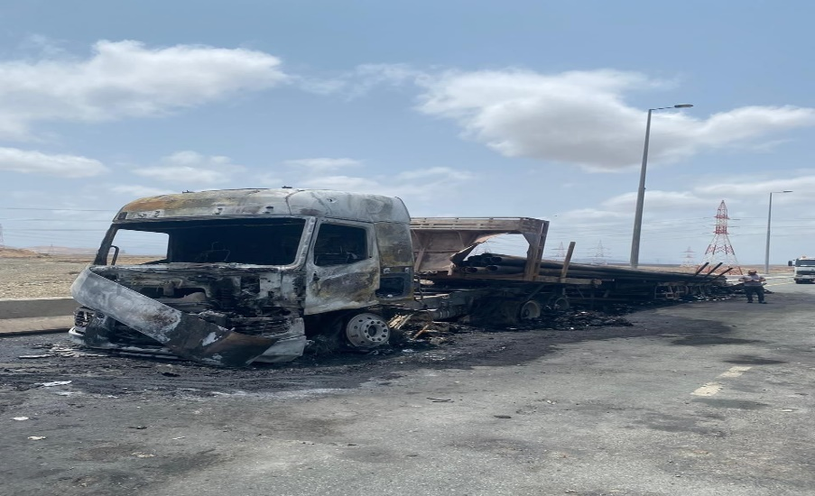
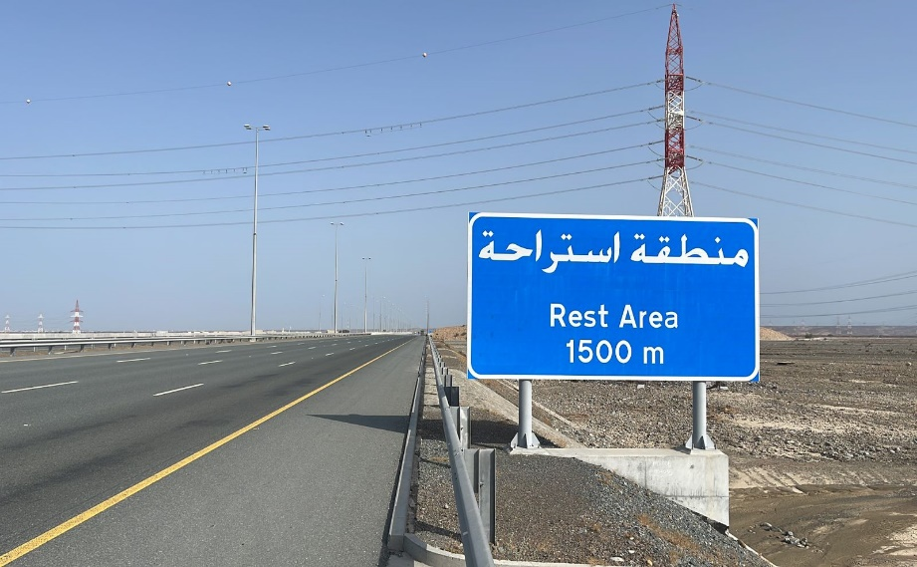
PDO Second Alert
Date: 08/08/2024 Incident title: 3rd party HIPO Pattern: MVI Potential severity: C 4P Activity: Driving
Target Audience: Logistics
What happened?
On 08th August 2024, at 08:45hrs, A sub-contracted tractor unit coupled with 60 ft flatbed trailer with load of pipes experienced a tire puncture while in transit at Sohar expressway. The driver maneuvered and stopped the truck in emergency lane. A TP truck loaded with chemicals from Dubai struck the vehicle from rear side at the emergency lane. As a result of the crash, a fire broke out. Both the trucks sustained extensive damage from the fire. The driver was taken to Sohar Hospital for treatment, where he was found to have sustained cuts and bruises.
Why it happened/Finding :
The Sub – Contractor driver did not apply defensive driving techniques after seeing a break down vehicle on a straight stretch.
The warning triangle wasn’t placed far enough to attract the attention of other drivers.
The Sub – Contractor driver did not park the vehicle to the safe area.
The sub-contractor management communication on third party vehicle risks was inadequate.
Your learning from this incident.
Always stay cautious on the road.
Call SJM on the breakdown during transit and plan the recovery/repair.
Always move to a safe area in the event of a breakdown.
Always anticipate unexpected events and adhere to defensive driving techniques.
Always ask for assist during a breakdown.
Always ensure that safe area is identified and immediately evacuated on to !
Notes:
Ensure all dates and titles are input
A short description should be provided without mentioning names of contractors or individuals. You should include, what happened, to who (by job title) and what injuries this resulted in. Nothing more!
Four to five bullet points highlighting the main findings from the investigation. Remember the target audience is the front line staff so this should be written in simple terms in a way that everyone can understand.
The strap line should be the main point you want to get across
The images should be self explanatory, what went wrong (if you create a reconstruction please ensure you do not put people at risk) and below how it should be done.

Slide 2
Management self audit
Date: 08/08/2024 Incident title: HIPO Pattern: MVI Potential severity: C4P Activity: Driving
As a learning from this incident and ensure continual improvement all contract managers must review their HSE risk management against the questions asked below
Confirm the following:
Do you ensure that the JM is informed in the event of a breakdown?
Do you ensure that the driver is aware on safe area in the event of a breakdown?
Do you ensure that the driver is educated on the proper distance to place a warning triangle in case of an emergency?
Do you ensure that the TP road related hazards communicated from stakeholders are cascaded to your team?
* If the answer is NO to any of the above questions please ensure you take action to correct this finding
Disclaimer
This document is provided for information only. It may not be relied upon for any purpose. Neither PDO nor any party providing information for this document accepts any liability for its accuracy, completeness, omissions, advice, or any consequences arising from its use, even if reasonable care was not exercised. No representation or warranty, express or implied, is made that following this document will achieve any specific results or meet any legal or regulatory requirements. This document does not constitute technical advice; consult a qualified professional if such advice is needed
Notes:
Ensure all dates and titles are input
Make a list of closed questions (only ‘yes’ or ‘no’ as an answer) to ask others if they have the same issues based on the management or HSE-MS failings or shortfalls identified in the investigation.
Imagine you have to audit other companies to see if they could have the same issues.
These questions should start with: Do you ensure…………………?

