Slide 1
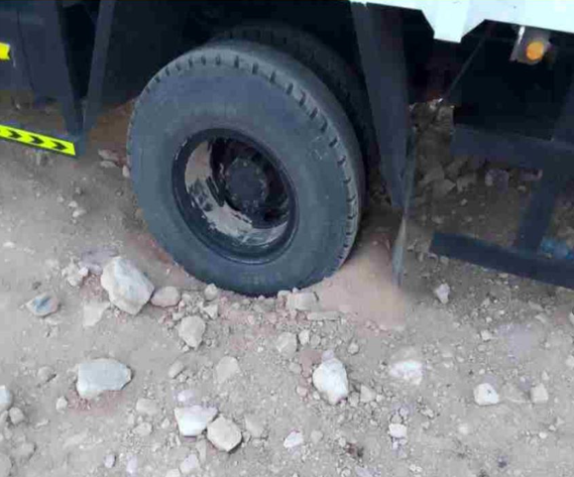

PDO Second Alert
Date: 27/08/2024 Incident title: HiPo#25 Pattern: Man Lost Potential severity: C4P Activity: Driving
Target Audience: All Field Operations
What happened?
On 27-08-2024 around 05:46 PM after delivering fishing tools to WTU# 8 and on its way to Awn2 (WTU# 12) by a heavy vehicle truck on a journey management plan got stuck on the graded road (Al Noor –Awn2 shortcut road). Driver tried to release the vehicle with different attempts but without success. He tried to call for support with no success due to being in non-coverage area. As night started, driver decided to stay within vehicle cabin over night (Equipped with bed and sufficient water (~10 liters) with light snacks).
Next day early morning (around 0600 am), driver walked for 8.2 km to get the signal and report the incident (man lost). A nearby vehicle was sourced and sent to the incident location. Driver was found healthy and was taken to a nearby camp for rest.
Why it happened/Finding:
The Journey plan was in place for the trip along with certified driver and truck. However, route from Al Noor – Awns 2 via Marmul was not specified
Truck and tools were inspected and found satisfactory.
Road was not accessible to pass through (Shortcut).
No effective communication between driver and JM after receiving JMP.
Driver took shortcut route, no communication between driver & journey manager and no trip monitoring/ closure.
Your learning from this incident:
• Always ensure effective journey management procedure (plan, monitor, close and handover ) is followed
• Assure emergency response related to Man Lost protocol is initiated when required.
• Always avoid shortcut routes and verify from IVMS monitoring
• Always follow effective communication between all parties (Driver, JM and JMC)
Follow your Safe Journey Management Procedure and escalation process
Always Ensure Effective Implementation of Journey Management Procedure.
Notes:
Ensure all dates and titles are input
A short description should be provided without mentioning names of contractors or individuals. You should include, what happened, to who (by job title) and what injuries this resulted in. Nothing more!
Four to five bullet points highlighting the main findings from the investigation. Remember the target audience is the front line staff so this should be written in simple terms in a way that everyone can understand.
The strap line should be the main point you want to get across
The images should be self explanatory, what went wrong (if you create a reconstruction please ensure you do not put people at risk) and below how it should be done.

Slide 2
Management Self-audit
Date: 27/08/2024 Incident title: HiPo#25 Pattern: Man Lost Potential severity: C4/P Activity: Driving
As a learning from this incident and ensure continual improvement all contract managers must review their HSE risk management against the questions asked below
Confirm the following:
Do you ensure journey management procedure (planning, monitoring, closure & handover) is enforced including sub-contractors?
Do you ensure man-lost is initiated when required?
Do you ensure drivers use main roads and avoid shortcuts roads?
Do you ensure effective handover/ resources available when dedicated JM leave for any reason?
* If the answer is NO to any of the above questions please ensure you take action to correct this finding
Disclaimer
This document is provided for information only. It may not be relied upon for any purpose. Neither PDO nor any party providing information for this document accepts any liability for its accuracy, completeness, omissions, advice, or any consequences arising from its use, even if reasonable care was not exercised. No representation or warranty, express or implied, is made that following this document will achieve any specific results or meet any legal or regulatory requirements. This document does not constitute technical advice; consult a qualified professional if such advice is needed
Notes:
Ensure all dates and titles are input
Make a list of closed questions (only ‘yes’ or ‘no’ as an answer) to ask others if they have the same issues based on the management or HSE-MS failings or shortfalls identified in the investigation.
Imagine you have to audit other companies to see if they could have the same issues.
These questions should start with: Do you ensure…………………?

Slide 3
Management Self-audit
Date: 27/08/2024 Incident title: HiPo#25 Pattern: Man Lost Potential severity: C4P Activity: Driving
To make sure learning is translated to the site day to day activities , please answer the below questions:
How learning can be implemented at site ?
Close monitoring of all JM plan including subcontractors.
Second alert to be discussed effectively with all drivers and Journey managers.
Enforce implementation of JM procedure (handover, monitoring, communication, rest time, route verification and man lost initiation).
How can you sustain the action ?
1. Conduct random checks at departure and arrival points of trucks to verify trips are under effective journey management.
2. Effective monitoring of sub-contractors driving activities (e.g.: main contractor to manage Journey Management)
3. Conduct frequent man-lost drills covering all journey managers.
4. Conduct effective TBT with drivers and journey managers to refresh and enforce JM controls.
5. Conduct frequent assurance practices to verify effective implementation of JM procedure (Trip audit, inspection, JM audit..etc.).
Notes:
Ensure all dates and titles are input
Make a list of closed questions (only ‘yes’ or ‘no’ as an answer) to ask others if they have the same issues based on the management or HSE-MS failings or shortfalls identified in the investigation.
Imagine you have to audit other companies to see if they could have the same issues.
These questions should start with: Do you ensure…………………?

