Slide 1
HiPo#35, PIM # 1170964, 01-October-2024, Halliburton
Tanker Rolled onto its side in Burhan-Awaifia Road
Causal Reasoned 5 Whys
Investigation Report
Confidential - Not to be shared outside of PDO/PDO contractors

Slide 2
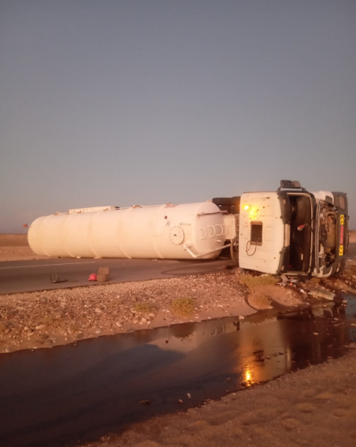
HiPo#35, PIM # 1170964, 01-October-2024, Halliburton
Confidential - Not to be shared outside of PDO/PDO contractors
Notes:
Only include a SINGULAR photograph that can add value explaining the incident or causes.
Ensure photo is of suitable clarity.

Slide 3
HiPo#35, PIM # 1170964, 01-October-2024, Halliburton
Incident Details
PDO directorate/dept | UPD | Incident Owner | UPK
Incident Classification | RO | PIM No | 1170964
Incident Location | Burhan-Awaifia Road |  | Date/Time | 01-10-2024 / 16:26
Contractor Name/Number | Peace Land-Halliburton-PDO/C311697
Actual RAM Rating | 1E
Potential RAM Rating | C4P, C4A, C3E
Incident Description
On 01 Oct 2024, The PL tanker dispatched from rig-132 early morning in a convoy at 06:31 and arrived to rig-63 backloaded WBM (22.5 m3/30 m3 at 12.8 kpa/m), job was completed around 1523hr then truck dispatched from rig heading to Fahud LMP as per journey plan. On his way to Fahud LMP, over Burhan-Awaifia road @1626hrs, driver fall a sleep, and the tanker partially deviated outside of the road and then immediately steered back the tanker to main road and applied harsh braking at speed 71 km/h leading to tanker rollover. Driver came off the truck cabin with help of road user and he was feeling pain in left leg . He reported the incident to PL Supervisor in Fahud, HSE and Supervisor. PDO, ROP emergency, ambulance informed about the incident and HSE team with Supervisor moved to the incident location. The IP transferred by PDO ambulance to Nizwa Badr Al Sama for further checkup. IP was discharged from Badr Al Sama Hospital; no injuries were reported. <1 m3 of WBM (Non-hazardous Materials) was spilled on the ground. Emergency service, including PDO emergency team and ROP, responded promptly to the incident. The tanker was successfully moved off the road, and WBM in the tanker was successfully backloaded in another tanker and spilled WBM contained in Tipper and disposed in approved yard in Fahud.
Problem Statement
Expected |  | The tanker Driver to maintain stable driving on the road without incident.
Actual |  | The tanker unexpectedly rolled onto its side. Applying harsh braking at speed of 71km/h and turning tanker 40 degrees leading to loss control and rollover due to fluid movement inside tanker
Impact | Actual Consequence | Driver received minor pain to his left leg and minor WBM spilled (less then 1m3) on the ground
 | Potential Consequence | Fatality (C4P)
Please refer to the notes section for guidance
Confidential - Not to be shared outside of PDO/PDO contractors
Notes:
Please see Slide 17 for a filled example.
Tips:
Provide details of the incident as succinctly as possible. Description should be free text writing and include the relevant facts explaining. what happened to all the relevant parties.
The description should be in sufficient detail to allow a person who does not know anything about the incident to imagine it.
It should only be about what happened and not why it happened.
Do not include investigation findings here, simply describe the incident as data has shown it happened.
Do not include a sequence of events here.

Slide 4
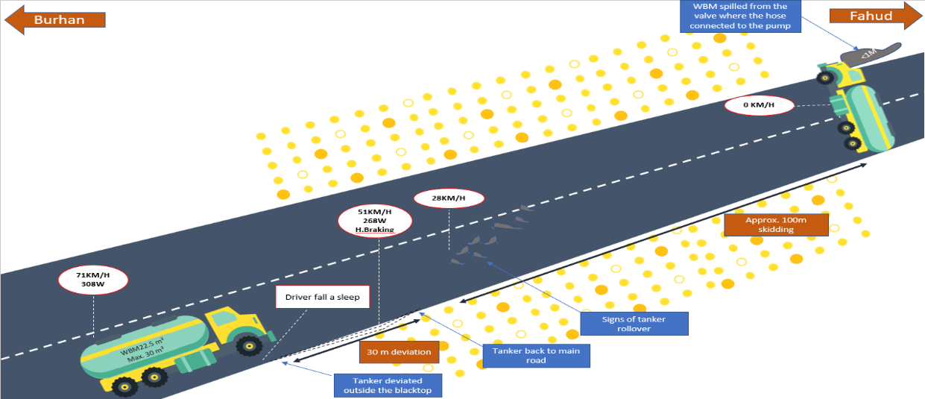
HiPo#35, PIM # 1170964, 01-October-2024, Halliburton
Photographs, diagrams & sketches:
Confidential - Not to be shared outside of PDO/PDO contractors
Notes:
Only include photos or sketches if they add value explaining the incident or causes.
Each photo/sketch must be labeled to explain what it is and why it has been shown.
Ensure photos are labeled to explain context (e.g. road looking in direction of; historical photo of plant before fire etc).
Ensure all photos are evidenced to the investigation. (have formed part of the investigation)
Ensure all photos are of suitable clarity.
Include a maximum of four photographs/sketches per page.
If you have additional images etc that you feel are useful put them in the back of the report in the supplementary findings section
Do not exceed three pages of photographs, diagrams and sketches

Slide 5
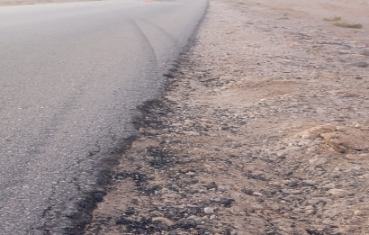
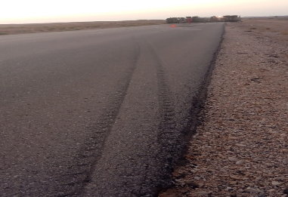
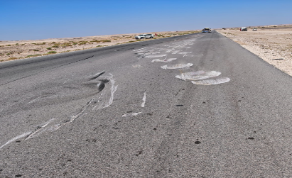
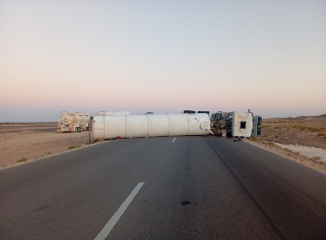
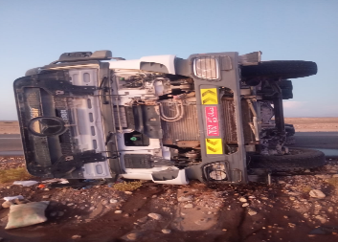
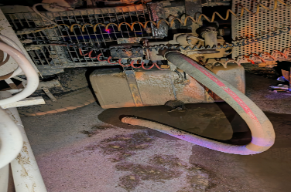
HiPo#35, PIM # 1170964, 01-October-2024, Halliburton
Photographs, diagrams & sketches:
1
2
3
The signs of tanker’s tires outside blacktop
Signs of tires when tanker back to blacktop
Signs of tanker rolledover on the road
4
5
6
The hose disconnected from the tanker valve which lead to spill of around 1m3
Tanker Rollover in Burhan-Awaifia Road
Primemover condition after rollover
Confidential - Not to be shared outside of PDO/PDO contractors
Notes:
Only include photos or sketches if they add value explaining the incident or causes.
Each photo/sketch must be labeled to explain what it is and why it has been shown.
Ensure photos are labeled to explain context (e.g. road looking in direction of; historical photo of plant before fire etc).
Ensure all photos are evidenced to the investigation. (have formed part of the investigation)
Ensure all photos are of suitable clarity.
Include a maximum of four photographs/sketches per page.
If you have additional images etc that you feel are useful put them in the back of the report in the supplementary findings section
Do not exceed three pages of photographs, diagrams and sketches

Slide 6
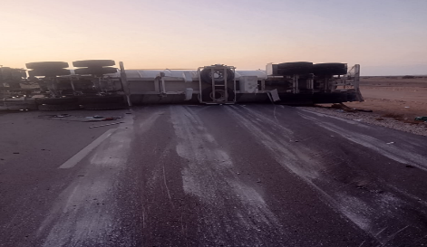
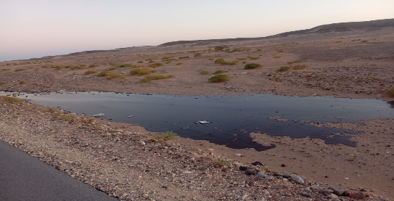
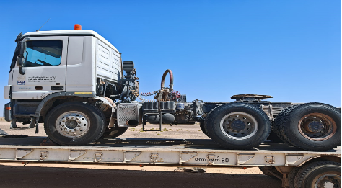
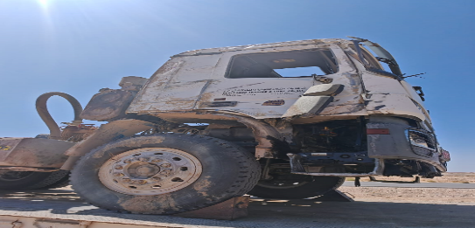
HiPo#35, PIM # 1170964, 01-October-2024, Halliburton
Photographs, diagrams & sketches:
7
8
Tanker position after rollover
WBM spill at the side of the road
9
10
Primemover after recovery
Primemover right side damage
Confidential - Not to be shared outside of PDO/PDO contractors
Notes:
Only include photos or sketches if they add value explaining the incident or causes.
Each photo/sketch must be labeled to explain what it is and why it has been shown.
Ensure photos are labeled to explain context (e.g. road looking in direction of; historical photo of plant before fire etc).
Ensure all photos are evidenced to the investigation. (have formed part of the investigation)
Ensure all photos are of suitable clarity.
Include a maximum of four photographs/sketches per page.
If you have additional images etc that you feel are useful put them in the back of the report in the supplementary findings section
Do not exceed three pages of photographs, diagrams and sketches

Slide 7
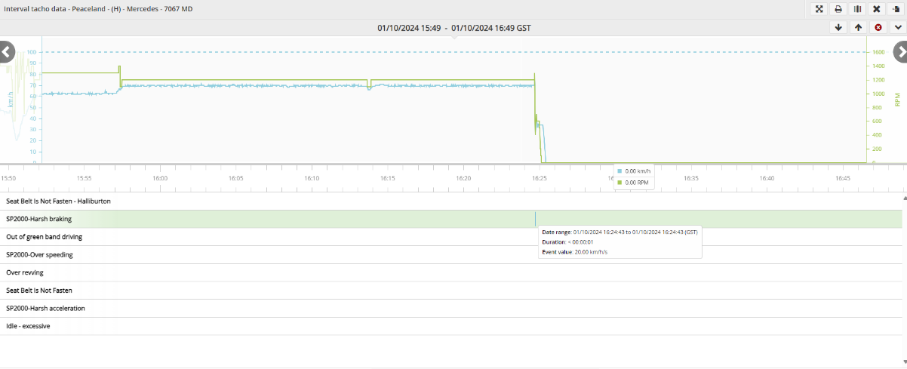
HiPo#35, PIM # 1170964, 01-October-2024, Halliburton
Photographs, diagrams & sketches:
Driver fall a sleep
Tanker speed 71KM/H
Harsh braking speed dropped 51 KM/H
*The speed limit for this road is 80 KM/H for heavy vehicles
*The driver was at speed of 71 KM/H
Confidential - Not to be shared outside of PDO/PDO contractors
Notes:
Only include photos or sketches if they add value explaining the incident or causes.
Each photo/sketch must be labeled to explain what it is and why it has been shown.
Ensure photos are labeled to explain context (e.g. road looking in direction of; historical photo of plant before fire etc).
Ensure all photos are evidenced to the investigation. (have formed part of the investigation)
Ensure all photos are of suitable clarity.
Include a maximum of four photographs/sketches per page.
If you have additional images etc that you feel are useful put them in the back of the report in the supplementary findings section
Do not exceed three pages of photographs, diagrams and sketches

Slide 8
HiPo#35, PIM # 1170964, 01-October-2024, Halliburton
Sequence Of Events
No. | Date | Time | Description of Event
1 | 30-09-2024 | 06:13 | Transferring R-OBM from old location to new location of Rig-132 covered 435 KMs driven between the old and new location including refuelling from Haima station, out of 7:30 hours driving, driver stopped in total 3:40 hours
2 | 30-09-2024 | 18:09 | Completed the job for the day
3 | 01-10-2024 | 06:31 | Driver started from Rig-132 towards Fahud with another 4 drivers in convoy
4 | 01-10-2024 | 09:13 | Driver stopped in Haima filling station after driving 2:54 and took break for 45 minutes along with the convoy vehicles
5 | 01-10-2024 | 10:00 | Started from Haima filling station towards Fahud
6 | 01-10-2024 | 13:04 | Driver stopped in Ghaba parking for 10 minutes after driving for 3 hours 7 minutes
7 | 01-10-2024 | 13:16 | Started from Ghaba parking towards Burhan after instructed by Dispatcher to backload WBM from Burhan Rig-63
8 | 01-10-2024 | 14:29 | Arrived Rig-63 for backloading WBM, started loading the tanker, driver was the last tanker loaded
9 | 01-10-2024 | 15:23 | Completion of loading and started the trip from Rig-63 towards Fahud as last vehicle where other vehicles moved early.
10 | 01-10-2024 | 16:26 | Driver fall a sleep, tanker deviated outside blacktop, harsh braking applied as received in email at speed of 51 km/h, and tanker rolled over in the Burhan-Awaifia Road
11 | 01-10-2024 | 16:28 | Driver got out of the tanker from front windscreen with support of road users
12 | 01-10-2024 | 16:29 | Driver and road users tried to find a warning sign but not found, therefore they placed two fire extinguishers at 100m from both sides to alert other road users
13 | 01-10-2024 | 16:30 | Driver tried to call ROP with no success .The road user was trying to call emergency number, but signal was low, at the same time driver tried with ROP and his Supervisor
14 | 01-10-2024 | 16:30 | Driver reported the incident immediately to PL Supervisor based in Fahud
Confidential - Not to be shared outside of PDO/PDO contractors
Please refer to the notes section for guidance:
Notes:
For the sequence of events, only use the table provided.
Only include events which are key to explaining what happened.
Include relevant information to the incident , that happened close to the event time, up to a few days before and after the event.
Relevant information also includes change in system conditions.

Slide 9
HiPo#35, PIM # 1170964, 01-October-2024, Halliburton
Sequence Of Events
No. | Date | Time | Description of Event
15 | 01-10-2024 | 16:33 | PL Supervisor reported to HSE and LMP Manager
16 | 01-10-2024 | 16:34 | HSE on location reported to PDO Emergency which they reported to ROP as well
17 | 01-10-2024 | 16:50 | PDO Emergency sent Ambulance to incident location
18 | 01-10-2024 | 17:03 | LMP Manager, Field HSE and Baroid HSE Manager moved to incident location
19 | 01-10-2024 | 18:01 | LMP Manager and HSE team arrived incident location
20 | 01-10-2024 | 18:06 | PDO ambulance transferred the IP to Nizwa Badr Al Sama
21 | 01-10-2024 | 18:07 | ROP arrived in location and secured the area by two vehicles from each side.
22 | 01-10-2024 | 18:20 | PDO rescue team arrived incident scene and standby in location
23 | 01-10-2024 | 19:45 | Two cranes arrived incident scene for moving tanker outside the road
24 | 01-10-2024 | 21:01 | The tanker has been shifted out of the road safely
25 | 01-10-2024 | 21:01 | Driver released from Badr Al Sama hospital, pain in left thigh
26 | 01-10-2024 | 21:57 | WBM backloaded from the tanker to another empty tanker
27 | 01-10-2024 | 22:29 | Rescue team cleaned the road from WBM
28 | 01-10-2024 | 22:40 | ROP opened the road to public
29 | 02-10-2024 | 07:45 | PL sent team, chemical covered fully with sand
30 | 02-10-2024 | 09:30 | Contaminated sand removed from incident location and disposed in approved yard in Fahud
Confidential - Not to be shared outside of PDO/PDO contractors
Notes:
For the sequence of events, only use the table provided.
Only include events which are key to explaining what happened.
Include relevant information to the incident , that happened close to the event time, up to a few days before and after the event.
Relevant information also includes change in system conditions.

Slide 10

HiPo#35, PIM # 1170964, 01-October-2024, Halliburton
Timeline of Incident (Optional)
16:28 –Driver got out safely from the tanker
18:06 – Driver was transferred to hospital
16:33 –Reported to HSE& Supervisor
Driving towards Fahud
14:29-Arrived Rig-63
15:23 – completion of loading WBM and moving to FHD
6:31 – Driver departed from Rig 132 to FHD with convoy of 4 vehicles
16:26-Driver fall a sleep, tanker deviated from main road ,applied Harsh braking and tanker rollover
16:34 –Reported to PDO&ROP
06:00
12:00
14:00
15:00
16:00
18:00
20:00
22:15
9:13 – Driver stopped for 45 min in petrol station
13:04 – Driver stopped for rest
21:01 –Tanker removed from the road
18:03– Ambulance arrived at incident location
Notes:
For a timeline of the events. The chart above is only a guide.
Include only relevant information to the incident , no limited to what happened close to the event time.
Events on the timeline should be causal – only what actually happened, not what did not happen or what failed/ was missing.
Use a linear timescale
Relevant information also includes change in system conditions, MoC events, equipment change, personnel change, etc.

Slide 11
HiPo#35, PIM # 1170964, 01-October-2024, Halliburton
Causal Analysis
While travelling on Burhan Awaifia road, the tanker driver carried WBM loss controlled and rolled over.
Driver applied harsh brake and turn the tanker around 40 degrees
The driver was driving at 70 kms/Hrs with tanker 75% loaded, the last volume in location
Driver panicked and an instant and unplanned reaction was applied
Driver alone per SP 2000v5, driver has to have second competent driver if JP is over 500 KM
Driver sudden maneuver of the tanker 40 Degree
Driver was asleep and tanker deviated outside blacktop took him a couple of seconds to gain full situational awareness after waking up.
Initially journey was planned on a total of 370KM so, no second qualified driver was required . Requirement to have second driver is 500km
Fluid movement inside the tanker
, Tanker partially loaded (75%)
ABS/EBS in place, no Electronic stability, the type of partition in this tanker is fitted with compartment type (baffles)
lack of sleep , driver did not take sufficient rest during the trip. Driving 3hrs7min with rest 12min,then stopped for loading operation for 55min in the rig Burhand 63 . Driving 479KM till incident location
JM Manager upon initiating the JM calculated the distance from Haima but actual exact location was 180 KM from Haima. Which made second driver required
Trip to Burhan 63 was not part of the JM as the instruction came after throughout the JM, dispatcher instructed driver to go to Rig 63 without performing required Mustaeed steps.
Driver did not consider tanker capacity while applying instant maneuver as he was in panic situation after falling a sleep and realizing vehicle maneuvered off the road
JM Manager missed to validate the information with either : Rig site leads, share location, GPS for accurate information
JM Manager upon planning the JM with driver set stopping points to rest aligned with fatigue management (2hrs driving VS 30mns rest- 4hrs driving VS 1 hrs rest.
Burhan 63 was not part of this trip at that moment, and driving hours reached 9 hours
JM Manager with multi-tasks, overloaded JM planning (average of 30 to 40 JP a day), no backup JM :
Diesel tracking. Booking transportation for field engineers, Lunch booking
Driver did not apply safer defensive driving approach
Driver was not exposed to similar challenging driving conditions where safer defensive driving approach is required
Improper real time update and JP risk assessment for the task, and no Fatigue management DFMS in driver cabin for all fleet
Inadequate monitoring of vehicles and convoy procedure not followed , Management still in process for implementing DFMS
Driver did not have any experience managing road emergency scenarios : Collision, testing panic button, Man lost, deviation, wild animals on road.
No SWA used by either dispatcher, JM or driver to have enough rest and plan for the change.
Driver decided also not to stop in Burhan as it is desert no resting area or coffee shops around, waited to reach Awayfia to rest
Communication system needs improvement, lack of communication between JM and driver in discussing sleeping hours, rest hours, stop points, during the trip, etc
There is JM and it has a process to monitor the route, no system to count number of sleeping hours for employees, IVMS \ JM only track driven KM, and worked shifted
Notes:
Please see Slide 25 for a filled example.
Tips:
The top event should have at least one action and one conditions
Use as many branches as required on the causal tree, to explore all possible causes
Reason causally, state WHAT HAS HAPPENED/WHAT WAS HAPPENING AT TIME OF EVENT
Data provided here should be causal to the incident/event
Avoid focusing on what was missing or barriers that failed
Why questions are not limited to 5 (they can be more or less), keep asking until systemic cause is reached
Each cause (Boxes in the causal tree) should be supported by evdience
Evidence should be factual and based on data, not on assumptions, hear say or guesses.
Evidences should be provided to MSE3 with the first draft of this report, where required.

Slide 12
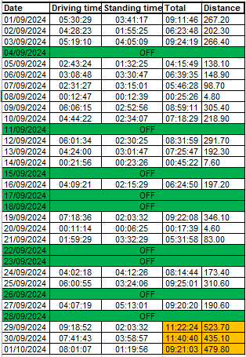
HiPo#35, PIM # 1170964, 01-October-2024, Halliburton
*These data for the driver involved in the incident, last week prior the incident 24/09 to 30/09:
Driver had two days off
Driver worked total of 18hrs 45 mins
Max working hours per day was on 29th and 30th of Sep driving 11 hrs each day including rest period and operation time (loading/offloading of fluids)
Notes:
For the sequence of events, only use the table provided.
Only include events which are key to explaining what happened.
Include relevant information to the incident , that happened close to the event time, up to a few days before and after the event.
Relevant information also includes change in system conditions.

Slide 13
HiPo#35, PIM # 1170964, 01-October-2024, Halliburton
Summary of Key Findings
FINDING - 1 | Fatigue Management
 | Working hours for the driver was 10 hours till the incident occur. Violation to SP2000v5 Working hour for the driver was not taking into consideration as overall journey will exceeds 10 hrs assuming incident did not happen. SP2000v5 specified maximum of 9 driving hours extendable to 10hrs not more than twice per week. This Journey already violated that standard. (highlighted in slide 13) 4 hours driving/ 1 hour rest not implemented, driver took only 12 minutes break after 3 hours of continuous driving (SP-2000 V5) Driver’s fatigue management system (DFMS) not in place
FINDING - 2 | Journey Management Process
 | Improper journey plan risk assessment for the task, the distance from Rig-132 to Fahud is 550KM, and journey plan stated the distance of 350 KM Failed to assign second driver or split the journey for two days Convoy driving procedures not followed, driver left as last vehicle loading from the rig where other four vehicles left earlier after loading from Burhan-63 Main stop point Burhan Rig-63 not captured in the journey plan Journey planned at 07:15AM where actual moving time was 06:30
FINDING - 3 | Communication System
 | Poor communication of journey plan details, driving hours and rest periods of drivers Lack of two ways communication during the journey, verifying rest timing, moving time,etc Convoy plan details were not double checked/verified to identify the total number of vehicles should move, where to stop for loading,etc
FINDING - 4 | Work Direction / Human Difficulties
 | 1. JM Manager failed to collect accurate JM distance due to being overloaded , multi-tasked, managing 30 to 40 JPs in a day. 2. No clear documented role and responsibility for JM Manager to avoid extra tasks
Notes:
Use this slide to summarise the key findings from the incident, grouped by topic.

Slide 14
HiPo#35, PIM # 1170964, 01-October-2024, Halliburton
Development of Remedial Actions
 | Causes to Address | Proposed Remedial Action | Concerns with Proposed Remedial Action | How will Remedial Action Prevent Recurrence of Incident | How will the Remedial Action be Sustained
1 | Fatigue Management | Install Driver’s fatigue management system for all vehicles in operation to comply with SP2000.V5 and review HEMP of Road safety including fatigue management requirement |  | Keeps monitoring driver fatigue continuously Alert drivers in case of fatigue | Inspect all vehicles to ensure they all installed with DFMS, Include in vehicle pre-post inspection checklist, DFMS checks annually by vendor and random device health check. (Fleet Management, Vendor) Review HEMP regularly based on job requirement, new hazards and risks associated with driving, learning from incident, annually. (Operation Team, HSE)
 |  | Conduct regular awareness for all drivers to emphasize driving hours, rest hours, convoy procedure, and using of SWA for any deviation and re-enforce full rest period at agreed stop points and verify it by call between journey manager and driver, maintain weekly sessions with engagement of Supervisor with all drivers | N/A | Ensuring driver has taken sufficient rest prior moving and reduce the risk of fatigue | Live driving monitoring through IVMS system (JM) Communication through phone at agreed stop points (JM, Driver). Pre-trip journey management toolbox talk, Safety meetings, learning from incident (Supervisor, JM, HSE) Weekly engagement with involvement of Supervisor
2 | Journey Management process | Ensure journey management system audited every year and records check at least once per month focusing on JM process, communication processes, fatigue management as part of journey management verifications | N/A | Verifying Journey Management Process in compliance and rectify any gaps in the system. | Yearly Journey management audit (Management), HSE monitoring plan , Monthly record checks (Supervisor, HSE, Operation Lead)
 |  | Carry out assessment to similar journeys, if distance more than 500 KM, assign two competent driver for the trip or split the journey for two days and provide accommodation for driver in Haima, maintain up to date register of Rig site locations and review it based on call outs, communication with Rig sites | N/A | Driver fatigue significantly reduce, and ensuring the driver behind the wheel well rested. Avoid long trips and identify the requirement of management approval for trips exceeding 500 KM | Review the plan ahead, assess long trip journey plans (Dispatcher, JM) carry out weekly JPs verification audit (Supervisor, HSE) Part of daily Journey Plan to create risk assessment for the trip prior departure, communication through emails ex. Callouts with planned rigs (JM, Dispatcher ,Field Supervisor)
3 | Communication System | Conduct refresher training on defensive driving approach to manage different situations fatigue, sleep, collision, other road safety emergencies and align it in annual in-house training schedule | N/A | Enhance the awareness with all drivers to react safely in case of any emergency | Yearly in-house trainings schedule, HSE monitoring plan, Quarterly Awareness campaign (Supervisor, HSE, JM)
4 | Human Difficulties / Work Direction | Review roles and responsibilities of the team dispatcher and JM Manager and work on manage the task to create balance and more effectiveness at execution | N/A | Eliminate load of work and multi-task jobs on JM Manager only. | Create one page role and responsibilities posted in office and acknowledged by employees (Operation Lead, HR)
Confidential - Not to be shared outside of PDO/PDO contractors
Notes:
Please see Slide xx for a filled example.
Input for this slide should ideally be developed after agreeing on the incident root cause(s) and key findings with the relevant stakeholders (see Action Development Guide document).
The incident owner (or delegate) should be part of the decision-making process when selecting which causes to address.
Tips – Test your Solutions:
If the solution had already been in place, how would it have prevented the incident and what would have been created instead?
How would the solution would have interrupted the sequence of events that occurred?
How effective will the solution be to prevent similar incidents in the future?
How can this solution be sustained? Think of solutions that can be be hardwired into the process.
It is also important to check whether the solution could have any unintended or undesirable consequences. A solution that eliminates a cause could still create an undesirable outcome if we are not careful.

Slide 15
HiPo#35, PIM # 1170964, 01-October-2024, Halliburton
Remedial Action Plan:
 | Action | Target date | Contractor action party | PDO action party for PIM | Action party accepted ? | PIM action No. | Status Open / Closed | Post action verifier for PIM
1 | Install Driver’s fatigue management system for all vehicles in operation to comply with SP2000.V5 and review HEMP of Road safety including fatigue management requirement | 31/12/2024 | Halliburton &Third party | UIK
2 | Conduct regular awareness for all drivers to emphasize driving hours, rest hours, convoy procedure, and using of SWA for any deviation and re-enforce full rest period at agreed stop points and verify it by call between journey manager and driver, maintain weekly sessions with engagement of Supervisor with all drivers | 15/12/2024 | Halliburton &Third party | UIK
3 | Carry out assessment to similar journeys, if distance more than 500 KM, assign two competent driver for the trip or split the journey for two days and provide accommodation for driver in Haima, maintain up to date register of Rig site locations and review it based on call outs, communication with Rig sites | 15/12/2024 | Halliburton &Third party | UIK
4 | Ensure journey management system audited every year and records check at least once per month focusing on JM process, communication processes, fatigue management as part of journey management verifications | 31/01/2025 | Halliburton &Third party | UIK
5 | Conduct refresher training on defensive driving approach to manage different situations fatigue, sleep, collision, other road safety emergencies and align it in annual in-house training schedule | 31/12/2024 | Halliburton &Third party | UIK
6 | Re-enforce the SWA empowerment to all crew, best transportation SWA after evaluation will receive an award part of best SWA of the month. | 15/12/2024 | Halliburton &Third party | UIK
7 | Review roles and responsibilities of the team dispatcher and Journey Manager and work on manage the task to create balance and more effectiveness at execution | 15/12/2024 | Halliburton | UIK
Confidential - Not to be shared outside of PDO/PDO contractors
Notes:
Plan the remedial actions to from the previous slide. These MUST be tracked for completion by the Investigation Team Lead and reported to MDIRC (if applicable).
Actions should be the outcome of a solution development session, as applicable.
They should address specific causes and be the most important remedial actions in stopping the incident from reoccurring.
Actions should be SMART and provide assurance to prevent re-occurrence of similar incidents.
Consider the hierarchy of control (E: Elimination, S: Substitution, EC: Engineering controls, AC: Administrative Controls, P: PPE)
Actions (planned or recommended) that require directorate or MD approval should be specified.
It is essential that you inform and agree with an action party prior to entering them in the PIM system.
All actions must be entered into PIM and a PIM ref number entered as confirmation.
At MSE3 IRC you must also confirm if you have a particular Post Action verifier. This must be a more senior level than the person entering in PIM or a subject matter expert (SME). They will check the evidence against the action to ensure it is adequately closed out. If a similar incident occurs this will be presented as evidence to the Director at IRC.

Slide 16
HiPo#35, PIM # 1170964, 01-October-2024, Halliburton
Immediate actions taken:
 | Actions taken | Date | Action party | Status
1 | Driver was sent to Nizwa Badr Al Sama | 01/10/2024 | PDO Emergency | Closed
2 | Tanker and Primemover removed from the road | 01/10/2024 | PDO Emergency | Closed
3 | WBM spill covered by sand | 02/10/2024 | HLB/PL | Closed
4 | Contaminated soil removed and disposed in approved yard in Fahud | 03/10/2024 | HLB/PL | Closed
5 | Investigation started and evidence collected | 03/10/2024 | Halliburton | Closed
Confidential - Not to be shared outside of PDO/PDO contractors
Notes:
Immediate actions taken include all those reported to have been taken and completed within 7 days of the incident.
These may be tracked for completion by the MSE team.

Slide 17
HiPo#35, PIM # 1170964, 01-October-2024, Halliburton
Key Insights From Incident
The importance of Installing Driver’s fatigue management system for all vehicles in operation
Ensure to take sufficient rest during the trip for light and heavy vehicle drivers
Improve the IVMS system notification to alert responsible persons in case driver failed to take complete rest period
Proper risk assessment for the journey to identify the distance and driving hours
Increase driver awareness and adherence to convoy procedures
Improve communication system between the Journey Manager and Drivers
Improve road shoulders for emergency stops, breakdowns, rests.
Regular awareness sessions on assessing and reacting to situational road risks
Apply stop work authority in case of fatigue and report to Journey Manager
Confidential - Not to be shared outside of PDO/PDO contractors
Notes:
Include the key learnings from the investigation that can benefit others.
Also include other learning/findings that may not be causal to the event but are identified as opportunities for improvement. These could be from interviews, etc

Slide 18

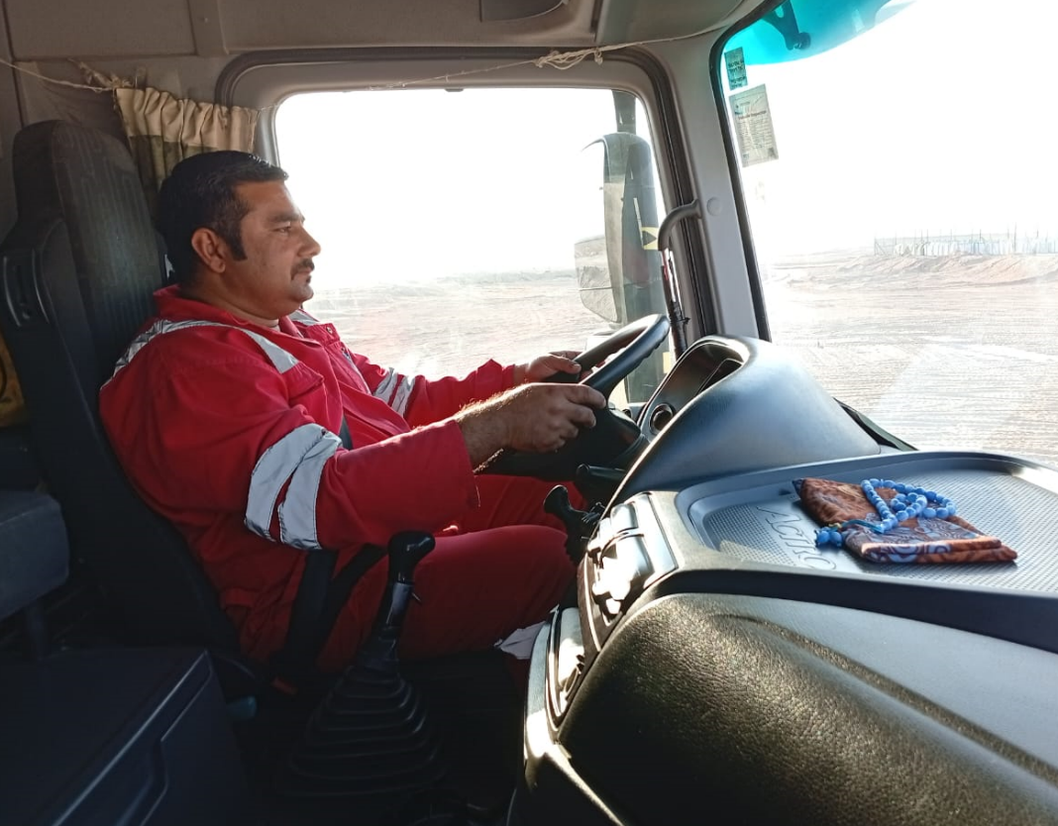

PDO Second Alert
Date: 01/10/2024 Incident title: Tanker Rollover Pattern: MVI RO Potential severity: C4P, C3E Activity: Transporting fluids
Target Audience: Drilling, Logistics, Operation & Construction
What happened?
On 01 Oct 2024, a third-party chemical tanker completed loading Water-Based Mud from Rig-63 located in Burhan, the driver started from the rig heading to Fahud LMP. On his way back to Fahud LMP, over Burhan-Awaifia road @1626hrs, the driver fall a sleep during driving and suddenly the tanker partially deviated outside of the road then immediately he steered back the tanker to main road and applied harsh braking leading to loss control and tanker rollover.
Why it happened/Finding
Working hours for the driver was 10 hours till the incident occur
4 hours driving/ 1 hour rest not implemented, driver took only 12 minutes break after 3 hours of continuous driving (SP-2000 V5)
Driver’s fatigue management system (DFMS) not in place
Improper journey plan risk assessment for the task, the distance from Rig-132 to Fahud is 550KM, and journey plan stated the distance of 350 KM.
Driver not familiar with similar situation, and how to react to road emergencies safely
Convoy procedure not followed
The road has no safe shoulders from both sides, difficult to park safely in case of emergency
Tanker loaded 75% of total capacity
Your learning from this incident
Ensure driver well rested prior issuing the journey plan
Monitor and ensure heavy & light vehicle drivers take sufficient rest during the trip
Proper risk assessment prior issuing the journey plan verifying the distance and driving hours
Ensure to dispatch tankers either fully loaded or empty
Ensure driver fatigue management system in place and working properly
Enhance the empowerment of Stop Work Authority.
If feel fatigue, stop the driving and take rest
Notes:
Ensure all dates and titles are input
A short description should be provided without mentioning names of contractors or individuals. You should include, what happened, to who (by job title) and what injuries this resulted in. Nothing more!
Four to five bullet points highlighting the main findings from the investigation. Remember the target audience is the front line staff so this should be written in simple terms in a way that everyone can understand.
The strap line should be the main point you want to get across
The images should be self explanatory, what went wrong (if you create a reconstruction please ensure you do not put people at risk) and below how it should be done.

Slide 19
Management Self-audit
Date: 01/10/2024 Incident title: Tanker Rollover Pattern: MVI RO Potential severity: C4P, C3E Activity: Transporting fluids
Confirm the following:
Do you discuss the importance of fatigue management during the toolbox talks with driver?
Do you verify driver has sufficient rest prior issuing the journey plan?
Do you ensure proper journey plan risk assessment in place for the trip?
Do you verify if the employee competent and aware for the assigned task?
Notes:
Ensure all dates and titles are input
Make a list of closed questions (only ‘yes’ or ‘no’ as an answer) to ask others if they have the same issues based on the management or HSE-MS failings or shortfalls identified in the investigation.
Imagine you have to audit other companies to see if they could have the same issues.
These questions should start with: Do you ensure…………………?

Slide 20
HiPo#35, PIM # 1170964, 01-October-2024, Halliburton
END OF INVESTIGATION

Slide 21
SUPPLEMENTARY SLIDES
(The following slides should only be filled if required. Move the slides that are filled to the appropriate section of the main slides)

Slide 22
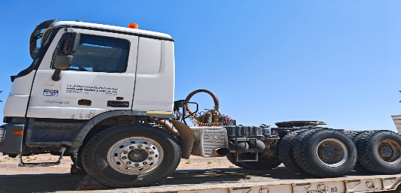
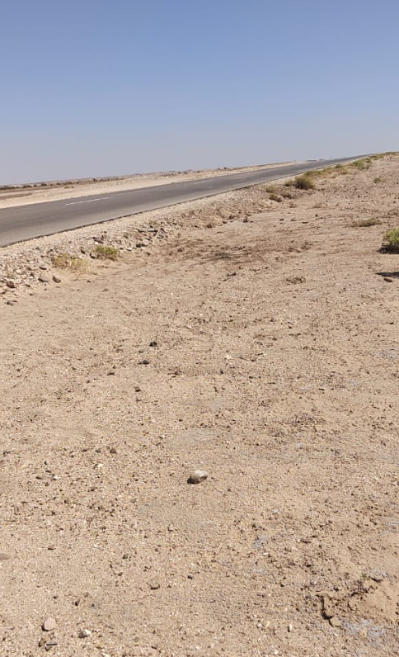
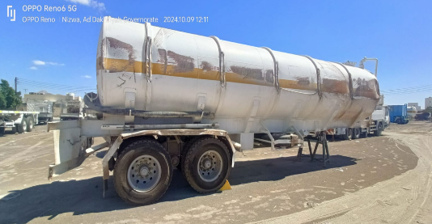
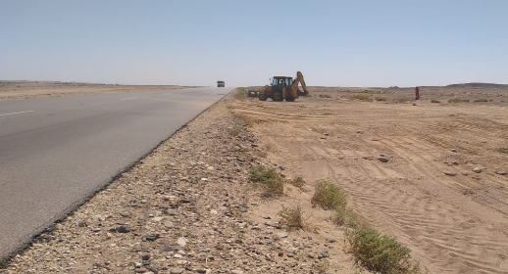
Photos from corrective actions

Slide 23
HiPo#35, PIM # 1170964, 01-October-2024, Halliburton
Details of the Emergency Response (ER) : If applicable
# | Emergency response | Yes/No | Comments
1 | Did they call 5555? | Yes
2 | How long did it take to call 5555 and why ? |  | Reported to Emergency at 16:34
:3 | In case they delayed or did not call 5555, why ? | No | Incident reported to emergency team immediately
4 | What time did the CCR receive the call? If delayed, why? |  | At the same time of the call, no delay in response
5 | What are the Emergency Response positive practices ? |  | -Contacted the representative and gathered more details -Prepare Ambulance for injury person -Provided all necessary equipment to recover the tanker from the road
6 | What are the Emergency Response Areas of Improvement?
7 | *What would be the ideal time for the ER services to reach the incident site to avoid further escalation ?
8 | What are the location coordinates ? |  | 22°08'47.5"N 57°03'50.4"E
9 | Others
GPS System (eg:PSD93) | E/ | N/
GPS System (eg:WGS84) | E/ | N/
Confidential - Not to be shared outside of PDO/PDO contractors
Notes:
* To be answered by medical team.

Slide 24
Incident Number, Incident Date & Main Contractor Name
An incident is considered as repeat if all the below criteria have been met:
Same Top Event
Same Immediate Cause
Same Activity
Maximum of Two-Year Time Frame between both Incidents (Personal Incidents only)
 | Criteria | Current Incident | Reference Incident
1 | PIM ID | 1170964
2 | Date of Incident | 1/10/2024
3 | Top Event | Driver lost control of vehicle and rolled over
4 | Immediate Cause(s) | Microsleep/Fatigue
5 | Activity | Driving
Please refer to the notes section for guidance
Notes:
NOTE: The decision of whether the incident is repeated or not will be jointly decided during the IRC session based on the above agreed input.

Slide 25
Details of Injured Person/Asset
HiPo#35, PIM # 1170964, 01-October-2024, Halliburton
Name | Ahmed Raza
Age | 31
Description of Injury | Left thigh pain
Job Description/ Experience | Heavy vehicle driver, his duty is delivering of Chemical fluids from Fahud to Rig, Rig to Rig, Rig to Fahud. He has total of 4 years and 10 months driving experience
Employer | Peace Land
Confidential - Not to be shared outside of PDO/PDO contractors

Slide 26
HiPo#35, PIM # 1170964, 01-October-2024, Halliburton
Fatigue Management:
Working hour for the driver was not taking into consideration as overall journey will exceeds 10 hrs assuming incident did not happen. SP2000v5 specified maximum of 9 driving hours extendable to 10hrs not more than twice per week. This Journey already violated that standard.
Journey Management Process failed 100%:
1. There was no proper Journey Route assessment, distance was wrongly assumed. JM missed to validate the information by either Rig team, GPS coordinates, shared location which led to wrong assume of distance to main city Haima only. JM Handling multi tasks and handling daily basis 30 to 40 JPs in a day
2. There was no pre-trip discussion between Driver and Journey manager on agreed rest point. The discussion was done with driver leader prior moving from the location by phone, however the stop point in Burhan was missed in journey plan.
3. There was no communication between driver and Journey manager over the first leg of the Journey. Communication was held with the driver leader who communicated with other drivers; however the leader transfer the details to all drivers involved in the convoy. This was done through mobile phone with the leader. The two ways communication were not managed properly at either start point, the stop points, as vehicles stopped for rest (non completed stops) and convoy procedure not followed during the trip and after the completion of loading from Burhan Rig-63.
4. Who approved the return Journey, The journey plan was approved once at the start (Rig-132 to FHD), however the journey plan not mentioned the stop at Burhan for backloading WBM on the way back to Fahud, this was applied for the entire convoy journey which started from Rig-132 to Burhan and final destination Fahud
IVMS Monitoring? Confirmed
Journey Management? Track only driving hours, sleeping hrs not system available just question the driver
Notes:
Please see Slide 25 for a filled example.
Tips:
The top event should have at least one action and one conditions
Use as many branches as required on the causal tree, to explore all possible causes
Reason causally, state WHAT HAS HAPPENED/WHAT WAS HAPPENING AT TIME OF EVENT
Data provided here should be causal to the incident/event
Avoid focusing on what was missing or barriers that failed
Why questions are not limited to 5 (they can be more or less), keep asking until systemic cause is reached
Each cause (Boxes in the causal tree) should be supported by evdience
Evidence should be factual and based on data, not on assumptions, hear say or guesses.
Evidences should be provided to MSE3 with the first draft of this report, where required.

Slide 27
HiPo#35, PIM # 1170964, 01-October-2024, Halliburton
List of Evidences
No. | Cause | Evidence | Comment
1 | Tanker deviated from main road | Photos of road signs | The tires signs can be identified at the side of main road where tanker deviated
2 | Driver fall a sleep during driving | Driver statement | Driver stated he fall asleep during driving
3 | Driver didn’t take sufficient rest during the trip | IMVS report | IVMS report shows driver took 12 minutes rest after driving for 3 hours and 7 minutes
4 | Fatigue management/working and rest hours not followed | IVMS report | Journey plan is tight, as it was long trip from south rig-132 to Fahud
5 | No safe road shoulders in case of emergency | Photos of the road | The road where incident happened, has no safe shoulders that could help the drivers to stop or react in case of emergency
6 | Sharp deviation of tanker loaded 75% of total capacity | Volume backloaded after incident | The tanker was loaded 22.5 m3 from total capacity of 30 m3 which is 75%
7 | Convoy procedure not followed | IVMS report | Driver was in convoy of 5 vehicles, however he was the last one left in location where others moved after completed loading their tankers
8 | Inadequate monitoring of vehicles movement | IVMS system | Vehicles didn’t maintain the proper spacing, stop times, moving times as a convoy, not captured in the live system during the trip and no intervene from the leader
Please refer to the notes section for guidance
Confidential - Not to be shared outside of PDO/PDO contractors
Notes:
For the sequence of events, only use the table provided.
Only include events which are key to explaining what happened.
Include relevant information to the incident , that happened close to the event time, up to a few days before and after the event.
Relevant information also includes change in system conditions.

Slide 28
HiPo#35, PIM # 1170964, 01-October-2024, Halliburton
Investigation Team
Name | Reference Indicator | Role In Investigation
Basil Alsalti | Contract Manager | Team Leader
Marwan Moneam | HLB BSM | Team Member
Nassiba Toumert | Area QHSE Manager | Team Member
Adhra Al Rawahi | Baroid HSE Manager | Team Member
Abdullah Al Ghazali | QHSE Coordinator | Team Member
Ahmed Al Mahrouqi | LMP Manager | Team Member
Sigin Mohan - PL | PL HSE manager | Team Member

