Slide 1
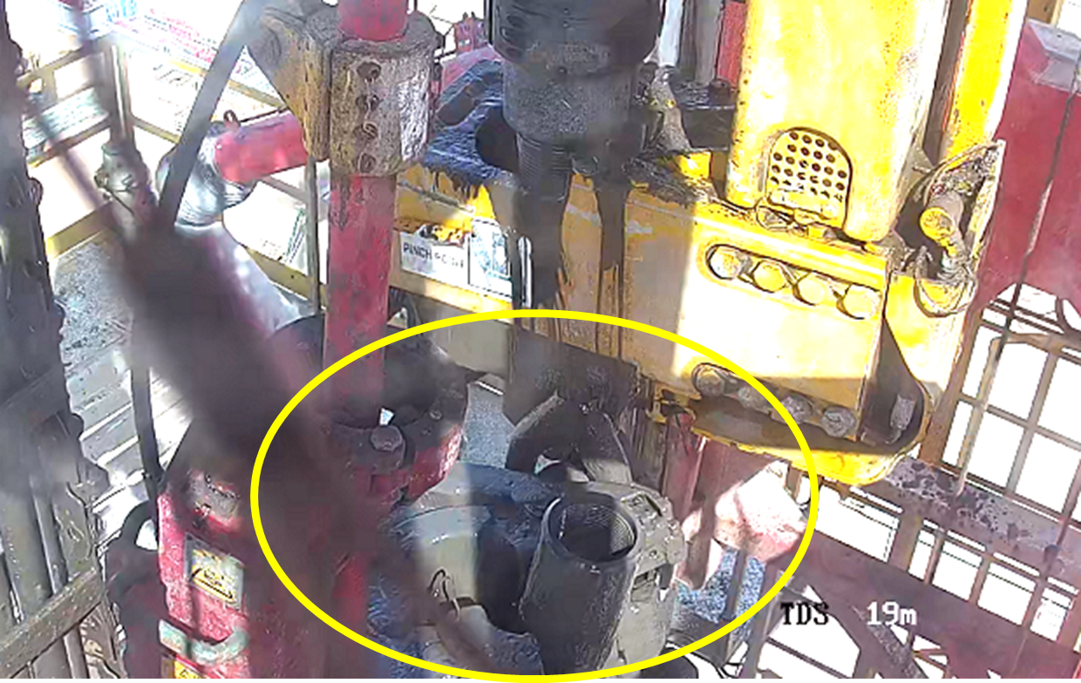

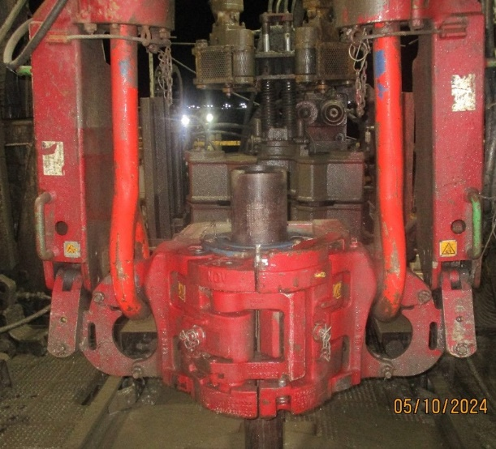
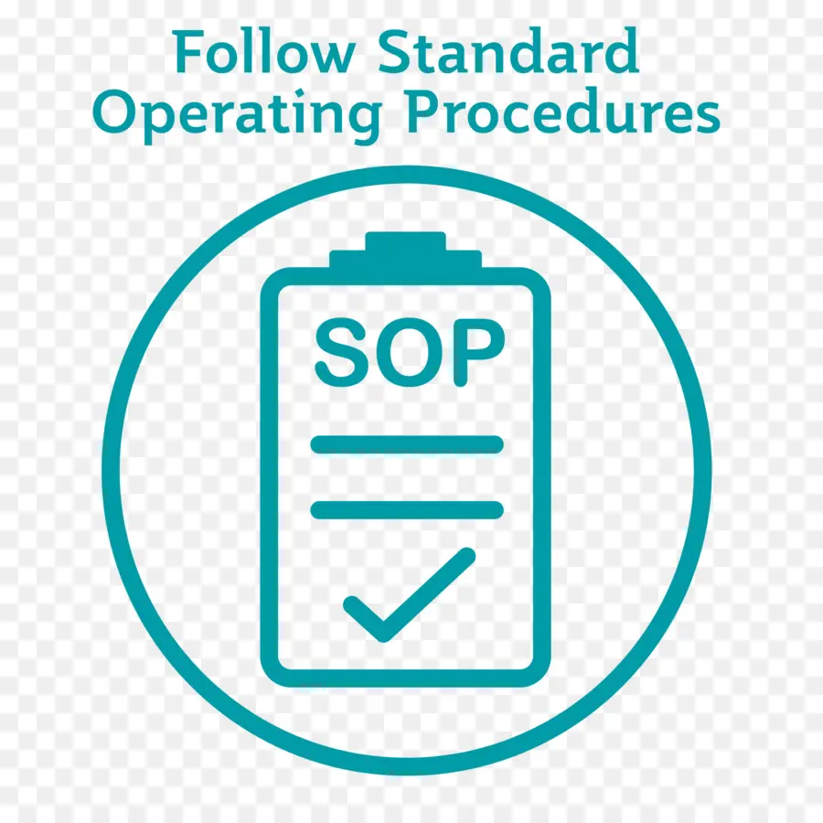
PDO Second Alert
Date:05/10/2024 Incident title: EQD Pattern: DROP Potential severity: C4P Activity: POOH (Back Reaming)
Target Audience: Toolpusher, Nightpusher Driller, Assistant Driller,
What happened?
On 05.10.2024 around 09:25, While back reaming the fourth 5” drill pipe stand @ 1644m, after breaking out a string and in process of lay down on the power catwalk using a 5” hydraulic elevator assist to push the pipe using a guide arm, after lowering the pipe 5 meters in power catwalk, observed the 5” drill pipe slip from elevator resulted in bounced on the catwalk and landed on the ground. There were no injuries, and zone management was maintained on the V-door and power catwalk areas (barricaded power walk in place).
Why it happened/Finding :
All control of work in place, TBT was conducted prior to the task; line of fire and zone management were discussed
All the equipment certifications are valid and fit for purpose. All PM records for regular maintenance are maintained and available. All the HMI functions in good order.
Good housekeeping was maintained around the rig floor, effective zone management was well managed in V-door and power catwalk areas. Line of fire was managed (no one was close to the V-door).
Driller missed to close the elevator prior to break out the top connection
Driller failed to identify the message from HMI (status) where showing the elevator still in open position.
Driller failed to confirm the final position of the elevator through the CCTV prior to pick up the pipe.
Driller not concentrate on the task as was distracted by other.
Your learning from this incident..
Always ensure crews adhere to the 7 steps of Musta’ed.
Always ensure crews handle Zone Management effectively and maintain a safe distance from the line of fire
Drillers must always ensure the elevator is closed before breaking out the top connection.
Drillers must always check the HMI screen and CCTV to verify the status of the elevator.
Floormen and Roustabouts must always stay focused on the task at hand and avoid distracting the Driller or Assistant Driller.
Drillers, Assistant Drillers, and Floormen must always prioritize learning, regardless of their experience level. Remember, even experts can make mistakes.
Automatic Elevator shows open
Always ensure to close the elevator before disconnect the Top Drive
Notes:
Ensure all dates and titles are input
A short description should be provided without mentioning names of contractors or individuals. You should include, what happened, to who (by job title) and what injuries this resulted in. Nothing more!
Four to five bullet points highlighting the main findings from the investigation. Remember the target audience is the front line staff so this should be written in simple terms in a way that everyone can understand.
The strap line should be the main point you want to get across
The images should be self explanatory, what went wrong (if you create a reconstruction please ensure you do not put people at risk) and below how it should be done.

Slide 2
Effective Learning
Date:05/10/2024 Incident title: EQD Pattern: DROP Potential severity: C4P Activity: POOH (Back Reaming)
To make sure learning is translated to the site day to day activities , please answer the below questions :-
How learning can be implemented at site ?
Provide updated procedure for Tripping and operating with top drive.
Approach the OEM with a proposal for installing a new safety device (interlock system), including detailed functionality steps.
NDSC is willing to support other contractors in adopting this interlock system, as it is not currently available in the existing mechanized equipment in their units.
How can you sustain the action ?
The interlock system has been provided by the OEM and is already installed at the site. Function testing confirms it is in good working condition. Monitor and track the interlock system through the PMS (Preventive Maintenance System) work orders.
Cascade the updated procedure for Tripping and Operating with Top Drive to the entire workforce (Contractor)
Disclaimer
This document is provided for information only. It may not be relied upon for any purpose. Neither PDO nor any party providing information for this document accepts any liability for its accuracy, completeness, omissions, advice, or any consequences arising from its use, even if reasonable care was not exercised. No representation or warranty, express or implied, is made that following this document will achieve any specific results or meet any legal or regulatory requirements. This document does not constitute technical advice; consult a qualified professional if such advice is needed
Notes:
Guideline for Effective Learning & Sustainability
•Can be replicated across similar contractor / activities
•Shall be SMART- Specific ,Measurable , Achievable ,Realistic & Timebound
•Can be implemented in a months' time

Slide 3
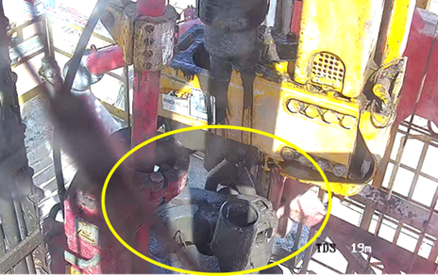
PDO Second Alert
Date:05/10/2024 Incident title: EQD Pattern: DROP Potential severity: C4P Activity: POOH (Back Reaming)
الفئة المستهدفة:
ماذا حدث؟
في 05.10.2024 حوالي الساعة 09:25، أثناء عملية إعادة سحب أنبوب الحفر الرابع بقياس 5 بوصات على عمق 1644 مترًا، وبعد فصل سلسلة الأنابيب وخلال عملية وضعه على power catwalk باستخدام رافعة هيدروليكي بقطر 5 بوصات لدفع الأنبوب باستخدام ذراع توجيه، تم خفض الأنبوب بمقدار 5 أمتار على power catwalk، تمت ملاحظة انزلاق أنبوب الحفر 5 بوصات من المصعد مما أدى إلى ارتداده على catwalk وسقوطه على الأرض. لم تحدث أي إصابات، وتم الحفاظ على إدارة المنطقة في مناطق V-door و power catwalk (حيث كانت الحواجز في مكانها).
نتائج التحقيق:
جميع إجراءات التحكم في العمل كانت موجودة، وتم إجراء جلسة السلامة قبل المهمة (TBT)؛ حيث تم مناقشة خط النار وإدارة المنطقة.
جميع شهادات المعدات سارية وصالحة للاستخدام. تم الحفاظ على جميع سجلات الصيانة الدورية (PM) . جميع وظائف شاشة (HMI)تعمل بشكل جيد.
تم الحفاظ على نظافة جيدة حول منصة الحفر، وكانت إدارة المنطقة فعالة في منطقتي V-door و power catwalk areas. تم إدارة خط النار بشكل جيد (لم يكن أحد قريبًا من V-door).
أخفق الحفار إغلاق الرافعة قبل فك الاتصال العلوي.
فشل الحفار في تحديد الرسالة المعروضة على شاشة (HMI) التي كانت تظهر أن الرافعة لا تزال في وضع الفتح.
فشل الحفار في تأكيد الوضع النهائي للرافعة عبر كاميرات المراقبة (CCTV) قبل رفع الأنبوب.
لم يكن الحفار مركزًا على المهمة بسبب تشتيت انتباهه من قِبل الآخرين.
الدروس المستفادة من الحادثة:
تأكد دائمًا من الالتزام بالخطوات السبع لمستعد.
تأكد دائمًا من إدارة منطقة العمل بشكل جيد والابتعاد عن مناطق الخطر.
تأكد دائمًا من إغلاق الرافعة قبل فك الاتصال العلوي.
تأكد دائمًا من فحص شاشةHMI) ) وكاميرات المراقبة CCTV)) للتحقق من حالة الرافعة.
حافظ دائمًا على التركيز في المهمة وتجنب تشتيت انتباه الحفار أو مساعد الحفار.
تأكد دائمًا من التعلم بغض النظر عن مستوى الخبرة. ذكّر نفسك أن ذوي الخبرة يمكن أن يرتكبوا أخطاء.
تأكد دائمًا من إغلاق الرافعة قبل فصل التوب درايف (Top Drive).
Notes:
Ensure all dates and titles are input
A short description should be provided without mentioning names of contractors or individuals. You should include, what happened, to who (by job title) and what injuries this resulted in. Nothing more!
Four to five bullet points highlighting the main findings from the investigation. Remember the target audience is the front line staff so this should be written in simple terms in a way that everyone can understand.
The strap line should be the main point you want to get across
The images should be self explanatory, what went wrong (if you create a reconstruction please ensure you do not put people at risk) and below how it should be done.

