Slide 1
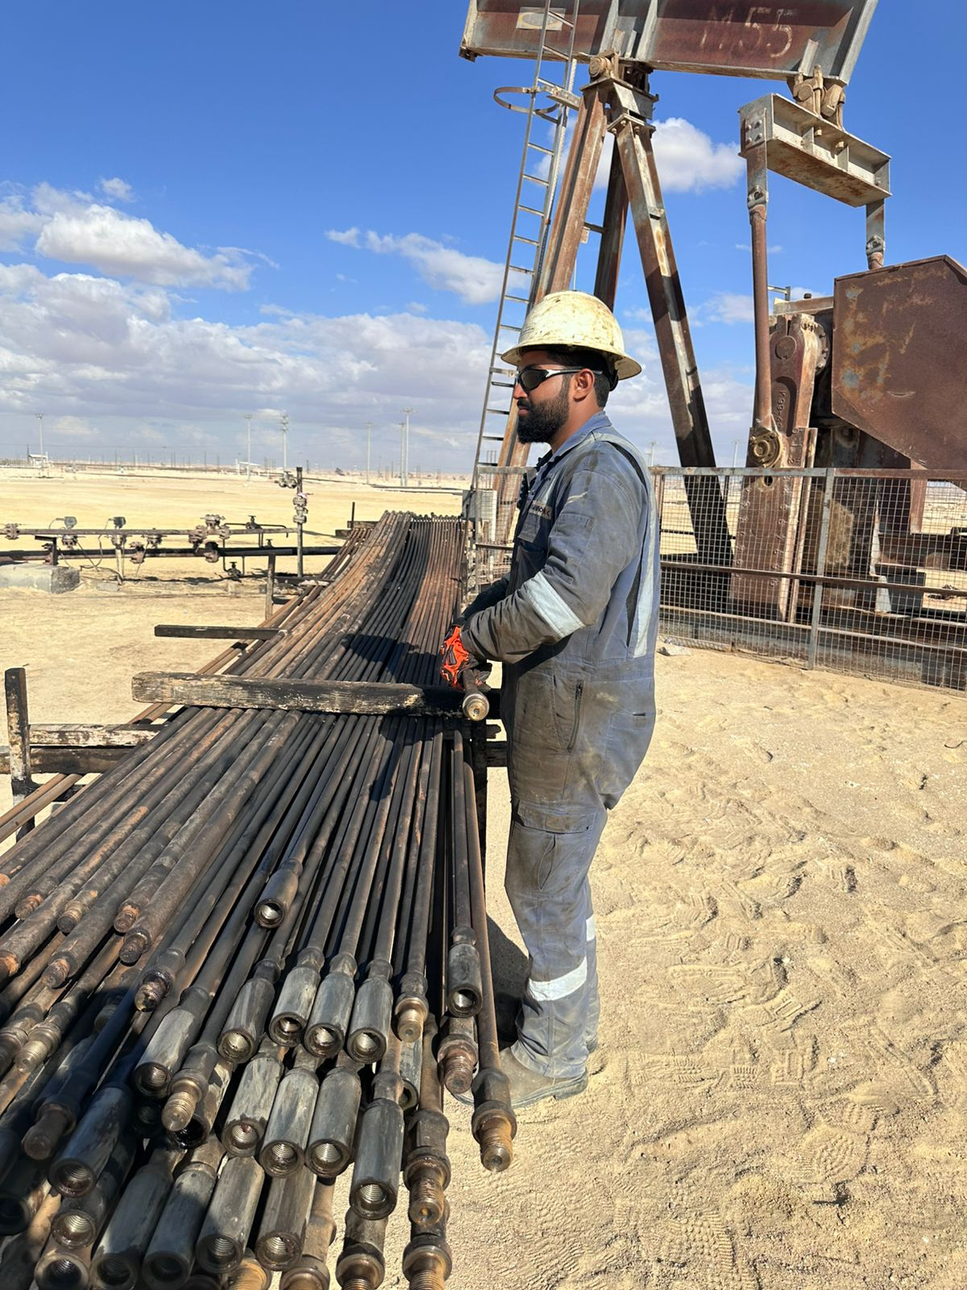
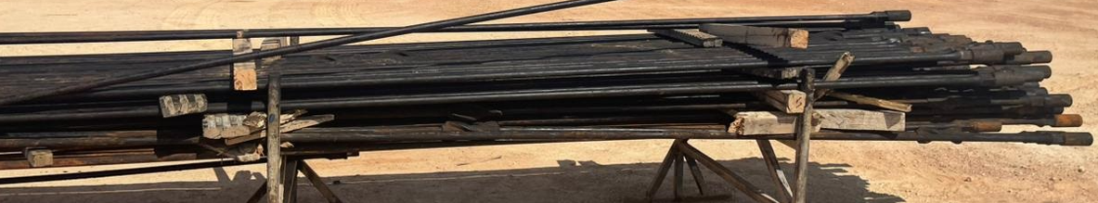
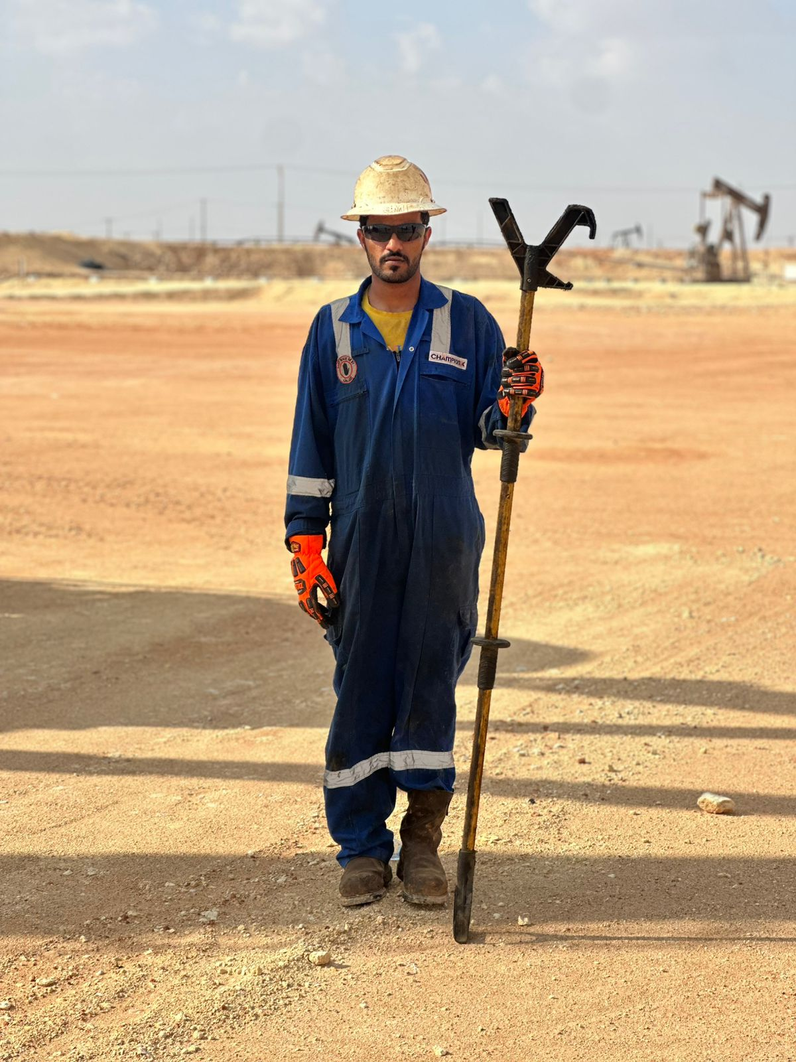
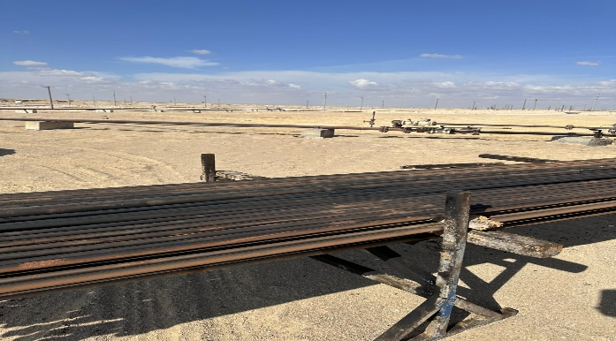
PDO Second Alert
Date:11/10/2024 Incident title: HiPo#35c Pattern: Release energy Potential severity: C4P Activity: POOH Sucker Rod
Target Audience: Drilling & Well Service Operation
Photo explaining what was done wrong
What happened?
On Friday 11th of October at 14:21, the crew were carrying out a POOH job by laying down sucker rod using an FBU Unit positioned in front of the wellhead and pulling the sucker rod from the well using a traveling block and rod elevator to lay the rod down on the dedicated rod stand positioned behind the wellhead. The full length of the sucker rod was already laid down on the stand wooden level separators. A crew member was standing at the back of the sucker rod stand (LHS) to ensure that the rod was not obstructed while being laid down. The crew member realigned the backend of the rod to make room for other rods which made the frontend role off the wood level separator and rest on the ground (90cm). This motion forced the backend (where the crew was standing) to suddenly swing up striking the crew member on the mouth.
This resulted in 1 tooth being dislodged and a fracture in another tooth
Why it happened/Finding :
Sucker Rod stand was stacked to the limit and the job continued
The wooden level separators were not the same level making the rod stack unstable
A crew member had to physically realign the rod in question, thus standing too close to the rod stand
Realigning the rod forced the frontend of the rod to fall from the rod stand, suddenly raising the backend where the crew was standing striking him on the mouth
Your learning from this incident..
Always visually and physically continually monitor safe load capacity of equipment being used
Always ensure that sub tools or materials used in conjunction with equipment are safe and adequate for the job
Always stop to assess & reassess obvious and potential risks before carrying out a routine task, ask questions if in doubt.
Always apply SWA and ask your seniors for clarification/guidance to the safety of the operation/activity, then recommence.
Always ensure that SOP’s & JSA’s for each tasks are clearly defined and up to date , including all relevant potential hazards& mitigations.
Photo explaining how it should be done right
Never position yourself in any potential line of fire
Notes:
Ensure all dates and titles are input
A short description should be provided without mentioning names of contractors or individuals. You should include, what happened, to who (by job title) and what injuries this resulted in. Nothing more!
Four to five bullet points highlighting the main findings from the investigation. Remember the target audience is the front line staff so this should be written in simple terms in a way that everyone can understand.
The strap line should be the main point you want to get across
The images should be self explanatory, what went wrong (if you create a reconstruction please ensure you do not put people at risk) and below how it should be done.

Slide 2
Effective Learning
Date: 11/12/2024 PIM Number: 117146 Pattern: Release energy Potential severity: C4P
To make sure learning is translated to the site day to day activities , please answer the below questions :-
How learning can be implemented at site ?
By reviewing the causes that resulted in this incident occurring with your crew, then conduct a hazard hunt with the whole crew to identify if you have similar gaps that need to be mitigated.
By Reviewing job specific SOP’s/JSA’s and all other Safe Systems of Work during your TBT meetings to ensure that they are up to date, relevant & effective for their intended purpose?
Frequently assess crew for position competency assurance in ability to carry out the job safely?
How can you sustain the action ?
Frequent compliance assurance audits (involving the crew) where results are shared with all other relevant Unit crew, then actively track improvement opportunities to closure and monitor for effectiveness.
Constantly remind and encourage your teams to intervene when unsafe acts or conditions are observed.
Frequent awareness training campaigns to assess and improve knowledge.
Disclaimer
This document is provided for information only. It may not be relied upon for any purpose. Neither PDO nor any party providing information for this document accepts any liability for its accuracy, completeness, omissions, advice, or any consequences arising from its use, even if reasonable care was not exercised. No representation or warranty, express or implied, is made that following this document will achieve any specific results or meet any legal or regulatory requirements. This document does not constitute technical advice; consult a qualified professional if such advice is needed
Notes:
Guideline for Effective Learning & Sustainability
•Can be replicated across similar contractor / activities
•Shall be SMART- Specific ,Measurable , Achievable ,Realistic & Timebound
•Can be implemented in a months' time

Slide 3
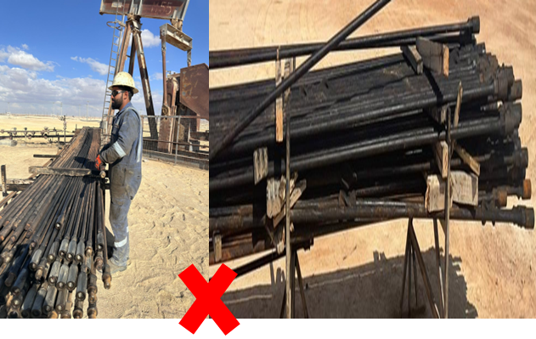
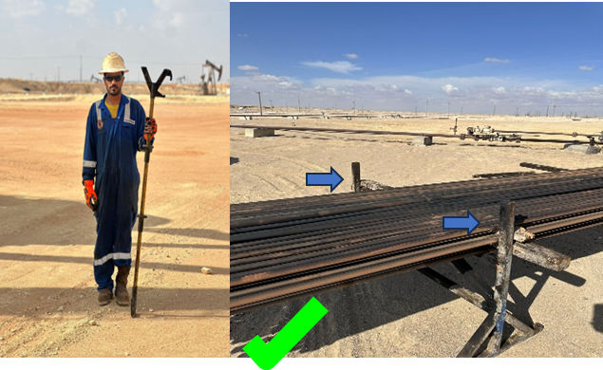
PDO Second Alert
Date: 11/10/2024 Incident title: HiPo#35c Pattern: حالة غير آمنة Potential severity: C4P
الفئة المستهدفة: عمليات الحفر وخدمة الآبار
ماذا حدث؟
في يوم الجمعة 11 أكتوبر الساعة 14:21، كان الطاقم ينفذ مهمة POOH عن طريق وضع قضبان الحديد (سكر رود) باستخدام وحدة FBU المتمركزة أمام رأس البئر وسحب السكر رود من البئر باستخدام مصعد رافعة الرود لوضعه على حامل الرود الموجود خلف رأس البئر. تم بالفعل وضع الطول الكامل للرود على فواصل المستوى الخشبي و كان أحد أفراد الطاقم يقف في الجزء الخلفي من حامل الرود على الجانب الايسر للتأكد من عدم إعاقة الرود أثناء وضعه. قام أحد أفراد الطاقم بإعادة ضبط الواجهة الخلفية للرود لإفساح المجال لقضبان اخرى مما جعل الواجهة الأمامية من الرود بالتدحرج والسقوط على الأرض (90 سم). أجبرت هذه الحركة الواجهة الخلفية (حيث كان أحد افرادالطاقم يقف) على التأرجح للاعلى فجأة لتصتدم بفمه.
مما أدى إلى خلع أحد الأسنان وكسر في سن آخر
نتائج التحقيق:
تم تكديس حامل قضبان الحديد (سكر رود) إلى الحد الأقصى واستمرت المهمة
لم تكن فواصل المستوى الخشبي بنفس المستوى مما يجعل كومة القضبان غير مستقرة
كان على أحد أفراد الطاقم إعادة ضبط الرود المعني فعليًا، مما اجبره من الوقوف بالقرب من حامل الرود
أدت إعادة ضبط الرود إلى سقوط الواجهة الأمامية للرود من حامل الرود، مما أدى فجأة إلى ا رتفاع الواجهة الخلفية حيث كان أحد افراد الطاقم يقف مما ادي الى ضربه على فمه.
الدروس المستفادة من الحادثة:
. قم دائمًا بمراقبة سعة التحميل الآمنة للمعدات المستخدمة بصريًا وفعلياً اثنا العمل
تأكد دائمًا من أن الأدوات الاساسية والثانويةالمستخدمة مع المعدات آمنة ومناسبة وكافية للمهمة
قبل القيام بمهمة روتينية دائمًا قييم وإعادة تقييم المخاطر الواضحة والمحتملة، وطرح الأسئلة إذا كان لديك شك.
قم دائمًا باستخدام صلاحية ايقاف العمل (SWA) واطلب من المسئولين التوضيح/التوجيه بشأن سلامة العملية/النشاط.
صورة توضح الخطأ الذي حدث
صورة توضح كيفية القيام بذلك بشكل صحيح
لا تضع نفسك أبدًا في أي مخاطر"خط نار "محتمله
Notes:
Ensure all dates and titles are input
A short description should be provided without mentioning names of contractors or individuals. You should include, what happened, to who (by job title) and what injuries this resulted in. Nothing more!
Four to five bullet points highlighting the main findings from the investigation. Remember the target audience is the front line staff so this should be written in simple terms in a way that everyone can understand.
The strap line should be the main point you want to get across
The images should be self explanatory, what went wrong (if you create a reconstruction please ensure you do not put people at risk) and below how it should be done.

