Slide 1
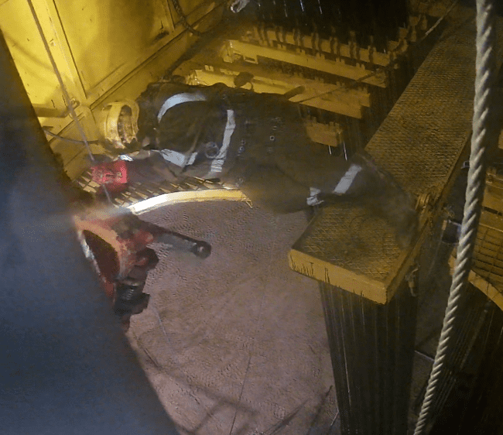

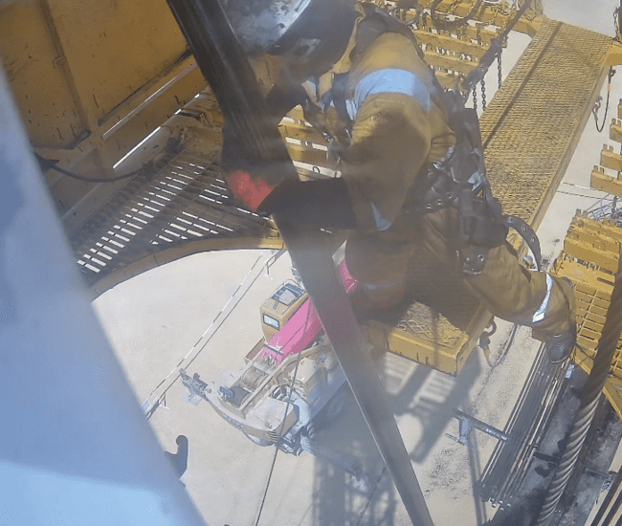
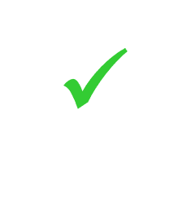
Date: 25/10/2024 Incident title: HIPO Pattern: Slip Potential severity: C4P Activity: RIH Drill Pipe
Target Audience: Drilling & workover Operation.
What happened?
During the operation to run the cleanout string with 3-1/2" drill pipe stands, the derrickman attempted to latch the first joint of the 3-1/2" drill pipe. Unfortunately, he lost control of the stand's movement, resulting in him losing his balance and falling off the driller’s side edge on the monkey board. no injury was sustained.
Why it happened/ Finding:
Safety meeting, JSA & Toolbox talk with Musta’ed were conducted before operations and work instructions in place
Before starting the job, all required pre-checks for the Harness and lanyard were done, and all inspections were completed.
While the Derrick Man attempted to latch the joint, he unfortunately lost control of the stand movement.
The DM checked the lanyard to ensure that the lanyard's parameters were satisfactory.
The DM failed to stop and release the stand when he noticed he had lost control of the stand movement.
the final position of DM
Your learning from this incident..
Always ensure effective TBT is in place before starting any job and Musta’ed implementation
Always check the harness and lanyard condition before starting the job.
Always ensure that the stand's movement is guided and controlled with careful attention, maintaining complete control at all times.
Always maintain proper body posture techniques while standing for RIH.
Maintain complete control of the stand.
Always ensure that the stand's movement is guided and controlled with careful attention, maintaining complete control
Notes:
Green Tick all Musta’ed Steps which were followed
Red Cross all Musta’ed steps which were not followed

Slide 2
Effective Learning
Date: 25/10/2024 Incident title: HIPO Pattern: Slip Potential severity: C4P Activity: RIH Drill Pipe
To make sure learning is translated to the site day to day activities , please answer the below questions :-
How learning can be implemented at site?
Awareness sessions will ensure that DMs understand and adhere to proper techniques while working on the monkey board.
How can you sustain the action?
CCTV Representee will be focused on observing DM techniques while RIH stands
The learning to be tracked and addressed on the LFI tracker
Disclaimer
This document is provided for information only. It may not be relied upon for any purpose. Neither PDO nor any party providing information for this document accepts any liability for its accuracy, completeness, omissions, advice, or any consequences arising from its use, even if reasonable care was not exercised. No representation or warranty, express or implied, is made that following this document will achieve any specific results or meet any legal or regulatory requirements. This document does not constitute technical advice; consult a qualified professional if such advice is needed
Notes:
Guideline for Effective Learning & Sustainability
•Can be replicated across similar contractor / activities
•Shall be SMART- Specific ,Measurable , Achievable ,Realistic & Timebound
•Can be implemented in a months' time

