Slide 1
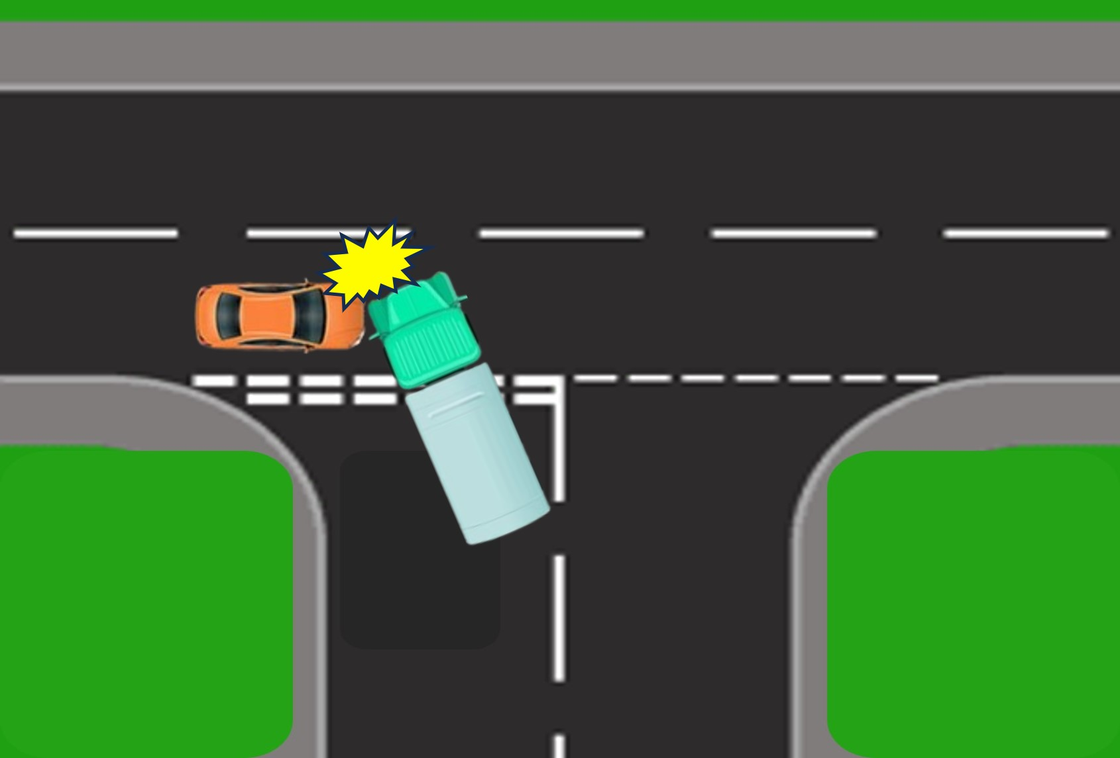
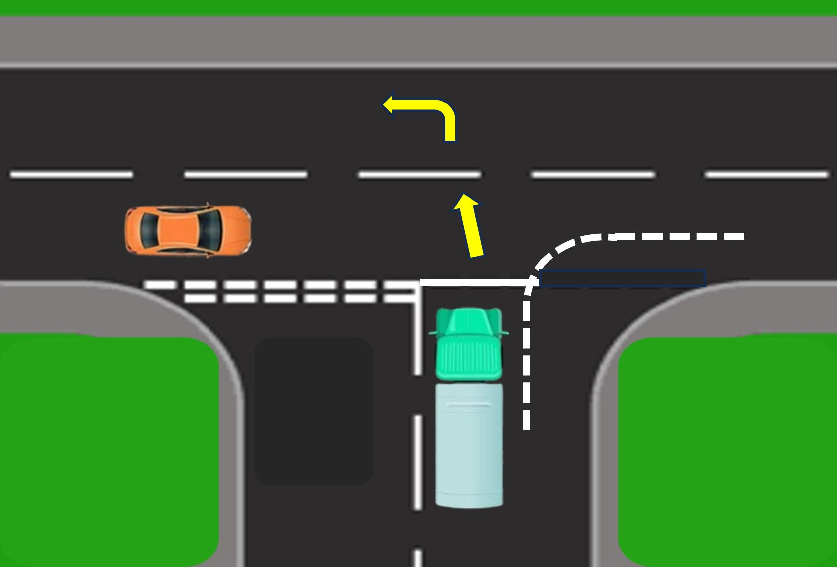

PDO Second Alert
Date: Time: | 20/11/2024 11:05 | Incident title: PIM# | HiPo#38 1172574 | Risk Category: Injury / Asset Damaged: | MVI Rollover Asset Damage | Actual Severity: Potential severity: | 3A C5P | Activity: Location: | Driving Fahud
Target Audience: Logistics, Operation & Construction
What happened?
A 3-ton canter collided with a private vehicle owned by an employee at the FHD-Qarn Alam Road T-junction. The collision occurred when the driver, attempting to turn left toward the Fahud area, failed to stop, hitting the private vehicle traveling towards Natih. The canter carried four occupants, while the private vehicle had only the driver.
Why it happened/Finding :
The Driver was taking a left turn before reaching the middle of the junction.
The driver was unfamiliar with the route and believed he was taking a curve.
No Intervention from the crew for the driver behavior.
Reflective Questions
Do you always fully stop and check both sides before entering the T-junction?
How do you ensure you always follow the road signages and speed limit?
Are you aware of the relevant defensive driving techniques for your journey and do you follow them?
Always give way to on-coming traffic at junctions
Notes:
Ensure all dates and titles are input
A short description should be provided without mentioning names of contractors or individuals. You should include, what happened, to who (by job title) and what injuries this resulted in. Nothing more!
Four to five bullet points highlighting the main findings from the investigation. Remember the target audience is the front line staff so this should be written in simple terms in a way that everyone can understand.
The strap line should be the main point you want to get across
The images should be self explanatory, what went wrong (if you create a reconstruction please ensure you do not put people at risk) and below how it should be done.

Slide 2
Management Self-audit
Date:20/11/2024 Incident title: HiPo#38 Pattern: MVI Potential severity: C5P Activity: Driving
As a learning from this incident and ensure continual improvement all contract managers must review their HSE risk management against the questions asked below
Confirm the following:
- What criteria should be used to identify risky driver behaviors effectively?
- How frequently should driver evaluations be conducted to ensure consistent improvement?
- What formal procedures can be developed to effectively address and manage unusual driver behavior?
- How can periodic reviews of these procedures ensure they remain fair, effective, and aligned with organizational goals?
* If the answer is NO to any of the above questions please ensure you take action to correct this finding
Disclaimer
This document is provided for information only. It may not be relied upon for any purpose. Neither PDO nor any party providing information for this document accepts any liability for its accuracy, completeness, omissions, advice, or any consequences arising from its use, even if reasonable care was not exercised. No representation or warranty, express or implied, is made that following this document will achieve any specific results or meet any legal or regulatory requirements. This document does not constitute technical advice; consult a qualified professional if such advice is needed
Notes:
Ensure all dates and titles are input
Make a list of closed questions (only ‘yes’ or ‘no’ as an answer) to ask others if they have the same issues based on the management or HSE-MS failings or shortfalls identified in the investigation.
Imagine you have to audit other companies to see if they could have the same issues.
These questions should start with: Do you ensure…………………?

