Slide 1
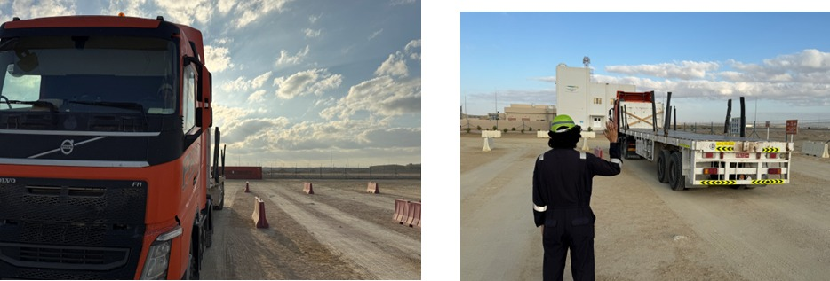
PDO Second Alert
Date: Time: | 17/12/2024 12:40 | Incident title: PIM# | HiPo#38B 1173291 | Risk Category: Injury / Asset Damaged: | Fire Asset Damage | Actual Severity: Potential severity: | 2A C4P | Activity: Location: | Driving Fahud
Target Audience: Logistics, Operation & Construction
What happened?
On 17th December 2024, at approximately 1240 hours, a truck caught fire near Awafiya (5.8 kms to Natih roundabout) while transporting 20 Jumbo Salt bags to Fahud Warehouse. The fire originated in the diesel tank area, leading to the complete burning of the truck and partial burning of the trailer, damaging 12 chemical bags. The driver heard an abnormal sound near the diesel tank area (passenger side) and immediately parked the truck aside. When he went down, he found the fire igniting in the diesel tank area. Despite using five fire extinguishers, the driver was unable to control the fire due to heavy wind which helped the fire ignite more.
The ROP and the PDO Emergency Team were notified and arrived at the scene by 1315 hours. The fire was fully extinguished at 1350 hours.
There were no injuries, and the driver was found to be in good health after a check-up, assurance taken from Fahud PDO clinic.
Why it happened/Finding :
The driver escalated to JMCC that he has hit the Concrete block of a light pole, but this reporting was done late.
The JMCC informed the Ops Supervisor, but it was not escalated to PDO.
Proper inspection was not conducted after the hit
Reversing without banksman
Reflective Questions
Are all incidents reported to PDO on time?
How often do you check for changes or updates in road conditions or diversions before starting your journey?
Are you following all safety procedures, such as inspecting the vehicle and ensuring clear surroundings before reversing?
Reverse with no Banksman
Reverse with Banksman
Always ensure all clear before reversing the vehicle.
Notes:
Ensure all dates and titles are input
A short description should be provided without mentioning names of contractors or individuals. You should include, what happened, to who (by job title) and what injuries this resulted in. Nothing more!
Four to five bullet points highlighting the main findings from the investigation. Remember the target audience is the front line staff so this should be written in simple terms in a way that everyone can understand.
The strap line should be the main point you want to get across
The images should be self explanatory, what went wrong (if you create a reconstruction please ensure you do not put people at risk) and below how it should be done.

Slide 2
Management Self-audit
Date: Time: | 17/12/2024 12:40 | Incident title: PIM# | HiPo#38B 1173291 | Risk Category: Injury / Asset Damaged: | Fire Asset Damage | Actual Severity: Potential severity: | 2A C4P | Activity: Location: | Driving Fahud
As a learning from this incident and ensure continual improvement all contract managers must review their HSE risk management against the questions asked below
Confirm the following:
Do you ensure that the incident is reported promptly to all relevant stakeholders (e.g., HSE team, client, PDO)?
Do you ensure that there are clear guidelines and training for supervisors on incident escalation protocols?
Do you ensure that the JMCC team follow up effectively after being informed of the truck's issues?
Do you ensure that the drivers are properly trained on responding to unexpected situations like diesel leakage or collisions?
* If the answer is NO to any of the above questions please ensure you take action to correct this finding
Disclaimer
This document is provided for information only. It may not be relied upon for any purpose. Neither PDO nor any party providing information for this document accepts any liability for its accuracy, completeness, omissions, advice, or any consequences arising from its use, even if reasonable care was not exercised. No representation or warranty, express or implied, is made that following this document will achieve any specific results or meet any legal or regulatory requirements. This document does not constitute technical advice; consult a qualified professional if such advice is needed
Notes:
Ensure all dates and titles are input
Make a list of closed questions (only ‘yes’ or ‘no’ as an answer) to ask others if they have the same issues based on the management or HSE-MS failings or shortfalls identified in the investigation.
Imagine you have to audit other companies to see if they could have the same issues.
These questions should start with: Do you ensure…………………?

