Slide 1
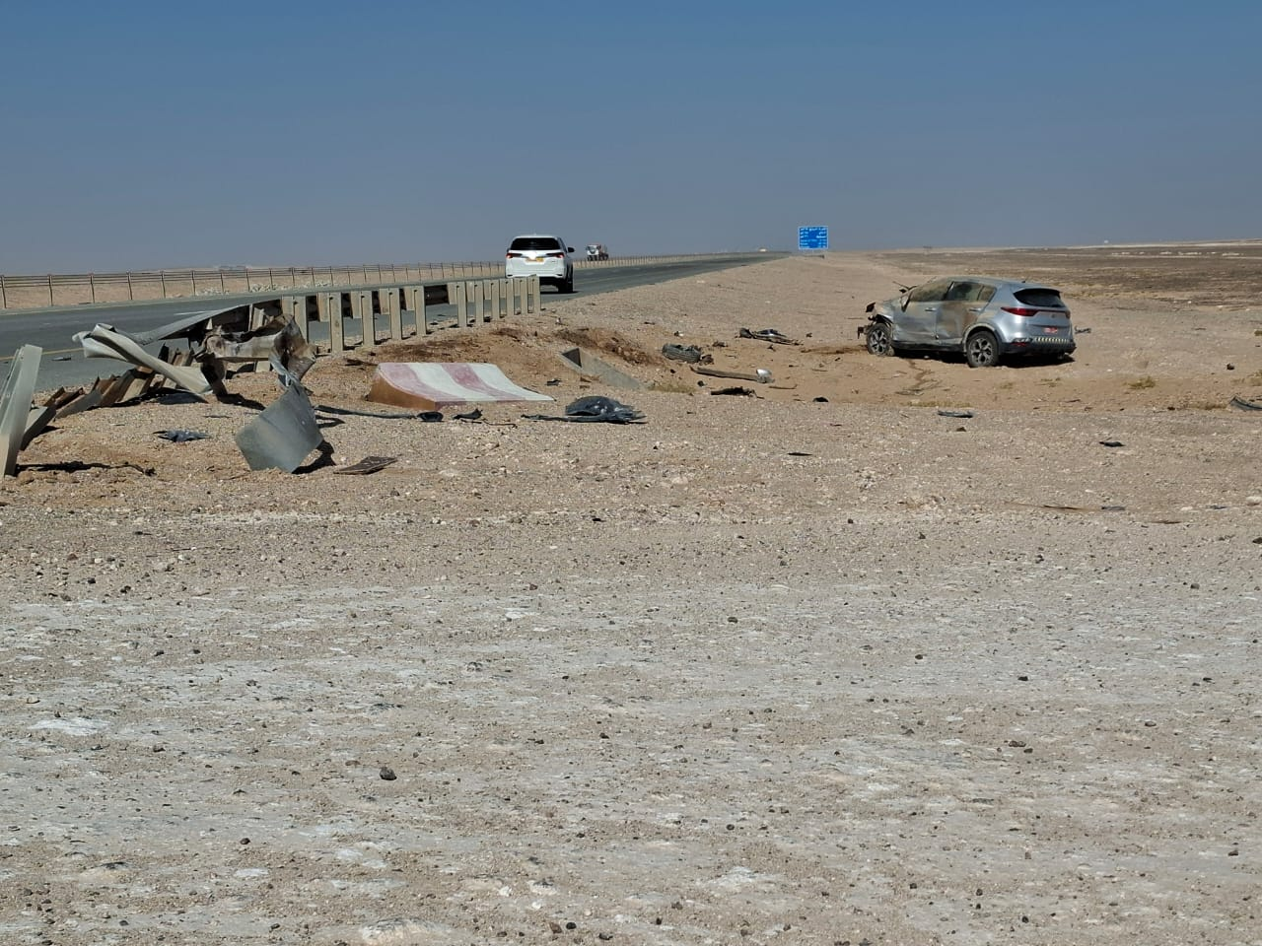
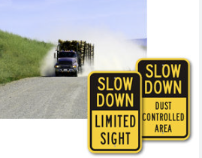
PDO Second Alert
Date: Time: | 22/12/2024 12:20 | Incident title: PIM# | HiPo#40 1173375 | Risk Category: Injury / Asset Damaged: | MVI Rollover Major vehicle damage | Actual Severity: Potential severity: | 2A D5P | Activity: Location: | Driving Qarn Alam
Target Audience: All
What happened?
On 22nd December 2024, at around 12:20 PM, Subcontractor was travelling on KIA Sportage from Qarn Alam to Abu Thailah HABUR G 911008 site, on the Muscat-Salalah Road. While travel to the site lost control and the vehicle crashed into a barrier and was propelled about 20 meters, landing on its side. Despite the force of the crash, the driver and passengers were unharmed, with no injuries reported.
Why it happened/Finding :
The driver/engineer was rushing to deliver food to site workers
The driver lost control of the vehicle while traveling at a high speed of 113 km/h.
The driver did not anticipate the road and weather conditions, resulting in a delayed and ineffective response to losing control.
Gusty winds and dust in the area likely contributed to the loss of control.
Reflective Questions
Are you aware of environmental factors that are crucial for maintaining control of your vehicle?
Do you ensure you adjust your speed according to road and environment conditions?
Do you stop and rest when you feel tired of fatigue stop and take rest.
How you manage your sub contractor?
Avoid driving in adverse weather
Follow the duct code , your life depends on it……
Notes:
Ensure all dates and titles are input
A short description should be provided without mentioning names of contractors or individuals. You should include, what happened, to who (by job title) and what injuries this resulted in. Nothing more!
Four to five bullet points highlighting the main findings from the investigation. Remember the target audience is the front line staff so this should be written in simple terms in a way that everyone can understand.
The strap line should be the main point you want to get across
The images should be self explanatory, what went wrong (if you create a reconstruction please ensure you do not put people at risk) and below how it should be done.

Slide 2
Management Self-audit
As a learning from this incident and ensure continual improvement all contract managers must review their HSE risk management against the questions asked below
Confirm the following:
Do you ensure adverse weather conditions are proactively identified?
Do you ensure that risks associated with driving in adverse weather conditions are assessed?
Do you ensure that all driver including subcontractor are having adequate rest?
Do you ensure the sub contractor compliance to SP2000?
Do you ensure that DFMS / IVMS monitoring, and intervention wherever required?
Do you ensure that Driver always report any defect in the vehicle to Journey manager?
* If the answer is NO to any of the above questions please ensure you take action to correct this finding
Disclaimer
This document is provided for information only. It may not be relied upon for any purpose. Neither PDO nor any party providing information for this document accepts any liability for its accuracy, completeness, omissions, advice, or any consequences arising from its use, even if reasonable care was not exercised. No representation or warranty, express or implied, is made that following this document will achieve any specific results or meet any legal or regulatory requirements. This document does not constitute technical advice; consult a qualified professional if such advice is needed
Notes:
Ensure all dates and titles are input
Make a list of closed questions (only ‘yes’ or ‘no’ as an answer) to ask others if they have the same issues based on the management or HSE-MS failings or shortfalls identified in the investigation.
Imagine you have to audit other companies to see if they could have the same issues.
These questions should start with: Do you ensure…………………?

