Slide 1
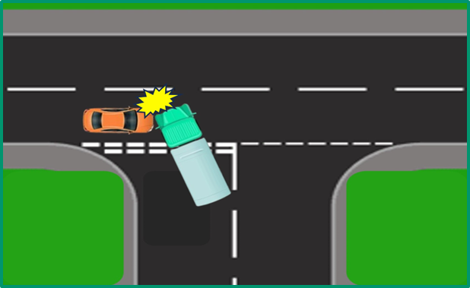
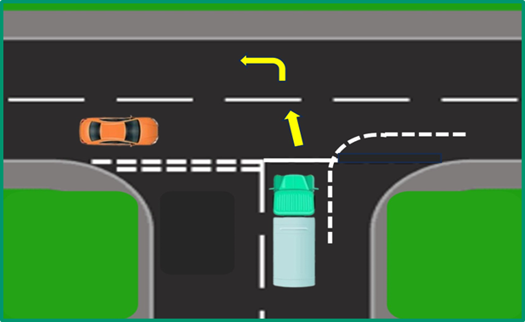
PDO Second Alert
Date: Time: | 22/ 12/ 2025 14:50 | Incident title: PIM# | HiPo#40 1173373 | Risk Category: Injury / Asset Damaged: | MVI Rollover Asset Damage | Actual Severity: Potential severity: | 2A C4P | Activity: Location: | Driving SIMR DEV - 2
Target Audience: Drilling, Logistics, Operation & Construction
What happened?
On 22/12/2024, at approximately 14:50, a Renault transit mixer(No: 4530 YS) was traveling from SRL
to SIMR DEV/2 lost control while making a left turn near its destination. This caused the truck to
topple onto its right side on the route. Fortunately, no injuries were reported.
Why it happened/Finding :
Poor Planning of activity led to Driver being in a haste to complete the trip
Driver was taking a left turn at 60km/h which led to his vehicle becoming unstable.
Driver was taking a diagonal exit from the main road into junction.
Reflective Questions
To Focal Point:
Do you always plan your activity in advance to prevent tight schedules?
How do you ensure that you always communicate to finish job in a safe manner?
To Driver:
Do you ensure you slow down and take the correct exit
How do you ensure you always follow the road signages and speed limit?
Are you aware of the relevant defensive driving techniques for your journey and do you follow them?
Always Slow-down your vehicle at junctions

Slide 2
Management Self-audit
Date:22/12/2024 Incident title: Pattern: MVI Potential severity: C4P Activity: Driving
As a learning from this incident and ensure continual improvement all contract managers must review their HSE risk management against the questions asked below
Confirm the following:
Do you ensure end-to-end planning is done to identify activities that may impact on Driver’s tasks?
Do you ensure that risky driver behaviours are identified effectively?
Do you ensure conducting the driver evaluations for consistent improvement?
Do you review the RAG report daily to determine the driver's behaviours?
Do you ensure conducting the traffic drill to identify the driver's behaviours?
* If the answer is NO to any of the above questions please ensure you take action to correct this finding
Disclaimer
This document is provided for information only. It may not be relied upon for any purpose. Neither PDO nor any party providing information for this document accepts any liability for its accuracy, completeness, omissions, advice, or any consequences arising from its use, even if reasonable care was not exercised. No representation or warranty, express or implied, is made that following this document will achieve any specific results or meet any legal or regulatory requirements. This document does not constitute technical advice; consult a qualified professional if such advice is needed
Notes:
Ensure all dates and titles are input
Make a list of closed questions (only ‘yes’ or ‘no’ as an answer) to ask others if they have the same issues based on the management or HSE-MS failings or shortfalls identified in the investigation.
Imagine you have to audit other companies to see if they could have the same issues.
These questions should start with: Do you ensure…………………?

