Slide 1
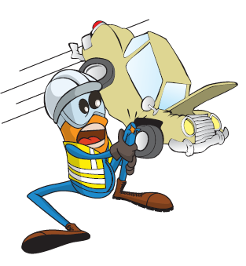
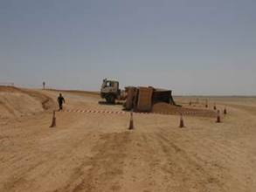


PDO Incident First Alert
Incident type | LTI(#08) | PIM ID | 1088772
Date/ time | 6/03/2015 (07:55 hrs) | Directorate
Location | Rabab Harweel | Dept
What happened
A 53 year old tipper driver driving an articulated tipper truck laden with sand took a short cut up a steep ramp. He was forced to brake when he missed his gear and the trailer rolled back down the ramp and overturned causing the cab to lift off the ground. The cab dropped back down to earth when the pin connecting the tipper to the cab snapped. The impact fractured the drivers pelvis.
Trailer on side
Mr. Musleh asks the questions of can it happen to you?
Do you avoid taking shortcuts on your route?
Do you know the size and capabilities of your vehicle?
Do you check your vehicle is not overloaded for the road conditions / terrain?
Do you check your vehicle is in good working order?
Please disseminate this LTI notification to your teams and use it in your tool box talks and HSE meetings and notice boards.

