Slide 1
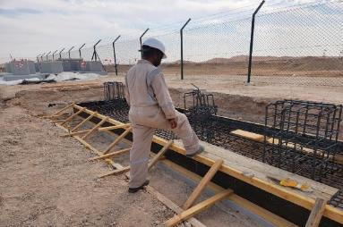
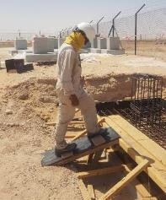
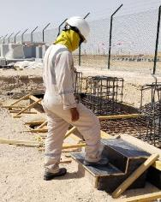
PDO Second Alert
Date: 14/03/2023 Incident title: LTI#02 Pattern: Personal Injury Potential severity: C3P Activity: Formwork, Steel Fixing
Target Audience: Drilling, Logistics, Operation & Construction
What happened?
On 14 March 2023 at 3:40 pm, while the steel Fixer, returning back from the rest shelter after drink water, stepped on the shuttering runner, lost balance and fell resting his left hand resulting in minor swelling and pain. He was initially seen by Medic and referred to Aster hospital in Ibri for detailed examination as advised by PDO Doctor, where X ray has taken which revealed displaced fracture involving distal radius.
Why it happened/Finding :
Steel fixer did not follow the human kinetic practices and was placing the foot in an unsafe manner on top of the wooden runner, which caused him to lose balance.
The steel fixer failed to pay attention to his footing and surroundings which lead to loss of his balance
The steel fixer was performing a routine activity without conscious thought and as a result was exposed to the hazard and fell.
Your learning from this incident..
Always be cautious of your surroundings and the hazards involved
Ensure the provision of safe access and egress in your work site and its correct use.
Ensure you intervene when you observe any unsafe act / condition
Watch your steps to avoid trips & falls
Notes:
Ensure all dates and titles are input
A short description should be provided without mentioning names of contractors or individuals. You should include, what happened, to who (by job title) and what injuries this resulted in. Nothing more!
Four to five bullet points highlighting the main findings from the investigation. Remember the target audience is the front line staff so this should be written in simple terms in a way that everyone can understand.
The strap line should be the main point you want to get across
The images should be self explanatory, what went wrong (if you create a reconstruction please ensure you do not put people at risk) and below how it should be done.

Slide 2
Management self audit
Date: 14/03/2023 Incident title: LTI#02 Pattern: Personal Injury Potential severity: C3P Activity: Form work and Steel Fixing
As a learning from this incident and ensure continual improvement all contract managers must review their HSE risk management against the questions asked below
Confirm the following:
Do you ensure that the hazards involved have been effectively assessed and captured in the TBT discussion prior to deploying the crew for the task?
Do you ensure the provision of safe access and egress for all parts of the work?
Do you ensure risk assessments and method statements are adequately capturing key stages of the activities involved?
Do you ensure your crews use and follow safe access and egress?
Do you ensure that the workers are aware of their authority to stop unsafe work practices?
* If the answer is NO to any of the above questions please ensure you take action to correct this finding
Disclaimer
This document is provided for information only. It may not be relied upon for any purpose. Neither PDO nor any party providing information for this document accepts any liability for its accuracy, completeness, omissions, advice, or any consequences arising from its use, even if reasonable care was not exercised. No representation or warranty, express or implied, is made that following this document will achieve any specific results or meet any legal or regulatory requirements. This document does not constitute technical advice; consult a qualified professional if such advice is needed
Notes:
Ensure all dates and titles are input
Make a list of closed questions (only ‘yes’ or ‘no’ as an answer) to ask others if they have the same issues based on the management or HSE-MS failings or shortfalls identified in the investigation.
Imagine you have to audit other companies to see if they could have the same issues.
These questions should start with: Do you ensure…………………?

