Slide 1
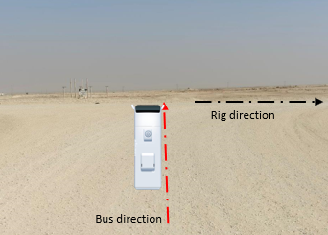
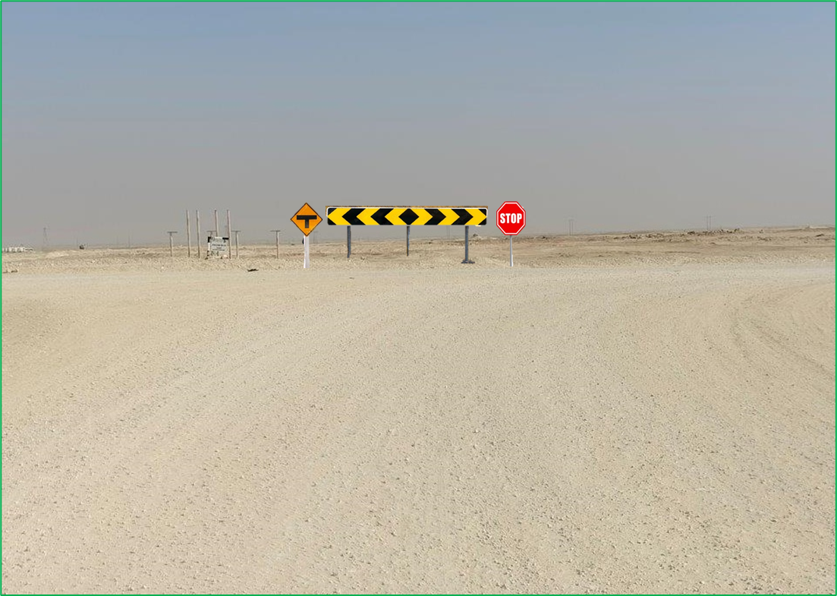
Learning From Incident - First Alert
Prevent
PIM # | 1174063 | Date & Time | 16.01.2025, 15:00 PM | Location | Runib South 48
Incident Type | LTI#01 | Category | Driving | Activity | Driving
Target Audience: All
What happened:
At 2:45 PM, the Rig Driver was transporting two passengers from the Rig Camp to the Rig site using the crew bus. On the way to the Rig site, at 3:00 PM, the Driver received instructions to collect a parcel for the Rig from a nearby location on Blacktop Road. After picking up the parcel, the Driver was driving on a graded road and was supposed to make a right turn at a T-junction.
However, at 3:15 PM, as the Driver approached the T-junction, he went straight across the road instead of turning right, driving at a speed of 70 km/h. This caused a sudden jerk in the bus. Although the Driver was able to stop the bus safely, he reported back pain. He was subsequently taken to Haima Hospital where he was diagnosed with an injury to one of the vertebral bones.
Initial Findings:
The Bus was serviced and inspected, the RAS was valid, and no defects were identified.
Driver Fatigue Management System (DFMS) was not installed.
The graded road conditions were good; however, no sign was posted at the T-junction to alert drivers.
As the vehicle approached the T-junction, the Driver continued at the same speed of 70 km/h, not aware of the need to slow down for the turn.
Engagement Questions:
Do you check for any missing signboards during route surveys?
Do you confirm that the DFMS is installed and operational in the replacement buses?
What measures do you implement to enhance drivers' awareness and ensure they remain alert and focused while driving?
Always stay attentive while driving and STOP at the T-Junction.
In case of an emergency please call PDO Emergency Number (Toll Free): 2467-5555
Notes:
Mr Musleh image on the top right will change according to incident pattern, MSE3 will provide you with the image as per the pattern
What happened: A short description should be provided without mentioning names of contractors or individuals. You should include, what happened, to who (by job title) and what injuries this resulted in. Nothing more!
Initial Finding: Four to five bullet points highlighting the initial main findings from the investigation. Remember the target audience is the front-line staff so this should be written in simple terms in a way that everyone can understand.
Learnings: Four to five learning message in the form of questionnaires linked with initial findings
The strap line should be the main learning point you want to get across
The images should be self explanatory, what went wrong (if you create a reconstruction please ensure you do not put people at risk) and below how it should be done.

