Slide 1
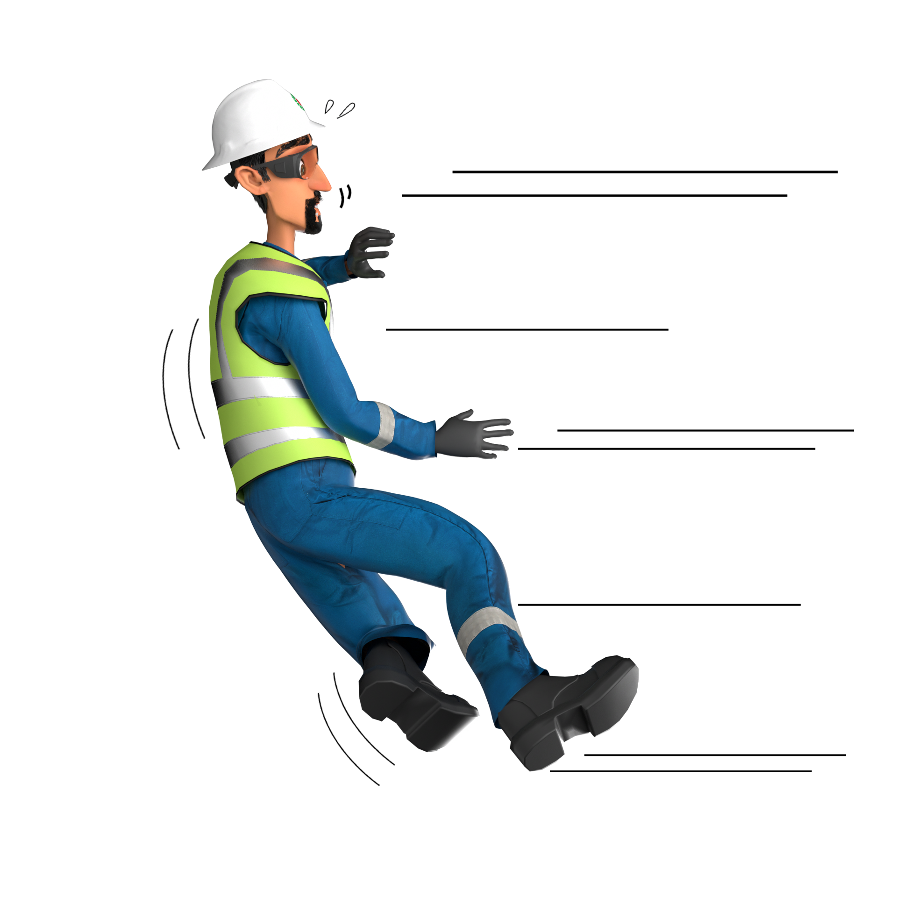
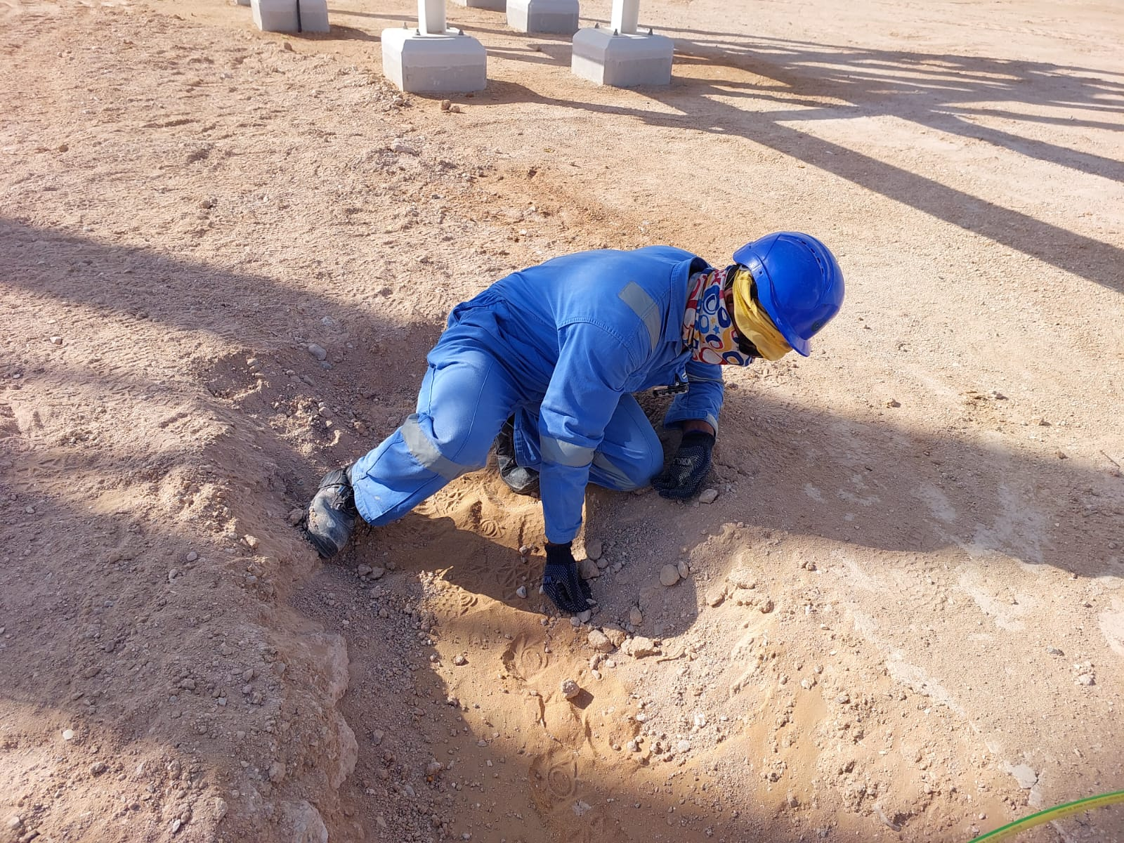
Learning From Incident - First Alert
Prevent
PIM # | 1161934 | Date | 03.01.2024 | Direct / Depart
Incident Type | LTI#01 | Time | 11:00 hrs | Location | RM Station, Yibal
Pattern | Slip, Trip & Fall | Contractor |  | Activity | Back filling
Target Audience: Mason, Equipment Operators, Mechanics, Supervisor …
What happened:
While the Mason was walking he twisted his ankle and fell into a trench hitting his left arm on the ground resulted to fractured left arm.
Initial Findings:
IP was placed his foot on edged of excavated area, which caused him to lose balance.
The IP was performing a routine activity without conscious thought
Engagement Questions:
How do you identify Slip, Trips and fall hazards around your working location?
Why is it important to pay attention where you are stepping?
How do you ensure crew are utilizing safe access/aggress at your site?
Always ensure to pay attention where you are stepping
In case of an emergency please call PDO Emergency Number (Toll Free): 2467-5555
Notes:
Mr Musleh image on the top right will change according to incident pattern, MSE3 will provide you with the image as per the pattern
What happened: A short description should be provided without mentioning names of contractors or individuals. You should include, what happened, to who (by job title) and what injuries this resulted in. Nothing more!
Initial Finding: Four to five bullet points highlighting the initial main findings from the investigation. Remember the target audience is the front-line staff so this should be written in simple terms in a way that everyone can understand.
Learnings: Four to five learning message in the form of questionnaires linked with initial findings
The strap line should be the main learning point you want to get across
The images should be self explanatory, what went wrong (if you create a reconstruction please ensure you do not put people at risk) and below how it should be done.

