Slide 1
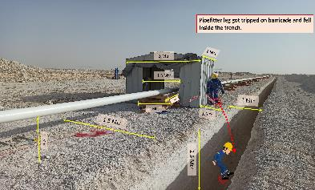
PDO Second Alert
Date:04/01/2022 Incident title: LTI#01 Pattern:Slip & Trip. Potential severity: C4P
Target Audience: Operation & Construction
What happened?
On 4th Jan 2022 at approx. 09:30 Hrs in the flow line (FL-01) area, a crew was engaged in preparatory work for the fit-up activities of 8” flow line. After mark up of the pipe, the pipe fitter walked in between the trench barricading and the welding booth to walk past the booth, during which time, his leg tripped over the barricading, resulting in loss of balance and causing his fall into the trench which is almost 2.5mtr deep. This fall resulted in a minor fracture on the calcaneus bone of the left foot.
Why it happened/Finding :
Lack of appropriate barrier
Use of Inappropriate access.
Slip & Trip
Your learning from this incident..
Always use only authorized access.
Always provide appropriate barrier.
Always respect the barriers.
Watch your steps while moving.
Never walk on the edge of the trench.
ENSURE APPROPRIATE BARRICADE, USE PROPER ACCESS
Notes:
Ensure all dates and titles are input
A short description should be provided without mentioning names of contractors or individuals. You should include, what happened, to who (by job title) and what injuries this resulted in. Nothing more!
Four to five bullet points highlighting the main findings from the investigation. Remember the target audience is the front line staff so this should be written in simple terms in a way that everyone can understand.
The strap line should be the main point you want to get across
The images should be self explanatory, what went wrong (if you create a reconstruction please ensure you do not put people at risk) and below how it should be done.

Slide 2
Management self audit
Date:04/01/2022 Incident title: LTI#01 Pattern:Slip & Trip. Potential severity: C4P
As a learning from this incident and ensure continual improvement all contract managers must review their HSE risk management against the questions asked below
Confirm the following:
Do you ensure the employees are using an appropriate access at the site ?
Do you ensure the barrier is appropriate/sufficient to prevent the movement of personnel?
Do you ensure all Hazards /controls identified in HEMP are addressed in TRIC ?
* If the answer is NO to any of the above questions please ensure you take action to correct this finding
Notes:
Ensure all dates and titles are input
Make a list of closed questions (only ‘yes’ or ‘no’ as an answer) to ask others if they have the same issues based on the management or HSE-MS failings or shortfalls identified in the investigation.
Imagine you have to audit other companies to see if they could have the same issues.
These questions should start with: Do you ensure…………………?

