Slide 1
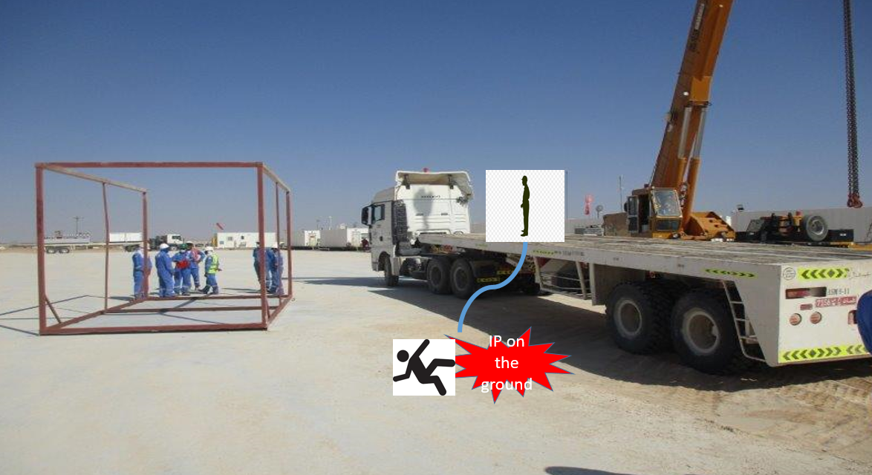
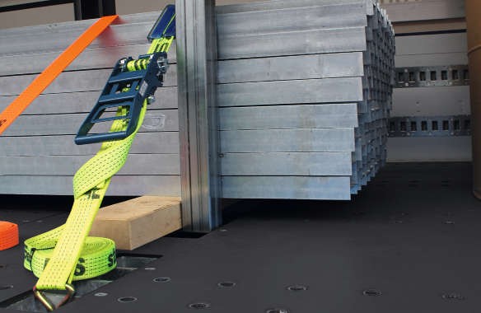
PDO Second Alert
Date: 02.01.2021 Incident type: LTI#01
What happened?
On 02nd Jan 2021, at around 11:15 Hrs. Operation was General Rig move from old location to new location which the destination was 1.7 km. Operations was moving ambulance shade frame from to new location using ASM flat-bed truck. Helper climbed on the top of the trailer to unsecure / release the load. IP was required to be inside of the frame to perform this task. After completing the removal of the chains and boomers, one weld on a beam of the frame resting on the truck deck failed from the passenger side of the truck bed. This resulted in a weight shift and allowed the frame to come / roll off of the truck bed (driver’s side). While the frame was moving the IP (still on truck bed) lost his balance on the edge of the truck bed and fell to the ground from 1.6 m height on the driver’s side, landed on his right hand. The IP reported to the Rig Medic and received first aid treatment whom referred to him to Ibri hospital for x ray. IP had an ortho doctor consultation in Ibri hospital, after the medical evaluation diagnosed a wrist fracture on his
Your learning from this incident..
Always ensure load are secured from the ground.
Ensure review of the JSA and mitigate the need to work from truck bed
Ensure engagement of sub contractors in adhering the BBS program
Ensure adequate supervision always on location
Always secure the load from the ground
Notes:
Ensure all dates and titles are input
A short description should be provided without mentioning names of contractors or individuals. You should include, what happened, to who (by job title) and what injuries this resulted in. Nothing more!
Four to five bullet points highlighting the main findings from the investigation. Remember the target audience is the front line staff so this should be written in simple terms in a way that everyone can understand.
The strap line should be the main point you want to get across
The images should be self explanatory, what went wrong (if you create a reconstruction please ensure you do not put people at risk) and below how it should be done.

Slide 2
Management self audit
Date: 02.01.2021 Incident type: LTI#01
As a learning from this incident and ensure continual improvement all contract
managers must review their HSE HEMP against the questions asked below
Confirm the following:
Do you ensure that you are audit and review your sub contractor management system.
Do you ensure that line of fire is considered in your risk assessment.
Do You Ensure the loads are secured as per SP 2001?
Do you ensure that loads are inspected and free from damage prior handling.
Do you ensure that all subcontractors are engaged in BBS Program and adhere to apply stop work authority .
Do you ensure that HEMP is communicated to rig movers and to all personnel.
* If the answer is NO to any of the above questions please ensure you take action to correct this finding.
Notes:
Ensure all dates and titles are input
Make a list of closed questions (only ‘yes’ or ‘no’ as an answer) to ask others if they have the same issues based on the management or HSE-MS failings or shortfalls identified in the investigation.
Imagine you have to audit other companies to see if they could have the same issues.
These questions should start with: Do you ensure…………………?

