Slide 1
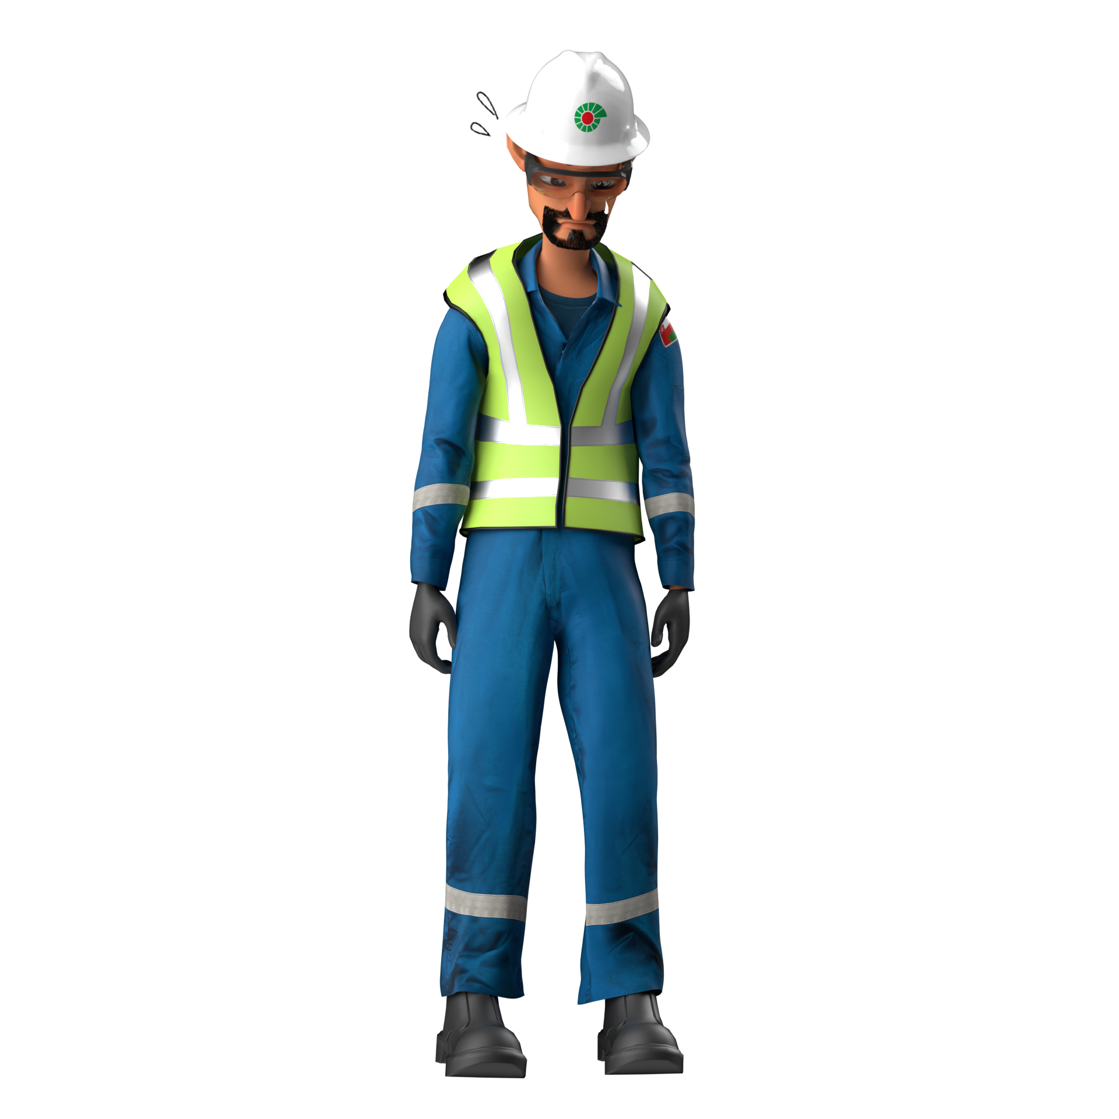
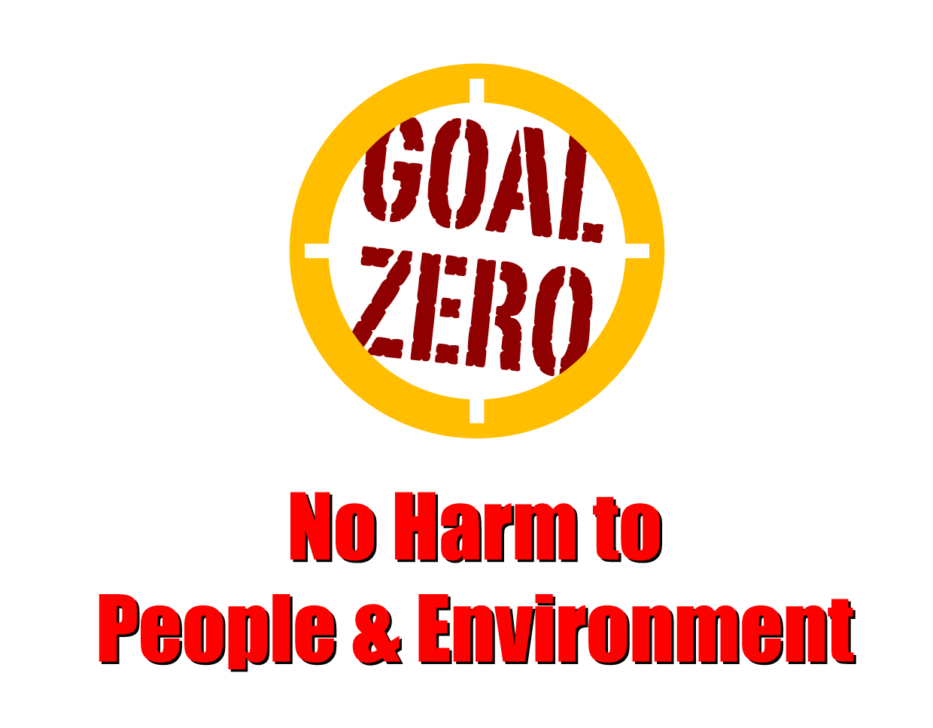
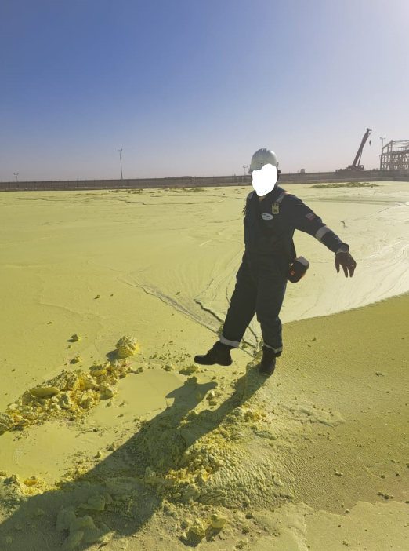
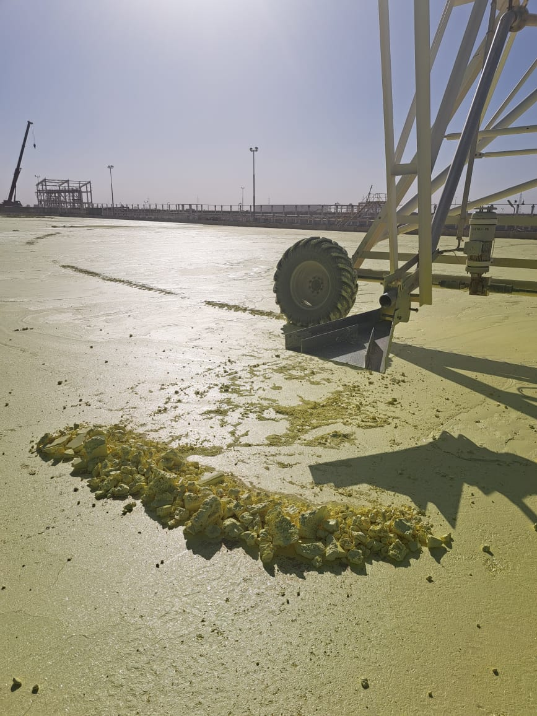
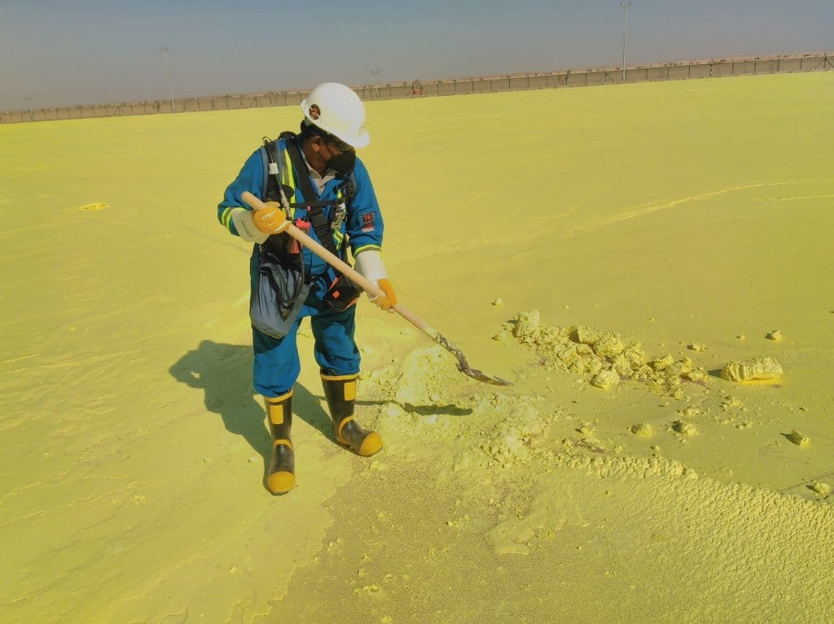
Learning From Incident - First Alert
Prevent
PIM # | 1150055 | Date | 09.02.2023 | Direct / Depart
Incident Type | LTI#01 | Time | 15:00 hrs | Location | Yibal Khuff
Pattern | Chemical Burn | Contractor |  | Activity | Sulphur Pouring
Target Audience: All
What Happened:
While field operator was inside the boundary of Sulphur blocking area to remove the build-up Sulphur using his right foot, he stepped on a thin crust of solid Sulphur which was not completely solidified underneath and his foots exposed to hot liquid Sulphur resulted in burn injuries on both ankles. He was initially treated at PDO Yibal clinic before being referred to Nizwa Hospital where revealed 2nd degree burn in the ankle.
Initial Findings:
Sulphur was hot and not completely solidified.
Field Operator was trying to drag the solid portion of Sulphur using his right foot.
Field Operator was using the normal PPE which are not suitable for the liquid /molten Sulphur.
Lack of supervision and intervention.
Non availability of Safety Signages/Cautions for hazards (Hot Sulphur Hazards/Mandatory PPE).
Initial Learnings:
How do you ensure the work is effectively supervised ?
How do you ensure correct PPE is worn?
What process do you have in place to ensure the operators are aware of hazard associated with the task ?
How do you effectively manage risk associated with Sulphur block access?
Adhere to Safe Operating Procedure (SOP)
In case of an emergency please call PDO Emergency Number (Toll Free): 2467-5555
Notes:
Mr Musleh image on the top right will change according to incident pattern, MSE3 will provide you with the image as per the pattern
What happened: A short description should be provided without mentioning names of contractors or individuals. You should include, what happened, to who (by job title) and what injuries this resulted in. Nothing more!
Initial Finding: Four to five bullet points highlighting the initial main findings from the investigation. Remember the target audience is the front-line staff so this should be written in simple terms in a way that everyone can understand.
Learnings: Four to five learning message in the form of questionnaires linked with initial findings
The strap line should be the main learning point you want to get across
The images should be self explanatory, what went wrong (if you create a reconstruction please ensure you do not put people at risk) and below how it should be done.

