Slide 1
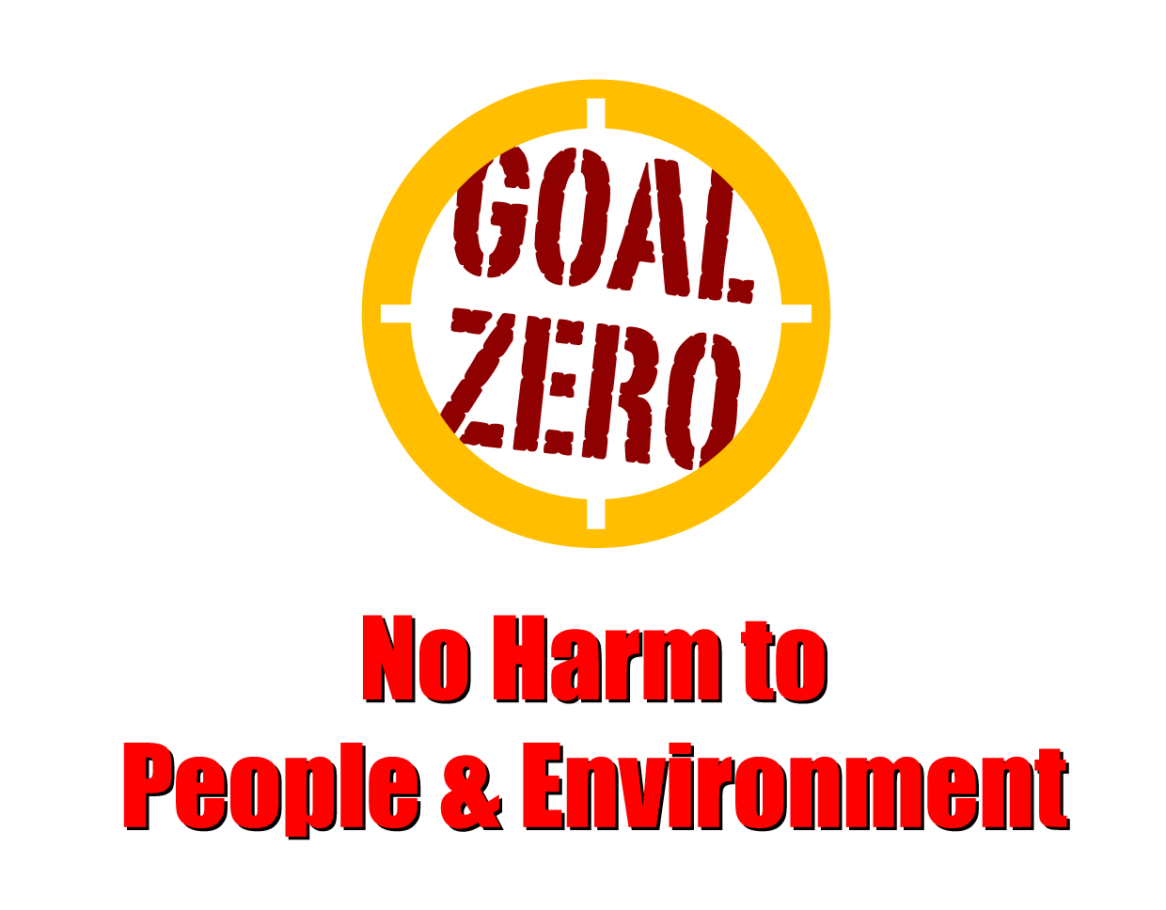
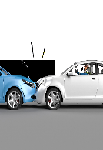
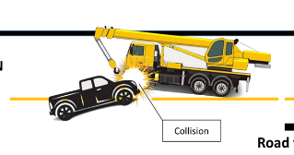
Learning From Incident - First Alert
Prevent
PIM # | 1162133 | Date | 14.01.2024 | Direct / Dept.
Incident Type | LTI#02& LTI#03 | Time | 14:16 PM | Location | Qarn Alam
Category | MVI | Contractor |  | Activity | Driving
Target Audience: All
What happened
On 14.1.2024 at approximately 14:16hrs, A pickup vehicle driven by the BST surveyor was involved in a collision with a mobile crane operated by STS. The pickup was en-route from Saih Rawl towards Qarn Alam on a diversion road after delivering food to his crew members at site. At around 14:14Hrs approximately 2Km away from Qarn Alam roundabout, the pickup veered onto the oncoming lane causing the front left corner of the pickup to collide with the front left corner of the STS crane approaching from Qarn Alam side.
X-rays revealed a compound fracture to Surveyor left arm and simple fracture to his left leg and knee. The Crane operator sustained simple fracture to his left knee. The helper (pickup passenger) was treated for minor injuries.
Initial Findings
The pickup was travelling at a speed of 101km/hr.
The speed limit for the diversion road was 40km/hr.
The pickup vehicle drove onto the oncoming lane with no signs of braking.
Engagement Questions:
How do you ensure that drivers are aware of speed limits on new routes/roads?
How do you know that drivers are well rested before commencing a journey?
As a driver, what steps do you take to ensure your safety while driving?
Follow the driving life saving rules and aintain the correct lanes while driving
Comply with the speed limits and stay alert while driving
In case of an emergency please call PDO Emergency Number (Toll Free): 2467-5555
Notes:
Mr Musleh image on the top right will change according to incident pattern, MSE3 will provide you with the image as per the pattern
What happened: A short description should be provided without mentioning names of contractors or individuals. You should include, what happened, to who (by job title) and what injuries this resulted in. Nothing more!
Initial Finding: Four to five bullet points highlighting the initial main findings from the investigation. Remember the target audience is the front-line staff so this should be written in simple terms in a way that everyone can understand.
Learnings: Four to five learning message in the form of questionnaires linked with initial findings
The strap line should be the main learning point you want to get across
The images should be self explanatory, what went wrong (if you create a reconstruction please ensure you do not put people at risk) and below how it should be done.

