Slide 1
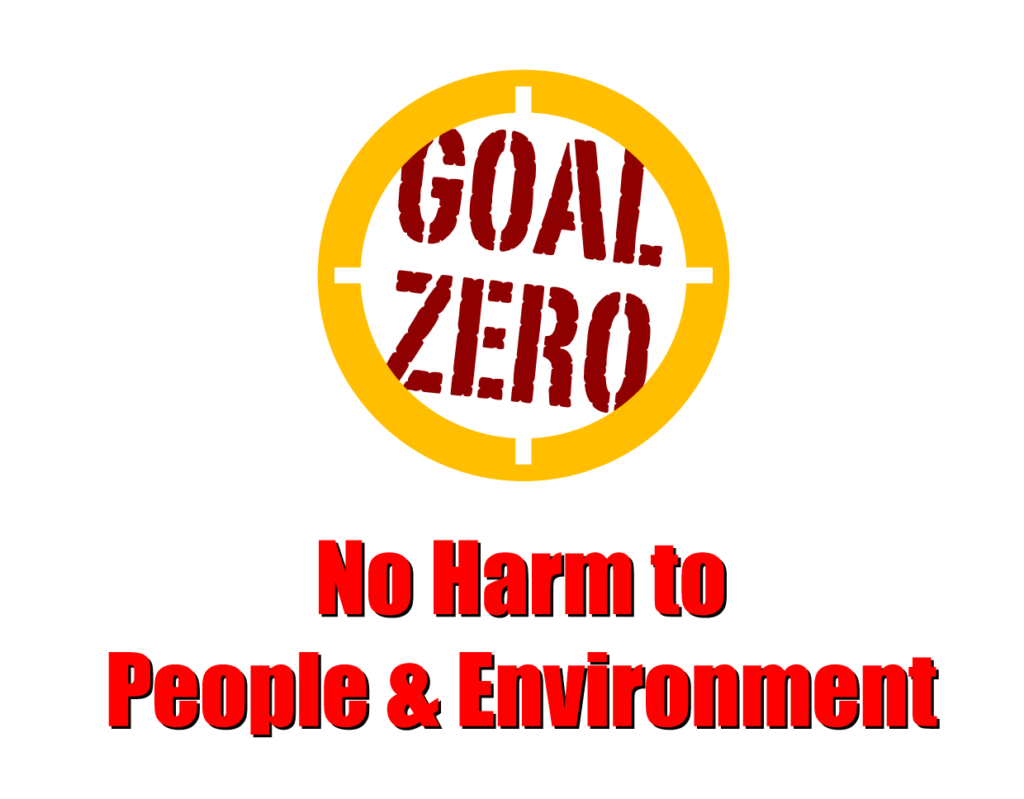
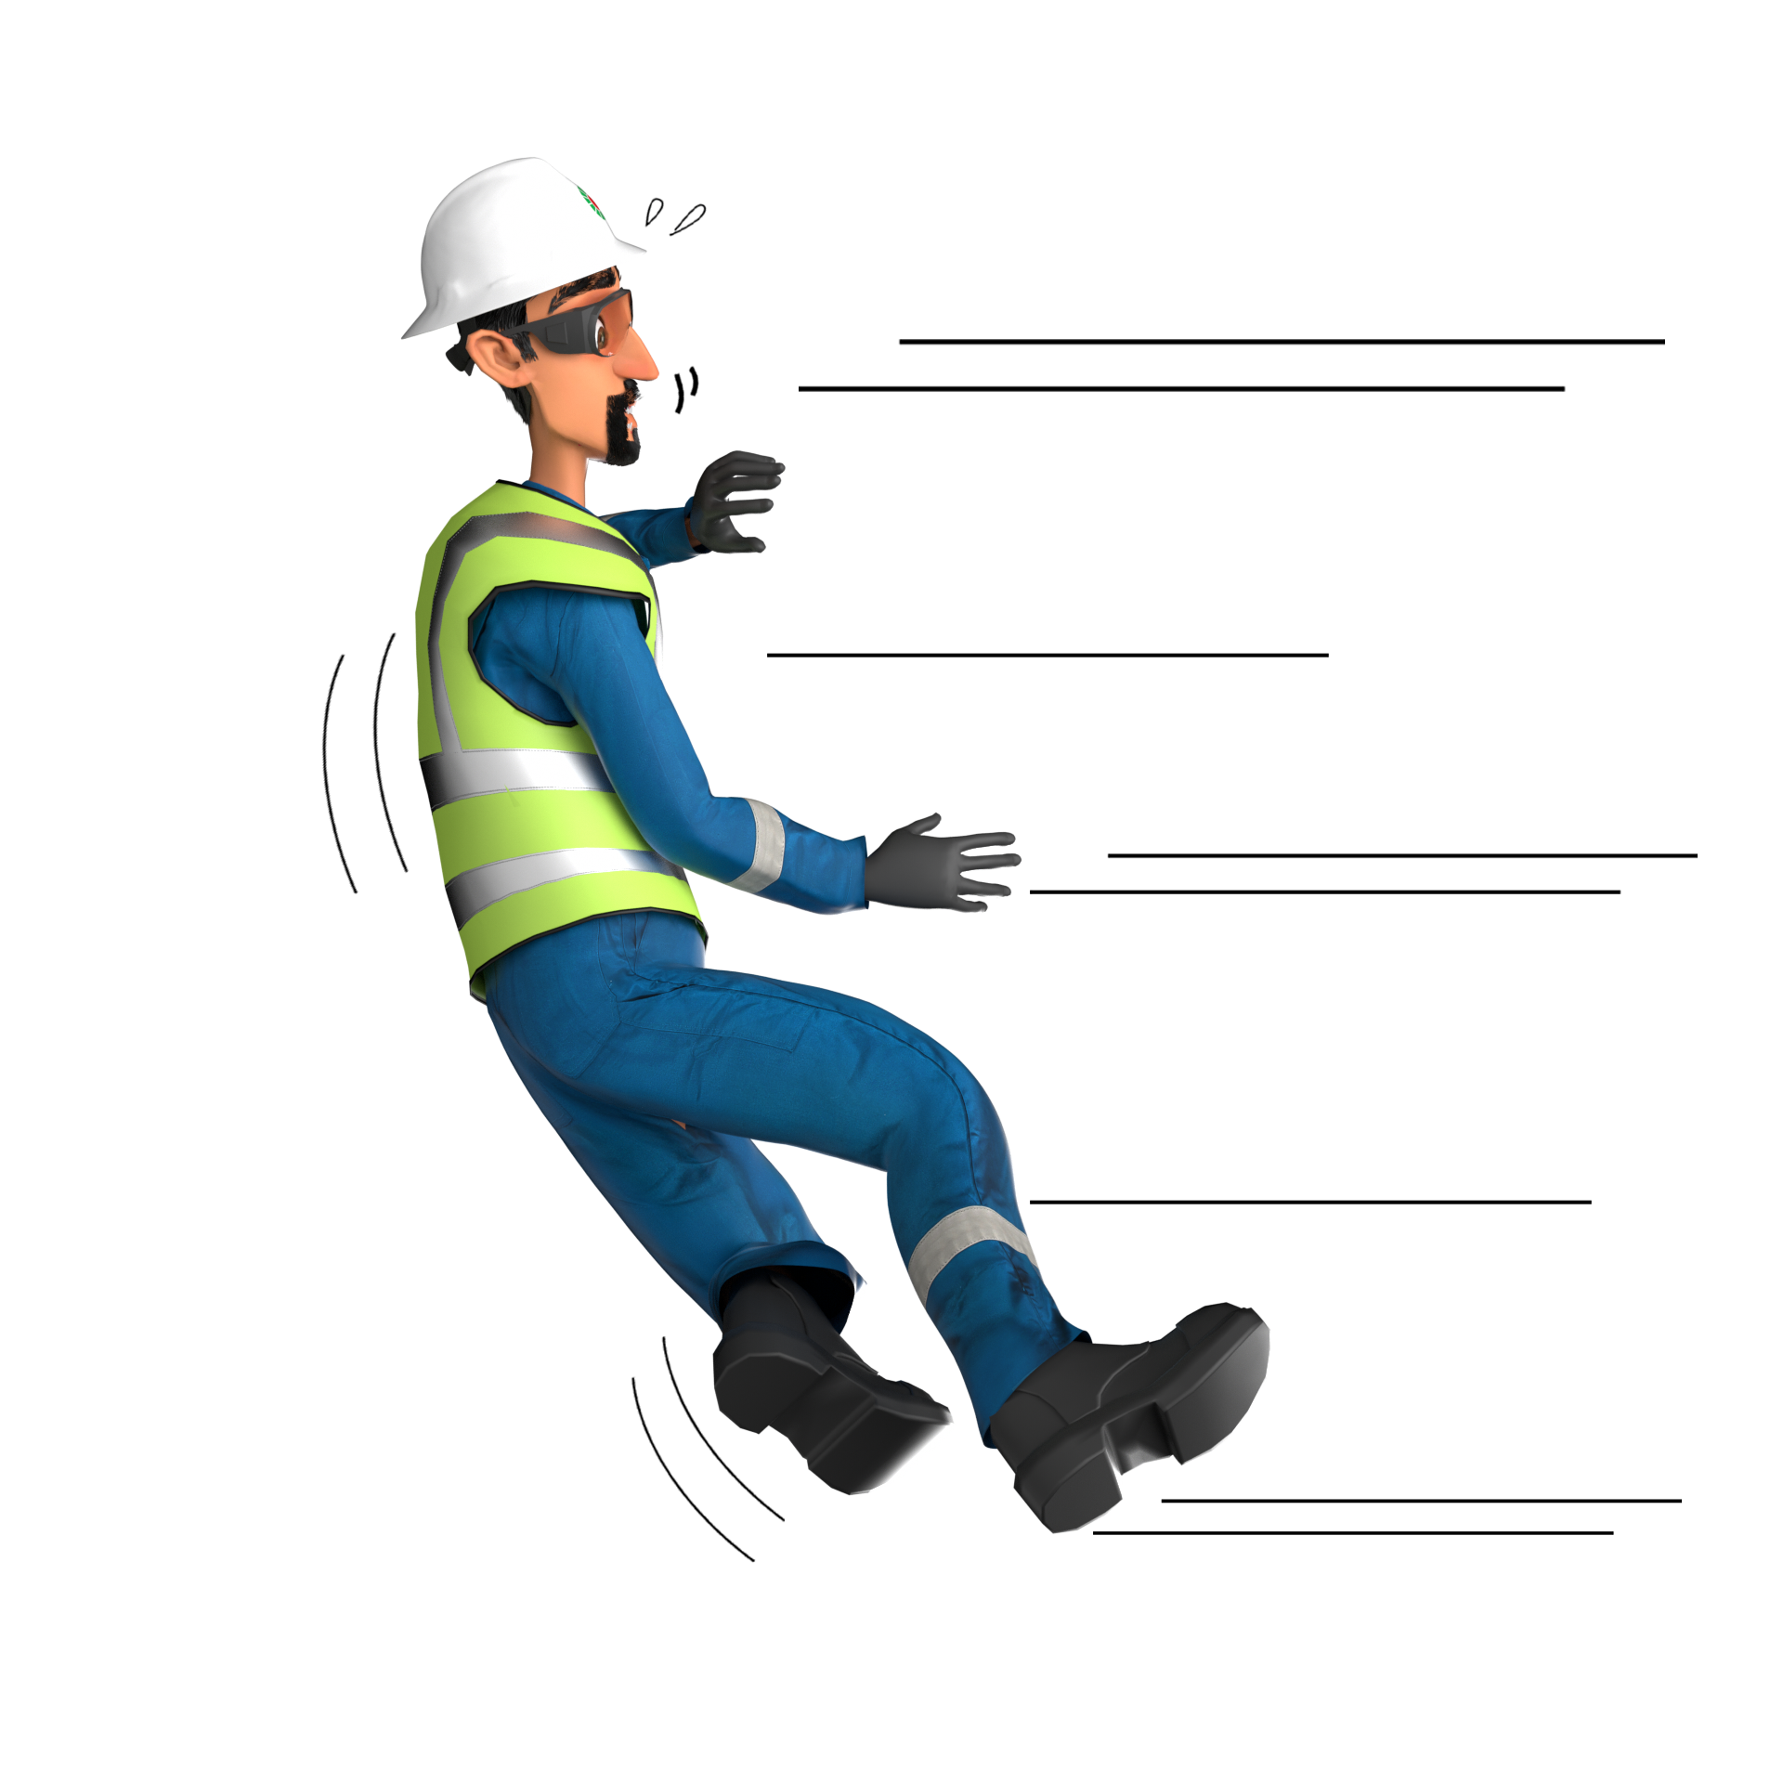
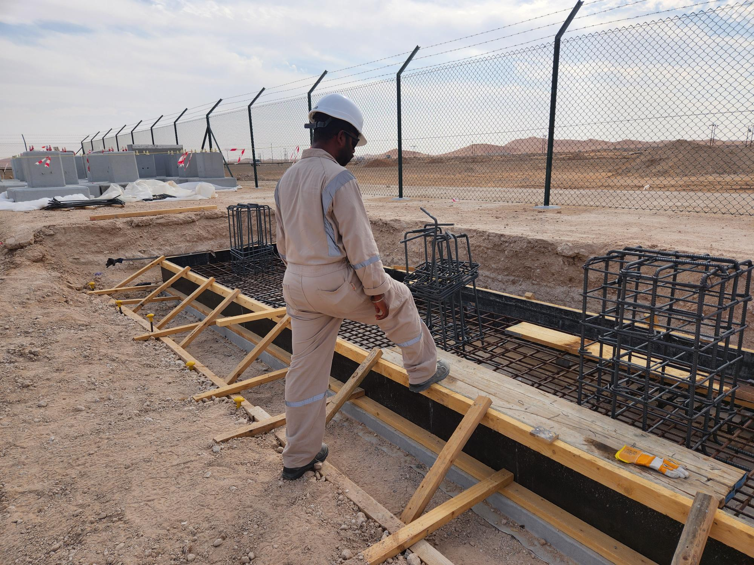
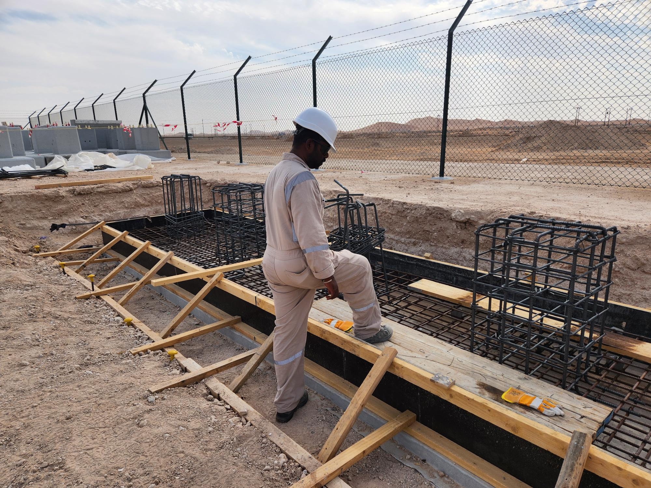
Learning From Incident - First Alert
Prevent
PIM # | 1151485 | Date | 14.03.2023 | Direct / Depart
Incident Type | LTI#02 | Time | 15:40 hrs | Location | Lekhwair
Pattern | Slip, Trip& Fall | Contractor |  | Activity | Steel Fixing
Target Audience: Permit Holders, permit Applicants, Mechanics, Supervisor ,Civil crew…
What happened:
While the Steel Fixer was stepping onto the shuttering runner, he lost his balance and fell down injuring his left wrist.
Initial Findings:
No safe access and egress provided.
Failed to identify the hazard related to slip, trip & fall
Initial Learnings:
How do you identify all hazards before starting a task ?
How do you ensure the provision of safe access and egress in you work site?
Do you ensure you use safe access and egress?
Do always pay attention to where you are stepping?
Do you ensure to intervene when observe unsafe act/Condition?
Always ensure to use safe egress and access
In case of an emergency please call PDO Emergency Number (Toll Free): 2467-5555
Notes:
Mr Musleh image on the top right will change according to incident pattern, MSE3 will provide you with the image as per the pattern
What happened: A short description should be provided without mentioning names of contractors or individuals. You should include, what happened, to who (by job title) and what injuries this resulted in. Nothing more!
Initial Finding: Four to five bullet points highlighting the initial main findings from the investigation. Remember the target audience is the front-line staff so this should be written in simple terms in a way that everyone can understand.
Learnings: Four to five learning message in the form of questionnaires linked with initial findings
The strap line should be the main learning point you want to get across
The images should be self explanatory, what went wrong (if you create a reconstruction please ensure you do not put people at risk) and below how it should be done.

