Slide 1
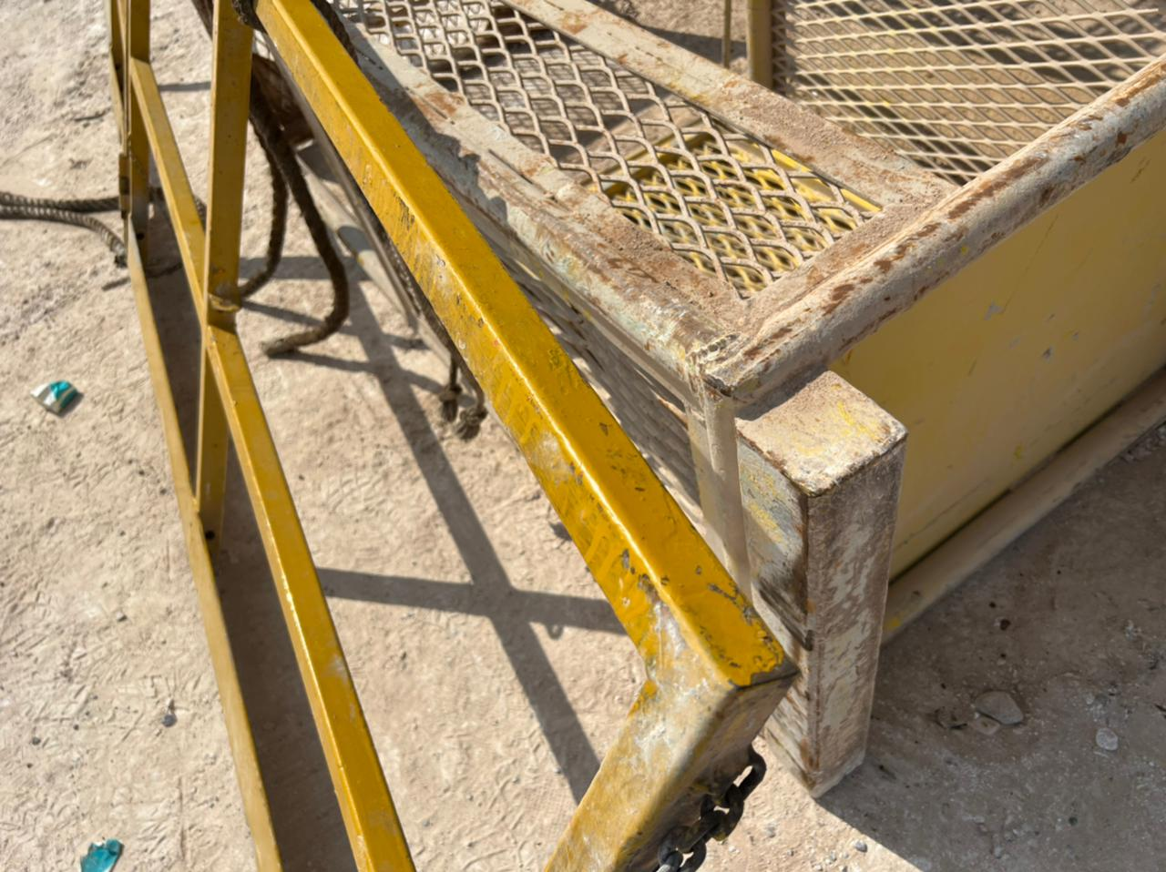
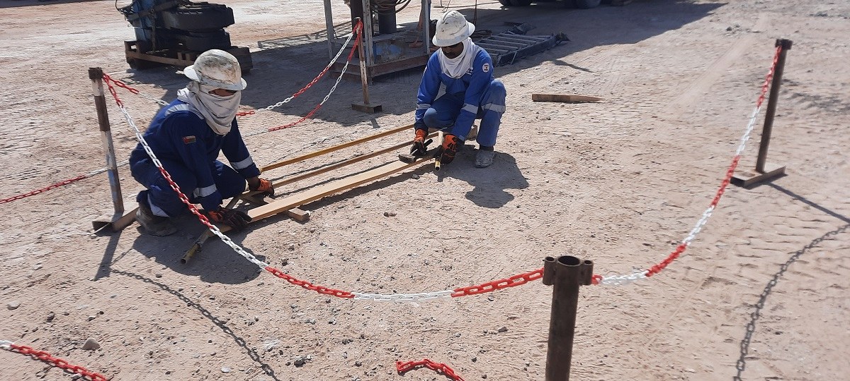
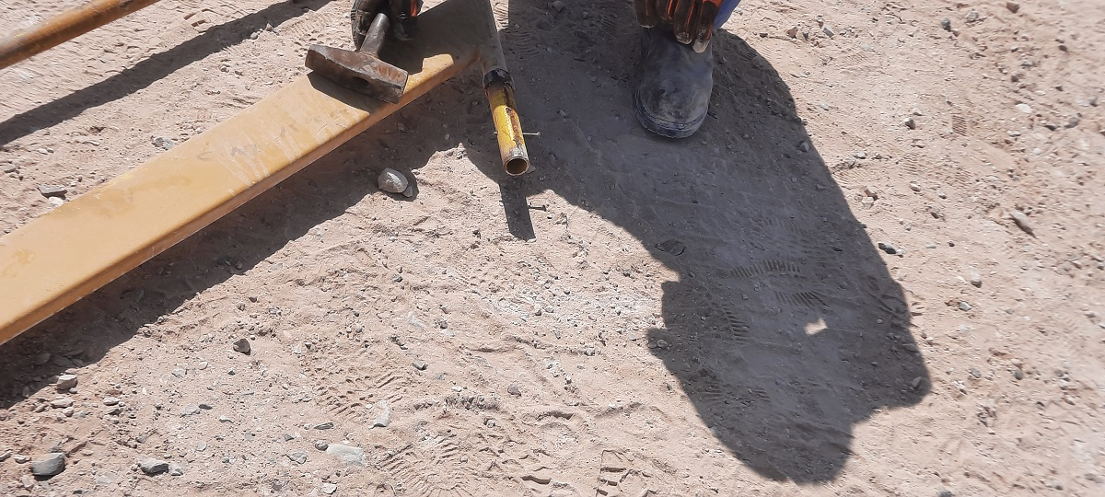
PDO Second Alert
Date:20/01/2022 Incident title: LTI#02 Pattern: Drops Potential severity: C3P
Target Audience: Drilling, Logistics, Operation & Construction
What happened?
At Approximately 9:40 am the Hoist 51;Welder was conducting minor repair activities to the handrail. The handrail was being
balanced on the ground by Welder outside Maintenance workshop, 1m meter away from the lifting basket. Whilst while welder was attempting to remove upper handrail pin using hammer, he lost balance causing him to fall forward with the Handrail towards lifting basket hitting his lower jaw. The fall caused damage and deformity of the teeth.
Why it happened/Finding :
No clear Procedure of the task
Violation of Manual Handling heaving heavy of Monkey Board Handrail’s in order to remove pin
Site supervisor’s Inadequate Coordination
Welder working alone
Welder’s poor judgement
Management and Supervisors’ Ineffective Monitoring and Supervision
Your learning from this incident..
Prepare the clear procedure of activities and follow-up
Always ensure to conduct Toolbox talks to the crew prior to start the work
Always ensure the task is done in a safe in designated place
Always inspect the workplace condition prior to start work and remove any obstruction
Ask your supervisor’s assistance if the work is not possible to do by one person-
Ensure do not lift heavy load (more than 25kg) alone
Ensure there is a Continual monitoring by competent person
Always laydown handrail to remove or repair pin
Do not lift heavy items alone. Perform work where weight is controlled
Notes:
Ensure all dates and titles are input
A short description should be provided without mentioning names of contractors or individuals. You should include, what happened, to who (by job title) and what injuries this resulted in. Nothing more!
Four to five bullet points highlighting the main findings from the investigation. Remember the target audience is the front line staff so this should be written in simple terms in a way that everyone can understand.
The strap line should be the main point you want to get across
The images should be self explanatory, what went wrong (if you create a reconstruction please ensure you do not put people at risk) and below how it should be done.

Slide 2
Management self audit
Date:20/01/2022 Incident title: LTI#02 Pattern: Drops Potential severity: C3P
As a learning from this incident and ensure continual improvement all contract managers must review their HSE risk management against the questions asked below
Confirm the following:
Do you ensure your crew are performing Risk assessment before the task?
Do you ensure that the right permit to work is obtained and correctly implemented at site?
Do you ensure proper TBT is conducted and all attending?
Do you ensure correct required manpower is placed to complete the job?
Do you ensure you removed all the obstruction in your workplace?
Do you ensure availability of correct equipment to handle the job?
Do you ensure continual monitoring process for activities?
* If the answer is NO to any of the above questions please ensure you take action to correct this finding
Notes:
Ensure all dates and titles are input
Make a list of closed questions (only ‘yes’ or ‘no’ as an answer) to ask others if they have the same issues based on the management or HSE-MS failings or shortfalls identified in the investigation.
Imagine you have to audit other companies to see if they could have the same issues.
These questions should start with: Do you ensure…………………?

