Slide 1
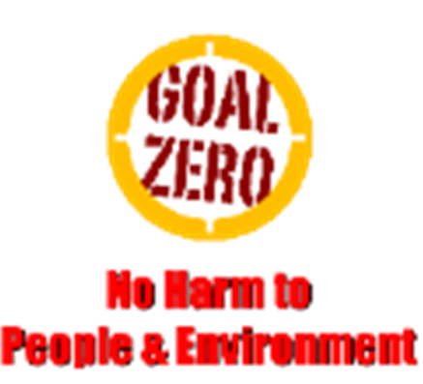
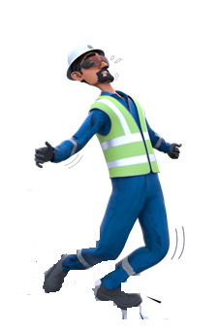
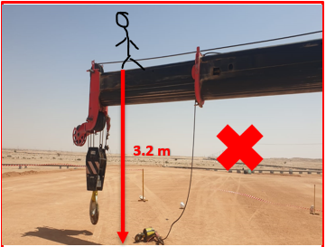
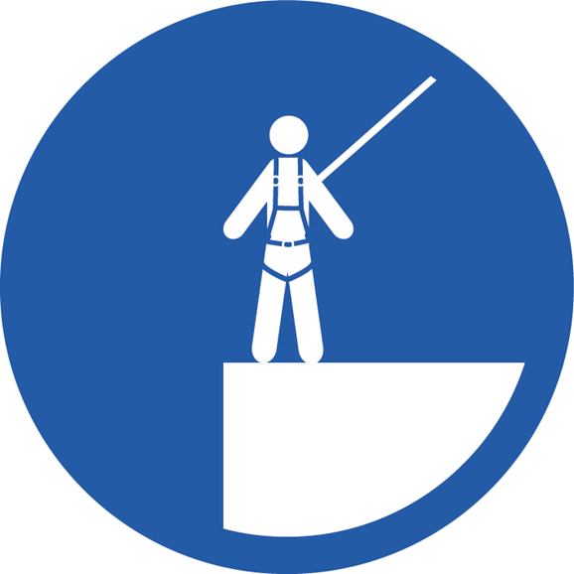
Learning From Incident - First Alert
Prevent
PIM # | 1175416 | Date & Time | 02.03.2025 / 12:45 | Location | Nimr
Incident Type | LTI#03 | Category | Fall from height | Activity | Crane Maintenance
Target Audience: All
What happened:
During the trouble shooting of Crane auxiliary hook, the crane Operator fell from crane boom at 3.2 metre height and suffered injuries on his right leg and wrist.
The Crane Operator was initially taken to NIMR PAC clinic before being transferred to Salalah hospital, where x-ray revealed compound fracture to his right leg and wrist.
Initial Findings:
The crane Operator was standing on top of crane boom unsecured to trouble shoot.
There was no proper plan to troubleshoot the crane at site.
The task is a non-routine task.
Engagement Questions:
Do you ensure limit switches are tested and functioned properly before any lifting operation?
Do you ensure crane inspection and recovery procedure is available and understood by all parties?
Do you ensure to perform dynamic risk review whenever work changes?
Always ensure that crane maintenance is carried out by competent crane maintenance specialist with proper tools
In case of an emergency please call PDO Emergency Number (Toll Free): 2467-5555
Notes:
Mr Musleh image on the top right will change according to incident pattern, MSE3 will provide you with the image as per the pattern
What happened: A short description should be provided without mentioning names of contractors or individuals. You should include, what happened, to who (by job title) and what injuries this resulted in. Nothing more!
Initial Finding: Four to five bullet points highlighting the initial main findings from the investigation. Remember the target audience is the front-line staff so this should be written in simple terms in a way that everyone can understand.
Learnings: Four to five learning message in the form of questionnaires linked with initial findings
The strap line should be the main learning point you want to get across
The images should be self explanatory, what went wrong (if you create a reconstruction please ensure you do not put people at risk) and below how it should be done.

