Slide 1
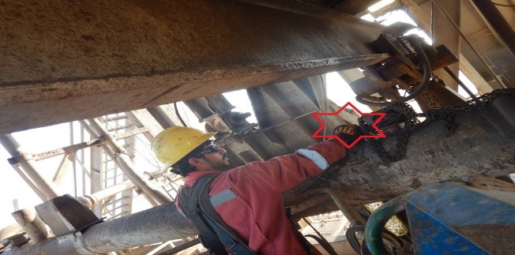
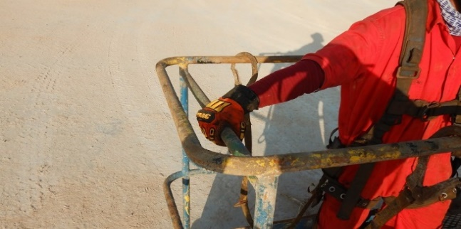
PDO Second Alert
Date: 11/01/2022 Incident title: LTI#03 Pattern: Hands & Finger Potential severity: C3P
Target Audience: Drilling, Logistics, Operation & Construction
What happened?
On 11th January at 00:00 hrs crew were working on N/up BOP. Afterwards, the crew started to connect the flow line extension to bell nipple using rig floor winch and MEWP to align the flow line. Floorman (1) placed his hand on flow line to have a better and clear view while aligning the flow line extension. Meanwhile without prior notice or given instructions, floorman (2) (the winch operator) started winching up the flow line, the floorman (1) hand was caught in between flow line and BOP winch beam, resulting in crush injury to the floorman (1) right hand thumb.
Held TOFS, floorman (1) was sent to rig medic for evaluation and referred to hospital for further medical evaluation as per ARA doctor advice.
Why it happened/Finding :
COW under a PTW were in place, along with using hand-held radios.
No proper tools or engineering design enabling safe and effective handling of the flow line manually without causing hand injuries.
Poor situational awareness - Floorman placed his hand in line of fire on flow line while overseeing the flow line alignment.
Task was taking place at midnight. Sufficient lighting was available at the subbase and surrounding areas.
Your learning from this incident..
Supervisors must ensure a quality TBT which should cover job-specific hazards and dynamic risk (Keep away your hands/ fingers from any equipment with potential to cause injury).
Ensure risk assessment is done specific to task and communicated to all crew members.
Empower all crew members to STOP any unsafe act / condition if observed.
Always ensure your hands and fingers are clear of pinch point, by using proper handling tools.
STOP the task if there is lack of supervision or monitoring.
Always maintain all hands inside the MEWP basket inner handrails.
Ensure adequate level of supervision is assigned to each task.
Always keep your hands and fingers away from the Line of Fire
Notes:
Ensure all dates and titles are input
A short description should be provided without mentioning names of contractors or individuals. You should include, what happened, to who (by job title) and what injuries this resulted in. Nothing more!
Four to five bullet points highlighting the main findings from the investigation. Remember the target audience is the front line staff so this should be written in simple terms in a way that everyone can understand.
The strap line should be the main point you want to get across
The images should be self explanatory, what went wrong (if you create a reconstruction please ensure you do not put people at risk) and below how it should be done.

Slide 2
Management self audit
Date: 11/01/2022 Incident title: LTI#03 Pattern: Hands & Finger Potential severity: C3P
As a learning from this incident and ensure continual improvement all contract managers must review their HSE risk management against the questions asked below
Confirm the following:
Do you ensure that rig structure is properly designed to allow for safe and efficient operation?
Do you ensure that each task is assigned a proper level of supervision?
Do you ensure that your crewmembers are empowered to stop any unsafe act/condition?
Do you ensure that hazard identification of LOF is discussed in each TBT?
* If the answer is NO to any of the above questions please ensure you take action to correct this finding
Notes:
Ensure all dates and titles are input
Make a list of closed questions (only ‘yes’ or ‘no’ as an answer) to ask others if they have the same issues based on the management or HSE-MS failings or shortfalls identified in the investigation.
Imagine you have to audit other companies to see if they could have the same issues.
These questions should start with: Do you ensure…………………?

