Slide 1
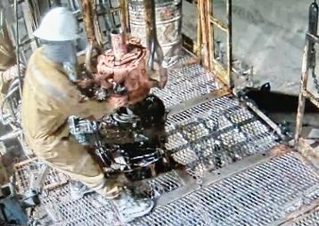
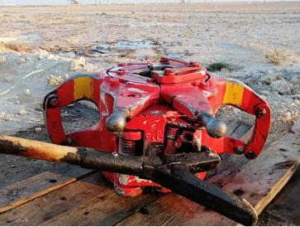
PDO Second Alert
Date: 14.01.2021 Incident Type: LTI#03 (Hands & Fingers)
What happened?
RIH with 3 ½” completion tubing was in progress. The Floorman approached the string to unlatch the elevator. He grabbed the left handle of the elevator with his left hand and opened it with his right hand. Once the elevator doors were opened the Floorman pinched his left middle finger in between the elevator handle and the power tong cylinder which had been rigged up on the rig floor for RIH.
Your learning from this incident..
Always know the control and mitigation measures for the risks identified
Always intervene and stop unsafe work practices
Always execute checks on controls in place while running longer lasting tasks
Always wear adequate hand protection
Always stop and ask questions if controls are not clear
Never proceed with a task if risks and control measures have not been defined
Always use hands off tools to avoid pinch injuries
Notes:
Ensure all dates and titles are input
A short description should be provided without mentioning names of contractors or individuals. You should include, what happened, to who (by job title) and what injuries this resulted in. Nothing more!
Four to five bullet points highlighting the main findings from the investigation. Remember the target audience is the front line staff so this should be written in simple terms in a way that everyone can understand.
The strap line should be the main point you want to get across
The images should be self explanatory, what went wrong (if you create a reconstruction please ensure you do not put people at risk) and below how it should be done.

Slide 2
Management self audit
Date: 14.01.2021 Incident type: LTI#3
As a learning from this incident and ensure continual improvement all contract
managers must review their HSE HEMP against the questions asked below
Confirm the following:
Do you ensure that SOP’s within your organization outline controls for the identified risks?
Do you ensure that learning from incidents are translated into appropriate actions and are verified by top management?
Do you ensure that there is pinch point awareness among field personnel?
Do you ensure that Management reviews the Pinch Point Awareness on site?
Do you ensure that learnings from CCTV footage review are captured and translated into actions?
Do you ensure that you have a verification process to assure the efficiency of corrective actions?
Do you ensure that the Hands off tools are appropriate for use (e.g. congested Rig Floor)?
* If the answer is NO to any of the above questions please ensure you take action to correct this finding.
Notes:
Ensure all dates and titles are input
Make a list of closed questions (only ‘yes’ or ‘no’ as an answer) to ask others if they have the same issues based on the management or HSE-MS failings or shortfalls identified in the investigation.
Imagine you have to audit other companies to see if they could have the same issues.
These questions should start with: Do you ensure…………………?

