Slide 1
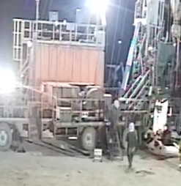
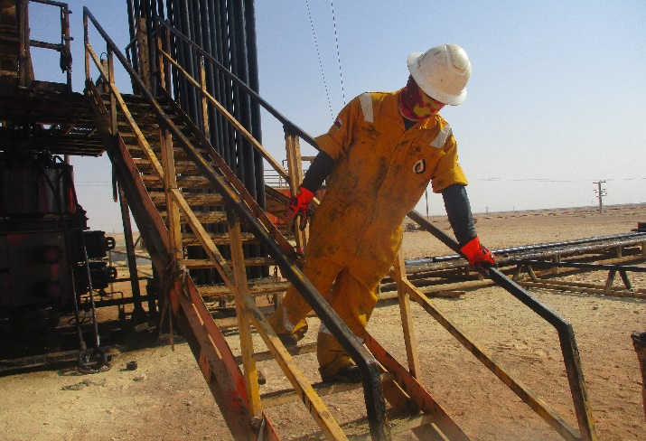
Learning From Incident - First Alert
Prevent
PIM # | 1153895 | Date | 09.05.2023 | Direct / Depart
Incident Type | LTI#03 | Time | 01:30 hrs | Location | WPH-40, Amal
Pattern | Slip & fall | Contractor |  | Activity | Descending from Hoist carrier stairs
Target Audience: All
What happened
While the Derrickman was descending from the hoist carrier staircase in a hurried manner, he twisted his foot and landed heavily on the ground resulting in a fractured at his right foot.
Initial Findings
Derrickman descending the stairs in a hurried manner.
Derrickman missed the last steps while descending.
Derrickman descended the stairs without paying attention to where he was stepping.
Learnings
How do you identify Slip, Trips and fall hazards around your working location?
Why is it important to pay attention where you are stepping?
How do you ensure safe descending/ascending while using the stairs?
Avoid rushing while using stairs
In case of an emergency please call PDO Emergency Number (Toll Free): 2467-5555
Notes:
Mr Musleh image on the top right will change according to incident pattern, MSE3 will provide you with the image as per the pattern
What happened: A short description should be provided without mentioning names of contractors or individuals. You should include, what happened, to who (by job title) and what injuries this resulted in. Nothing more!
Initial Finding: Four to five bullet points highlighting the initial main findings from the investigation. Remember the target audience is the front-line staff so this should be written in simple terms in a way that everyone can understand.
Learnings: Four to five learning message in the form of questionnaires linked with initial findings
The strap line should be the main learning point you want to get across
The images should be self explanatory, what went wrong (if you create a reconstruction please ensure you do not put people at risk) and below how it should be done.

