Slide 1
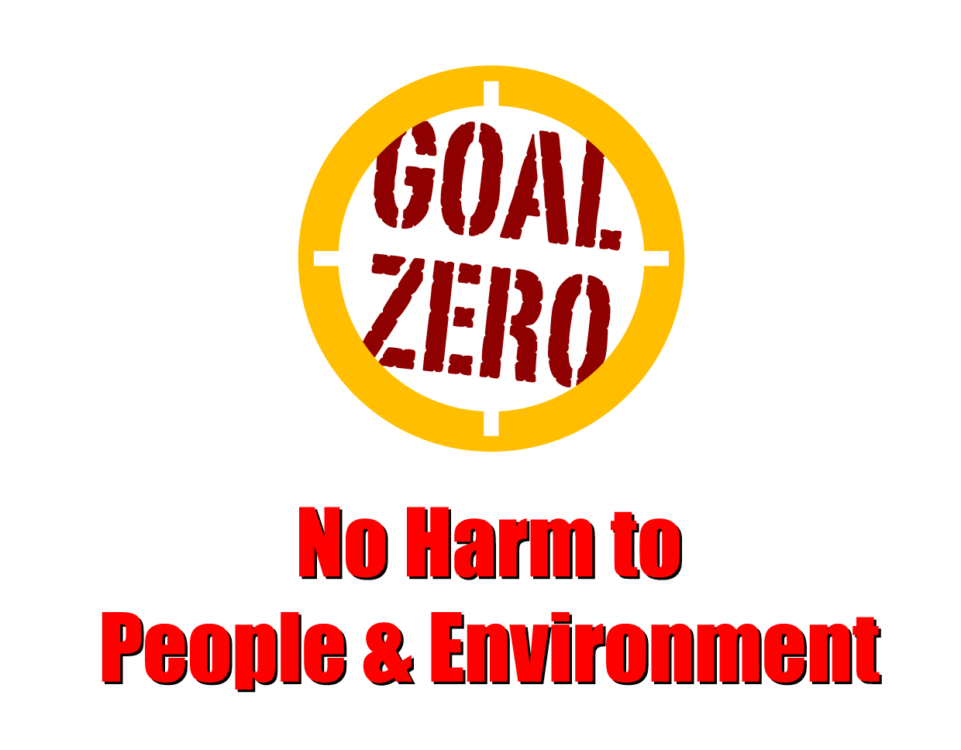
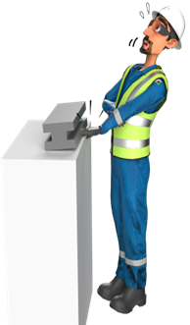
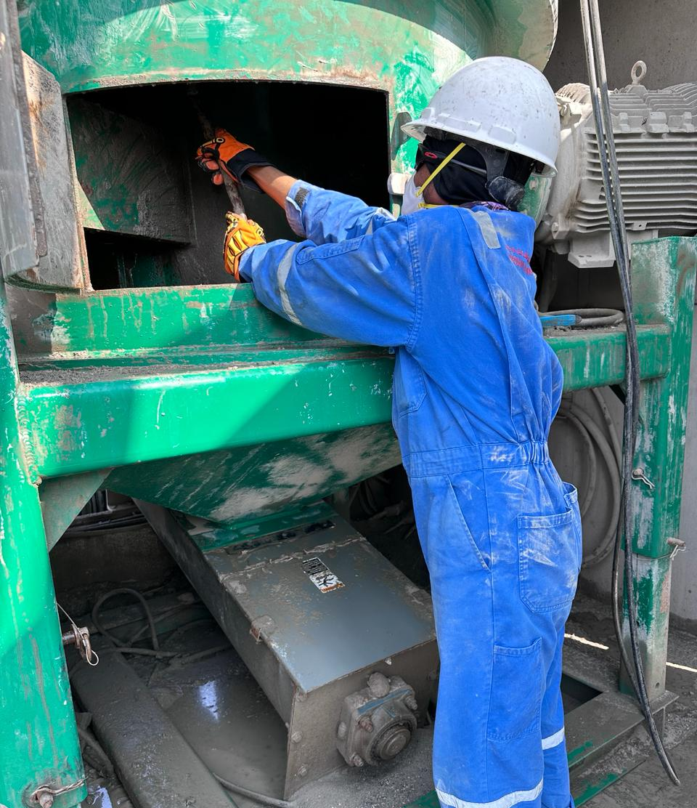
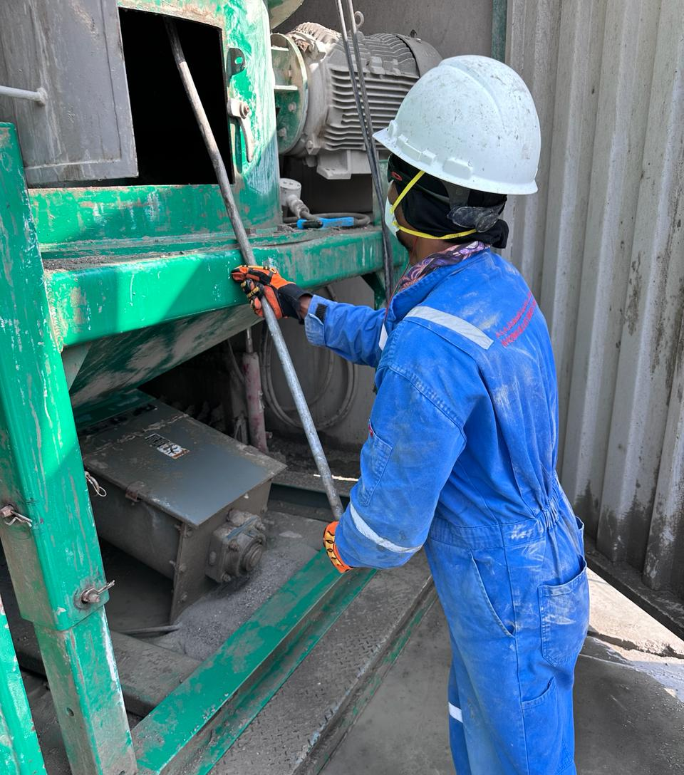
Learning From Incident - First Alert
Prevent
PIM # | 1162345 | Date | 06.01.2024 | Direct / Dept.
Incident Type | LTI#04 | Time | 09:00 AM | Location | Fahud
Category | Falling Object | Contractor |  | Activity | Cleaning OBM Treatment Plant
Target Audience: All
What happened
On 06.01.2024 at approximately 09:00 Hrs, While cleaning the Oil Based Mud (OBM) treatment plant, some dry OBM cutting dropped from the topside of Vertical Cuttings Dryer (VCD) onto the Helper’s right-hand consequently hitting his hand to the bottom hatch of the VCD unit resulted in an injury to his right-hand.
He was taken to Badar Al Sama Hospital in Muscat where the X-rays revealed a fractured to his right forearm.
Initial Findings
The hazard and risk of falling objects (dry OBM) were not identified and accessed.
Standard Operating Procedure available but not followed.
Lack of Supervision.
The event was not reported.
Engagement Questions:
How do you ensure all hazards are identified before starting and during the task?
How do you ensure crew are adhered to Safe Operating Procedure (SOP) while performing the task?
How do you ensure the work is effectively supervised?
Always expect the unexpected hazards while doing the task!
In case of an emergency please call PDO Emergency Number (Toll Free): 2467-5555
Notes:
Mr Musleh image on the top right will change according to incident pattern, MSE3 will provide you with the image as per the pattern
What happened: A short description should be provided without mentioning names of contractors or individuals. You should include, what happened, to who (by job title) and what injuries this resulted in. Nothing more!
Initial Finding: Four to five bullet points highlighting the initial main findings from the investigation. Remember the target audience is the front-line staff so this should be written in simple terms in a way that everyone can understand.
Learnings: Four to five learning message in the form of questionnaires linked with initial findings
The strap line should be the main learning point you want to get across
The images should be self explanatory, what went wrong (if you create a reconstruction please ensure you do not put people at risk) and below how it should be done.

